Slide 1
Optimization Techniques for Geometry Processing
Justin Solomon Princeton University
David Bommes RWTH Aachen University

Slide 2
This Morning’s Focus
Optimization.
Synonym(-ish): Variational methods.

Slide 3
This Morning’s Focus
Optimization.
Synonym(-ish): Variational methods.
Caveat: Slightly different connotation in ML

Slide 4
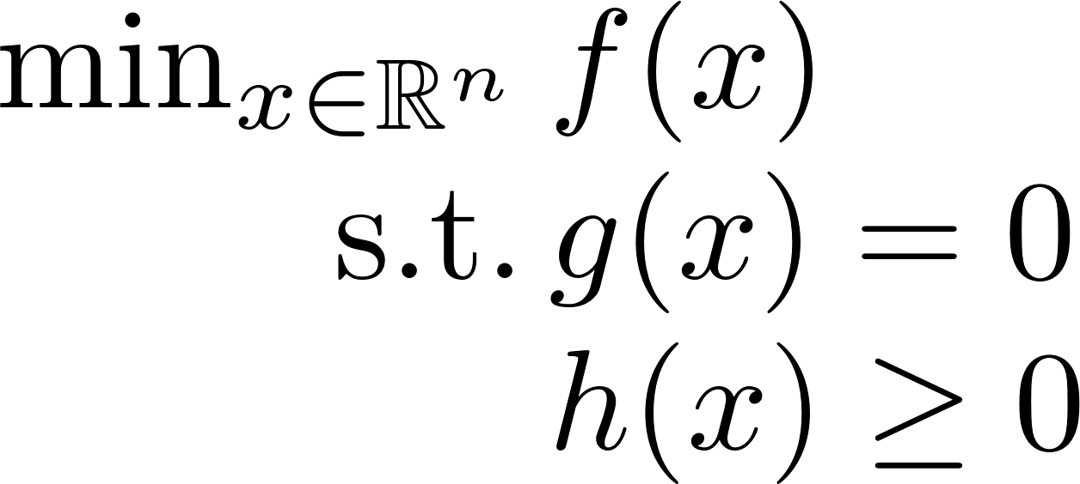
More Specifically

Slide 5
Two Roles
Client Which optimization tool is relevant?
Designer Can I design an algorithm for this problem?

Slide 6
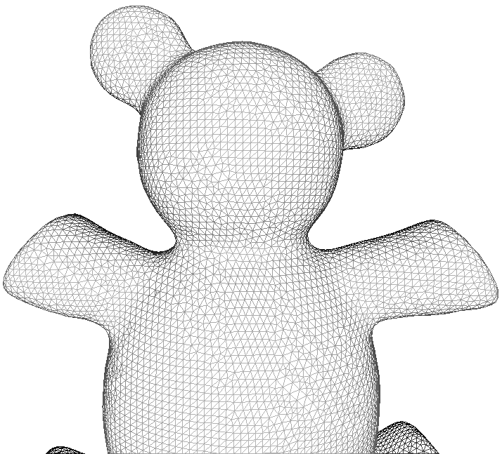
Our Bias
Patterns, algorithms, & examples common in geometry processing.
Optimization is a huge field.

Slide 7
Rough Plan
Part I (Justin)
Vocabulary
Simple examples
Unconstrained optimization
Equality-constrained optimization

Slide 8
Rough Plan
Part II (David)
Inequality constraints
Advanced algorithms
Discrete problems
Conclusion

Slide 9
Rough Plan
Part I (Justin)
Vocabulary
Simple examples
Unconstrained optimization
Equality-constrained optimization
(basic material!)

Slide 10
Optimization Terminology
Objective (“Energy Function”)

Slide 11
Optimization Terminology
Equality Constraints

Slide 12
Optimization Terminology
Inequality Constraints

Slide 13
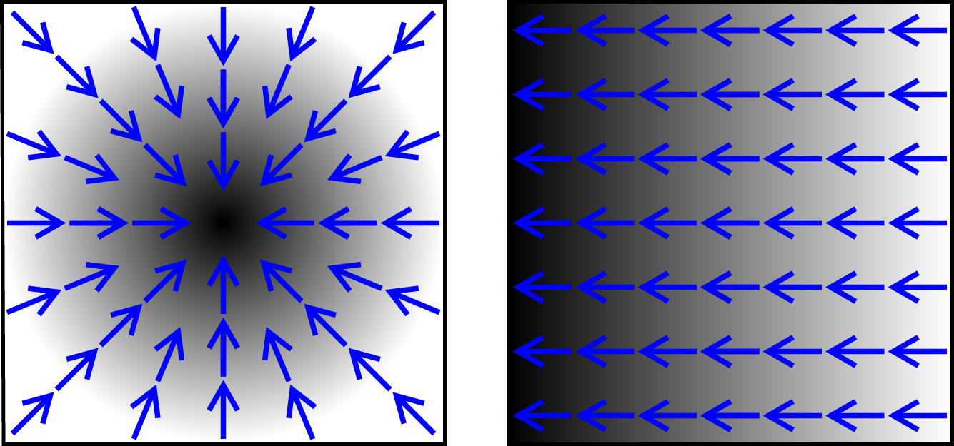
Optimization Terminology
https://en.wikipedia.org/?title=Gradient
Gradient

Slide 14
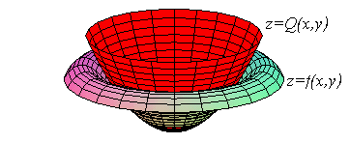
Optimization Terminology
http://math.etsu.edu/multicalc/prealpha/Chap2/Chap2-5/10-3a-t3.gif
Hessian

Slide 15
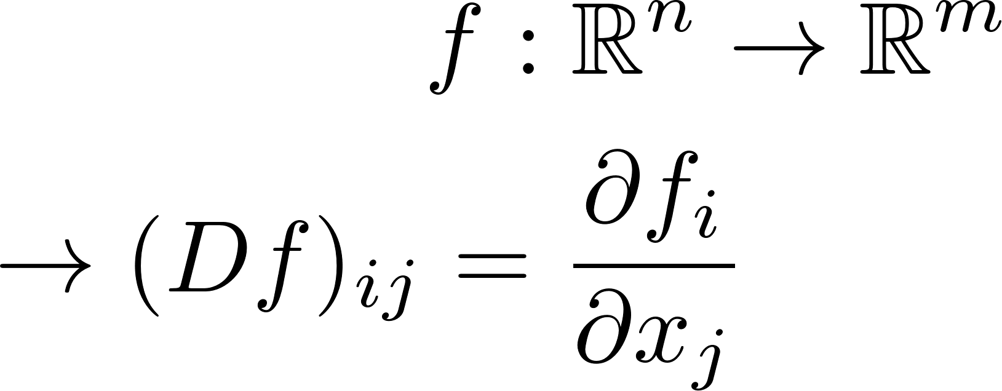
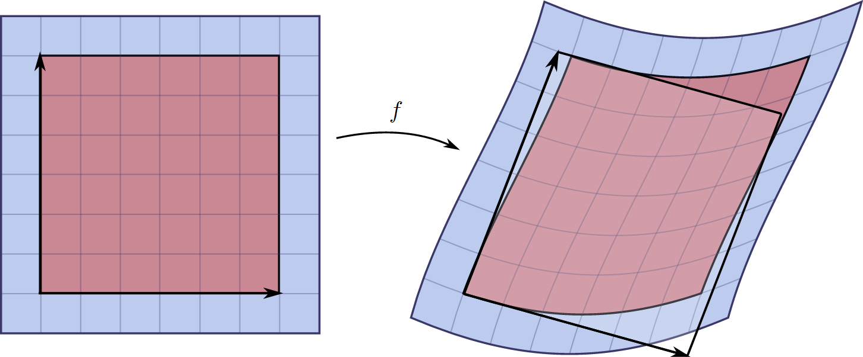
Optimization Terminology
https://en.wikipedia.org/wiki/Jacobian_matrix_and_determinant
Jacobian

Slide 16
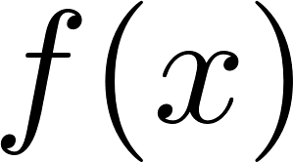
Optimization Terminology
(unconstrained)
Saddle point
Local max
Local min
Critical point

Slide 17
Common Mistake
Critical points
may not be minima.

Slide 18
Neither Sufficient nor Necessary

Slide 19
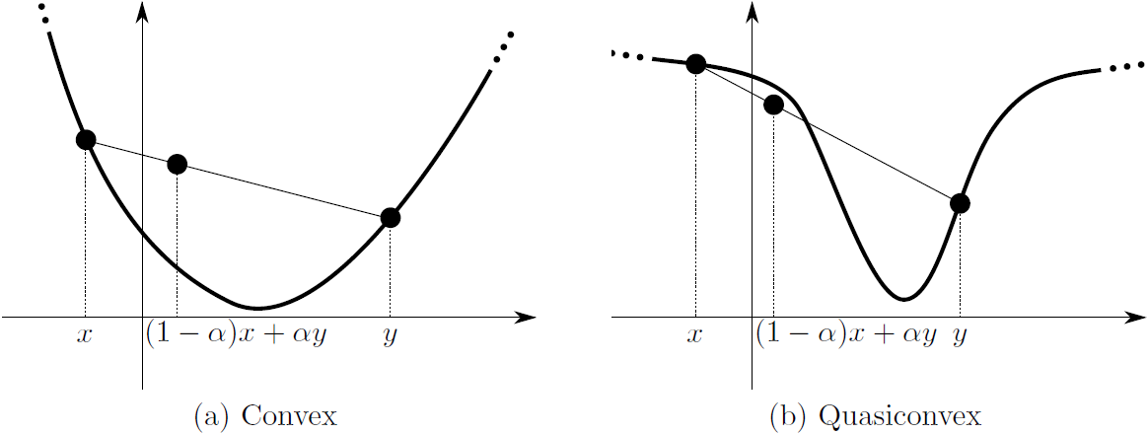
Except…
More later
Numerical Algorithms, Solomon

Slide 20
Rough Plan
Part I (Justin)
Vocabulary
Simple examples
Unconstrained optimization
Equality-constrained optimization

Slide 21
Encapsulates Many Problems

Slide 22
How effective are generic
optimization tools?

Slide 23
Generic Advice
Try the
simplest solver first.

Slide 24
Quadratic with Linear Equality
(assume A is symmetric and positive definite)

Slide 25
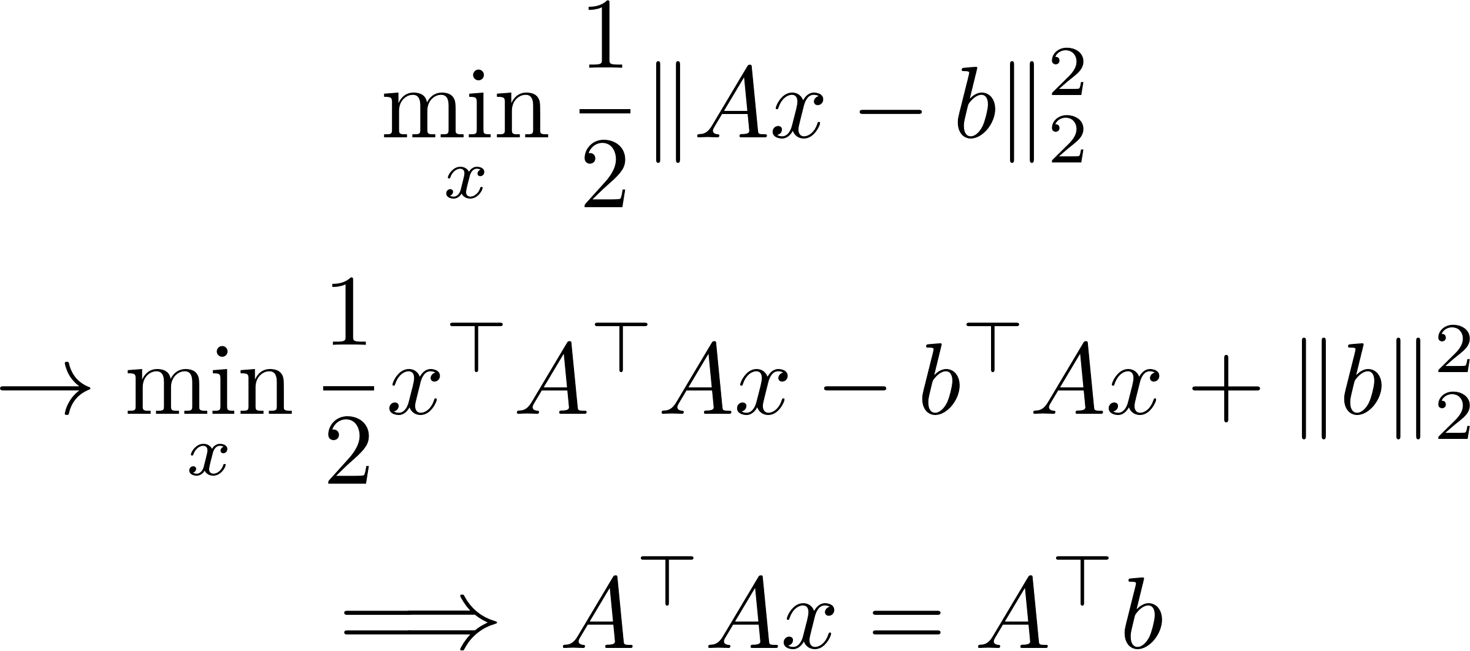
Special Case: Least-Squares
Normal equations
(better solvers for this case!)

Slide 26
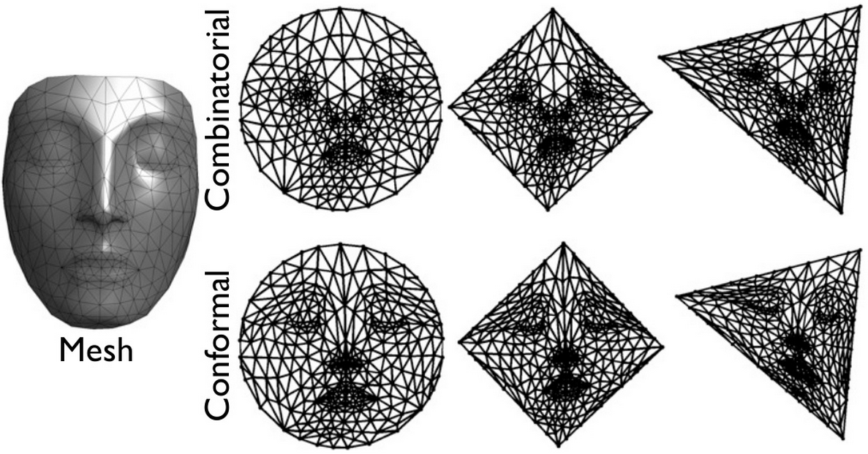
Example: Mesh Embedding
G. Peyré, mesh processing course slides

Slide 27
Linear Solve for Embedding
$w_{ij}≡1$: Tutte embedding
$w_{ij}$ from mesh: Harmonic embedding
Assumption: $w$ symmetric.

Slide 28
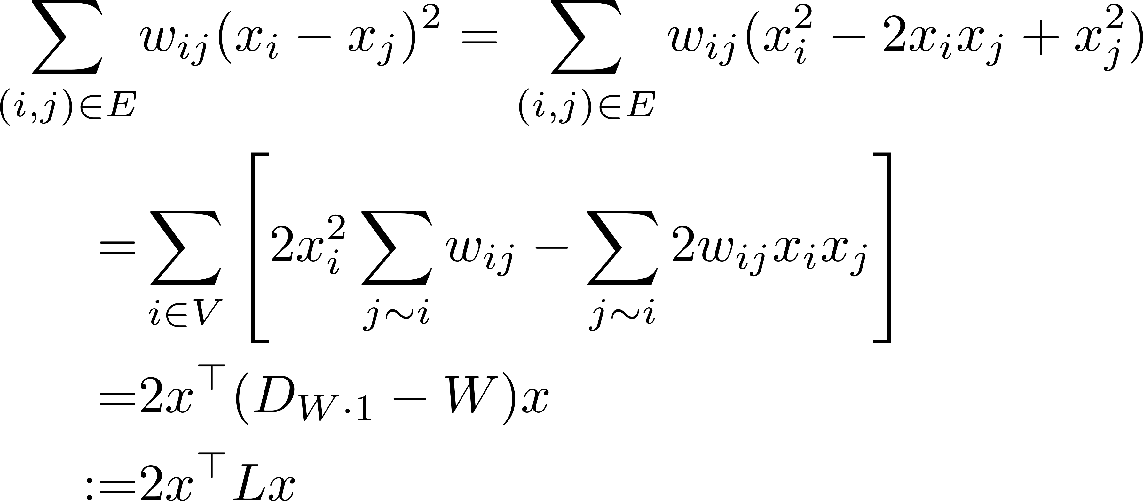
More Explicit Form
Laplacian matrix!

Slide 29
Differential Geometry Perspective
K. Crane, brickisland.net
Leads to famous cotangent weights!
Useful for interpolation.

Slide 30
Linear Solver Considerations
Never construct $A^{−1}$ explicitly (if you can avoid it)
Added structure helps Sparsity, symmetry, positive definite

Slide 31
Two Classes of Solvers
Direct (explicit matrix)
Dense: Gaussian elimination/LU, QR for least-squares
Sparse: Reordering (SuiteSparse, Eigen)
Iterative (apply matrix repeatedly)
Positive definite: Conjugate gradients
Symmetric: MINRES, GMRES
Generic: LSQR

Slide 32
Very Common: Sparsity
Induced by the connectivity of the triangle mesh.
Iteration of CG has local effect
$⇒$ Precondition!

Slide 33
Returning to Parameterization
What if
$V_{0}=\{\}$?

Slide 34
Nontriviality Constraint
Prevents trivial solution $x≡0$.
Extract the smallest eigenvalue.

Slide 35
Common Situation
Prevents trivial solution $x≡0$.
N contains basis for null space of A.
Extract the smallest nonzero eigenvalue.

Slide 36
Back to Parameterization
Mullen et al. “Spectral Conformal Parameterization.” SGP 2008.

Slide 37
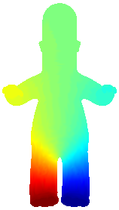
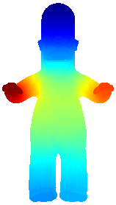
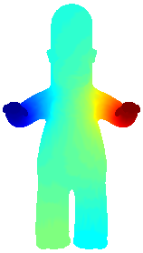
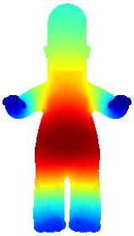
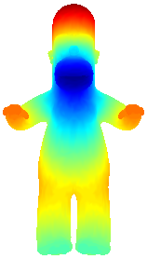
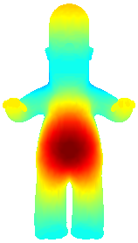
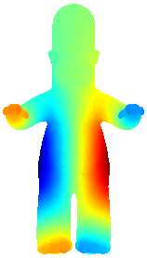
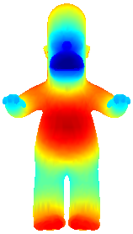
Continuous Story
2
3
4
5
6
7
8
9
10
“Laplace-Beltrami Eigenfunctions”

Slide 38
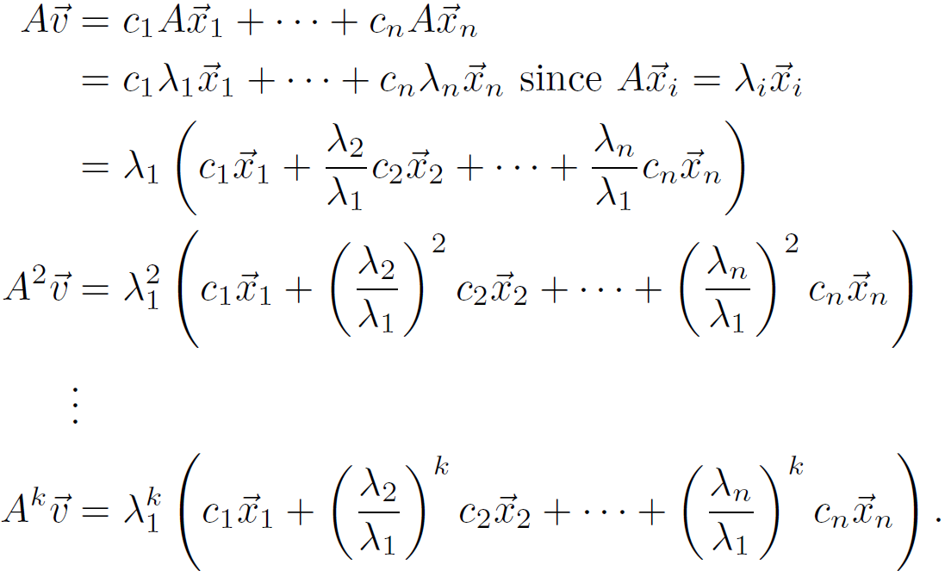
Basic Idea of Eigenalgorithms

Slide 39
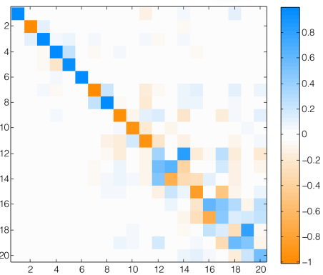
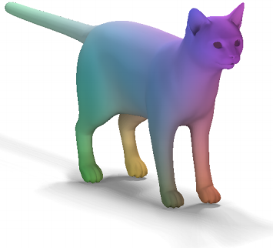
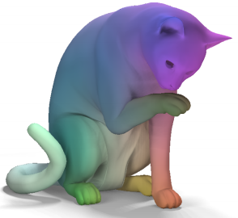
Combining Tools So Far
Roughly:
Extract Laplace-Beltrami eigenfunctions:
Find mapping matrix (linear solve!):
Ovsjanikov et al. “Functional Maps.” SIGGRAPH 2012.

Slide 40
Rough Plan
Part I (Justin)
Vocabulary
Simple examples
Unconstrained optimization
Equality-constrained optimization

Slide 41
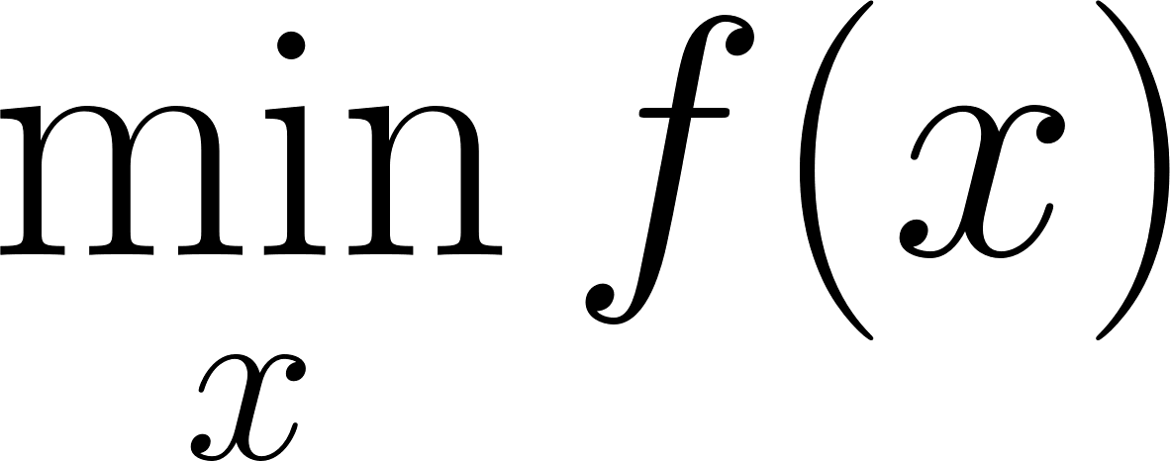
Unconstrained Optimization

Slide 42
Unconstrained Optimization
Unstructured.

Slide 43
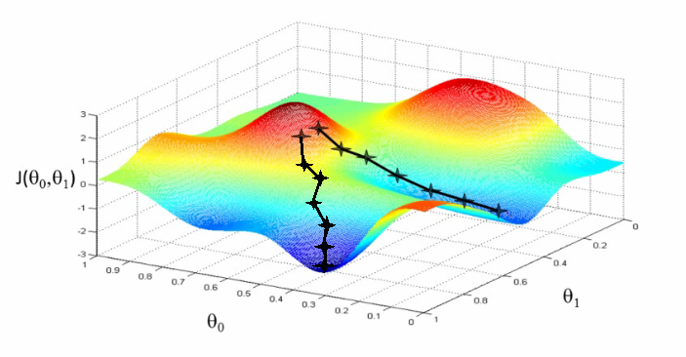
Basic Algorithms
Gradient descent

Slide 44
Basic Algorithms
Line search
Gradient descent

Slide 45
Basic Algorithms
Multiple optima!
Gradient descent

Slide 46
Basic Algorithms
Quadratic convergence on convex problems!
(Nesterov 1983)
Accelerated gradient descent

Slide 47
Basic Algorithms
1
2
Line search for stability
3
Newton’s Method

Slide 48
Basic Algorithms
Hessian approximation
(Often sparse) approximation from previous samples and gradients
Inverse in closed form!
Quasi-Newton: BFGS and friends

Slide 49
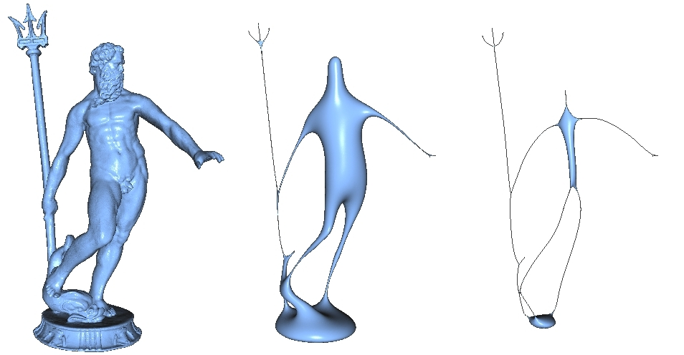
Geometric Flows
M. Kazhdan
Often continuous gradient descent

Slide 50
Example: Shape Interpolation
Fröhlich and Botsch. “Example-Driven Deformations Based on Discrete Shells.” CGF 2011.

Slide 51
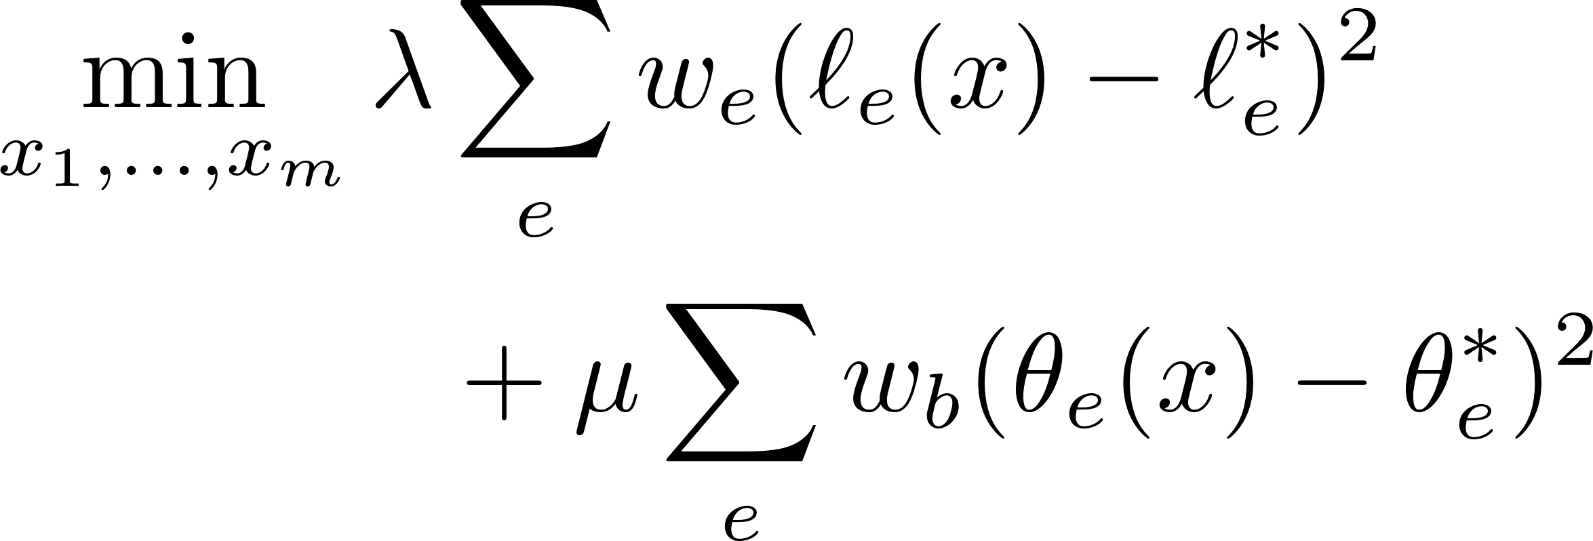
Interpolation Pipeline
Roughly:
Linearly interpolate edge lengths and dihedral angles.
Nonlinear optimization for vertex positions.
Sum of squares: Gauss-Newton

Slide 52
Software
Matlab: fminunc or minfunc
C++: libLBFGS, dlib, others
Typically provide functions for function and gradient (and optionally, Hessian).
Try several!

Slide 53
Rough Plan
Part I (Justin)
Vocabulary
Simple examples
Unconstrained optimization
Equality-constrained optimization

Slide 54
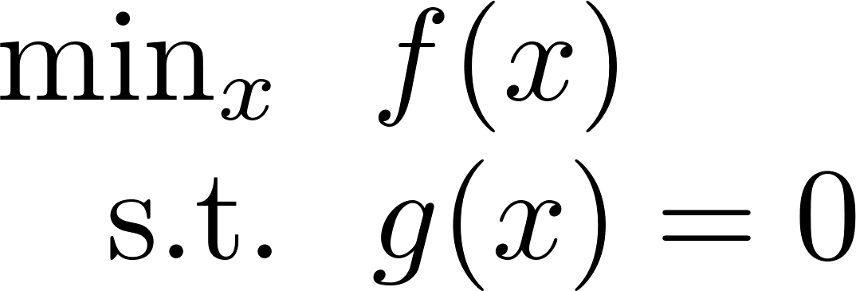
Lagrange Multipliers: Idea

Slide 55
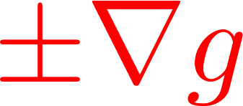
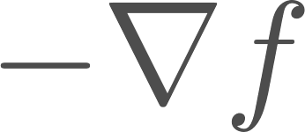
Lagrange Multipliers: Idea
- Decrease f: $−∇f$
- Violate constraint: $±∇g$

Slide 56
Lagrange Multipliers: Idea
Want:

Slide 57
Example: Symmetric Eigenvectors

Slide 58
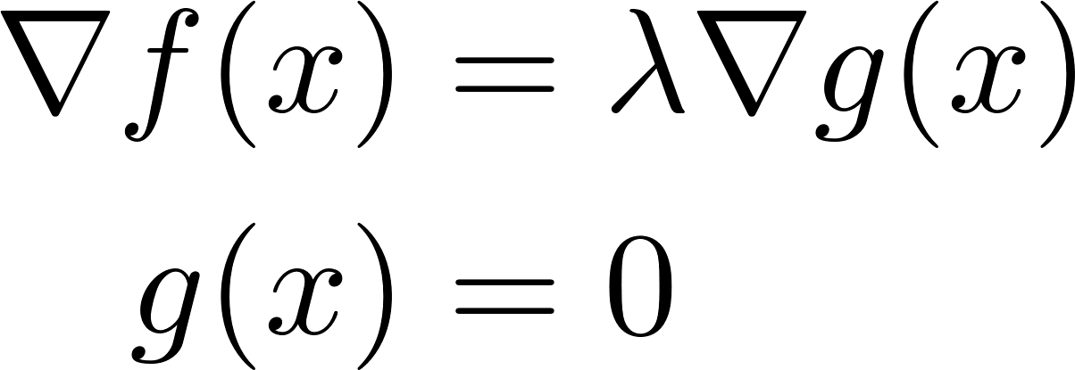
Use of Lagrange Multipliers
Turns constrained optimization into
unconstrained root-finding.

Slide 59
Many Options
Reparameterization Eliminate constraints to reduce to unconstrained case
Newton’s method Approximation: quadratic function with linear constraint
Penalty method Augment objective with barrier term, e.g. $f\left(x\right)+ρ|g\left(x\right)|$

Slide 60
Schur Complement Reduction
Recall:
(assume A is symmetric and positive definite)

Slide 61
Schur Complement Reduction
No longer positive definite!

Slide 62
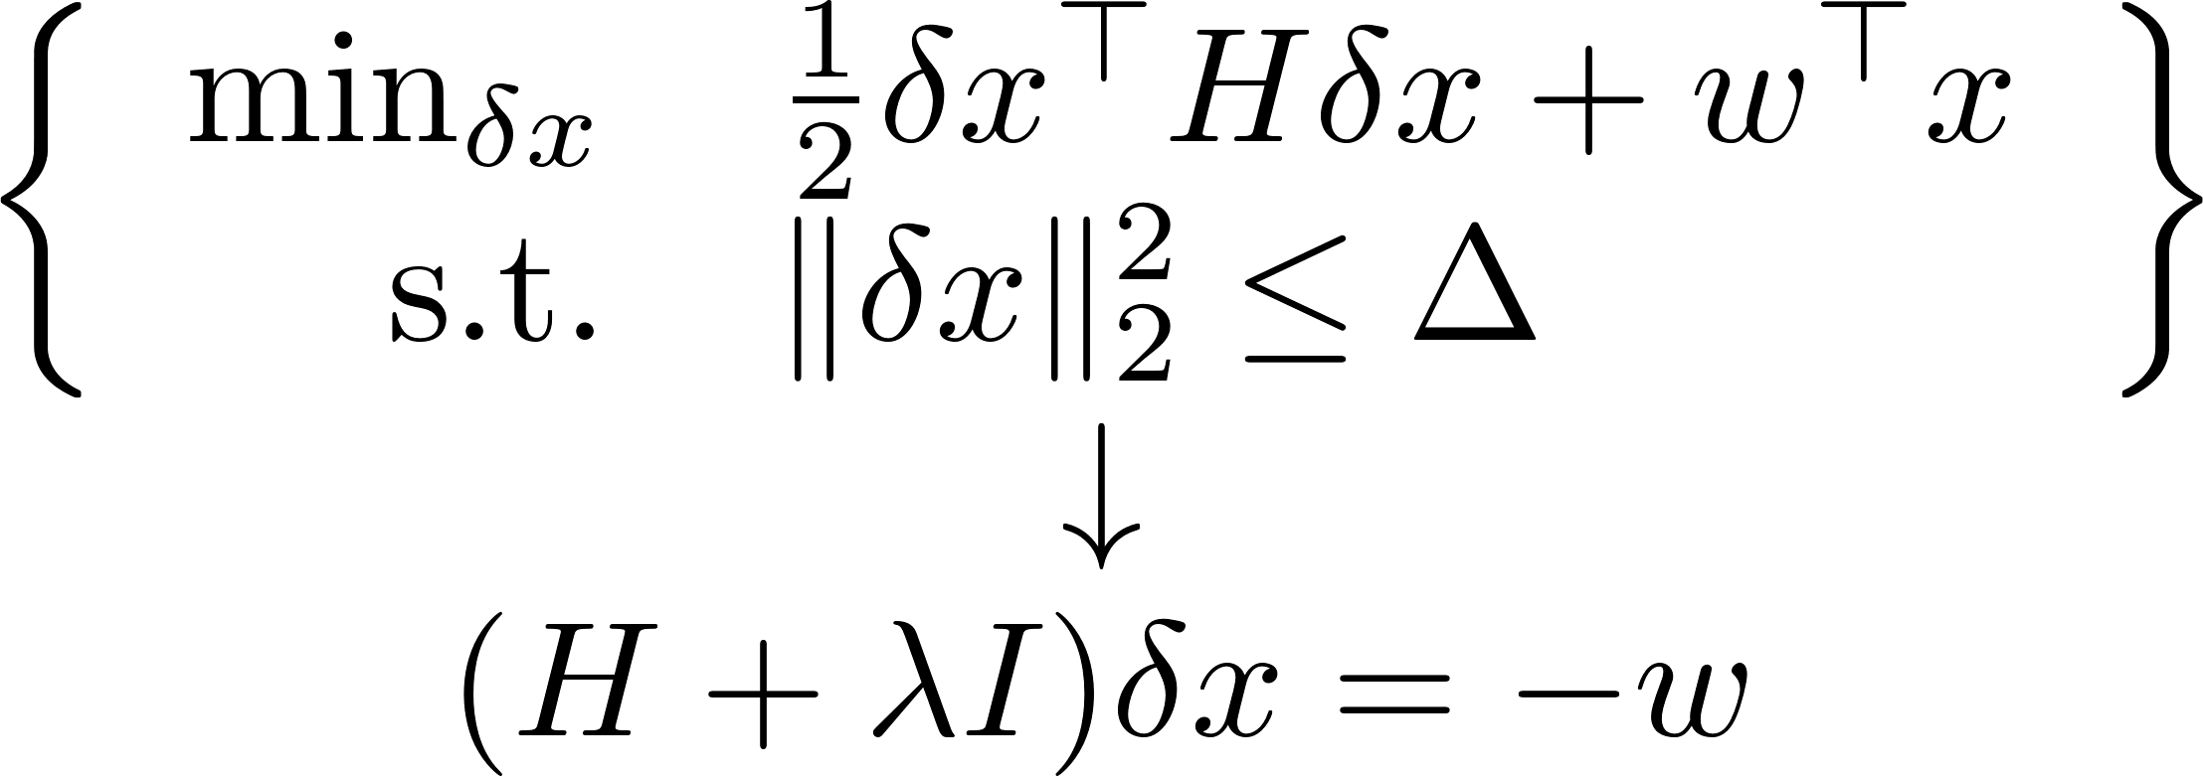
Trust Region Methods
Fix (or adjust) damping parameter $λ>0$.
Example: Levenberg-Marquardt

Slide 63
Example: Polycube Maps
Huang et al. “L1-Based Construction of Polycube Maps from Complex Shapes.” TOG 2014.

Slide 64
Nonlinear Constrained Problem
Align with coordinate axes
Preserve area
Note: Final method includes several more terms!

Slide 66
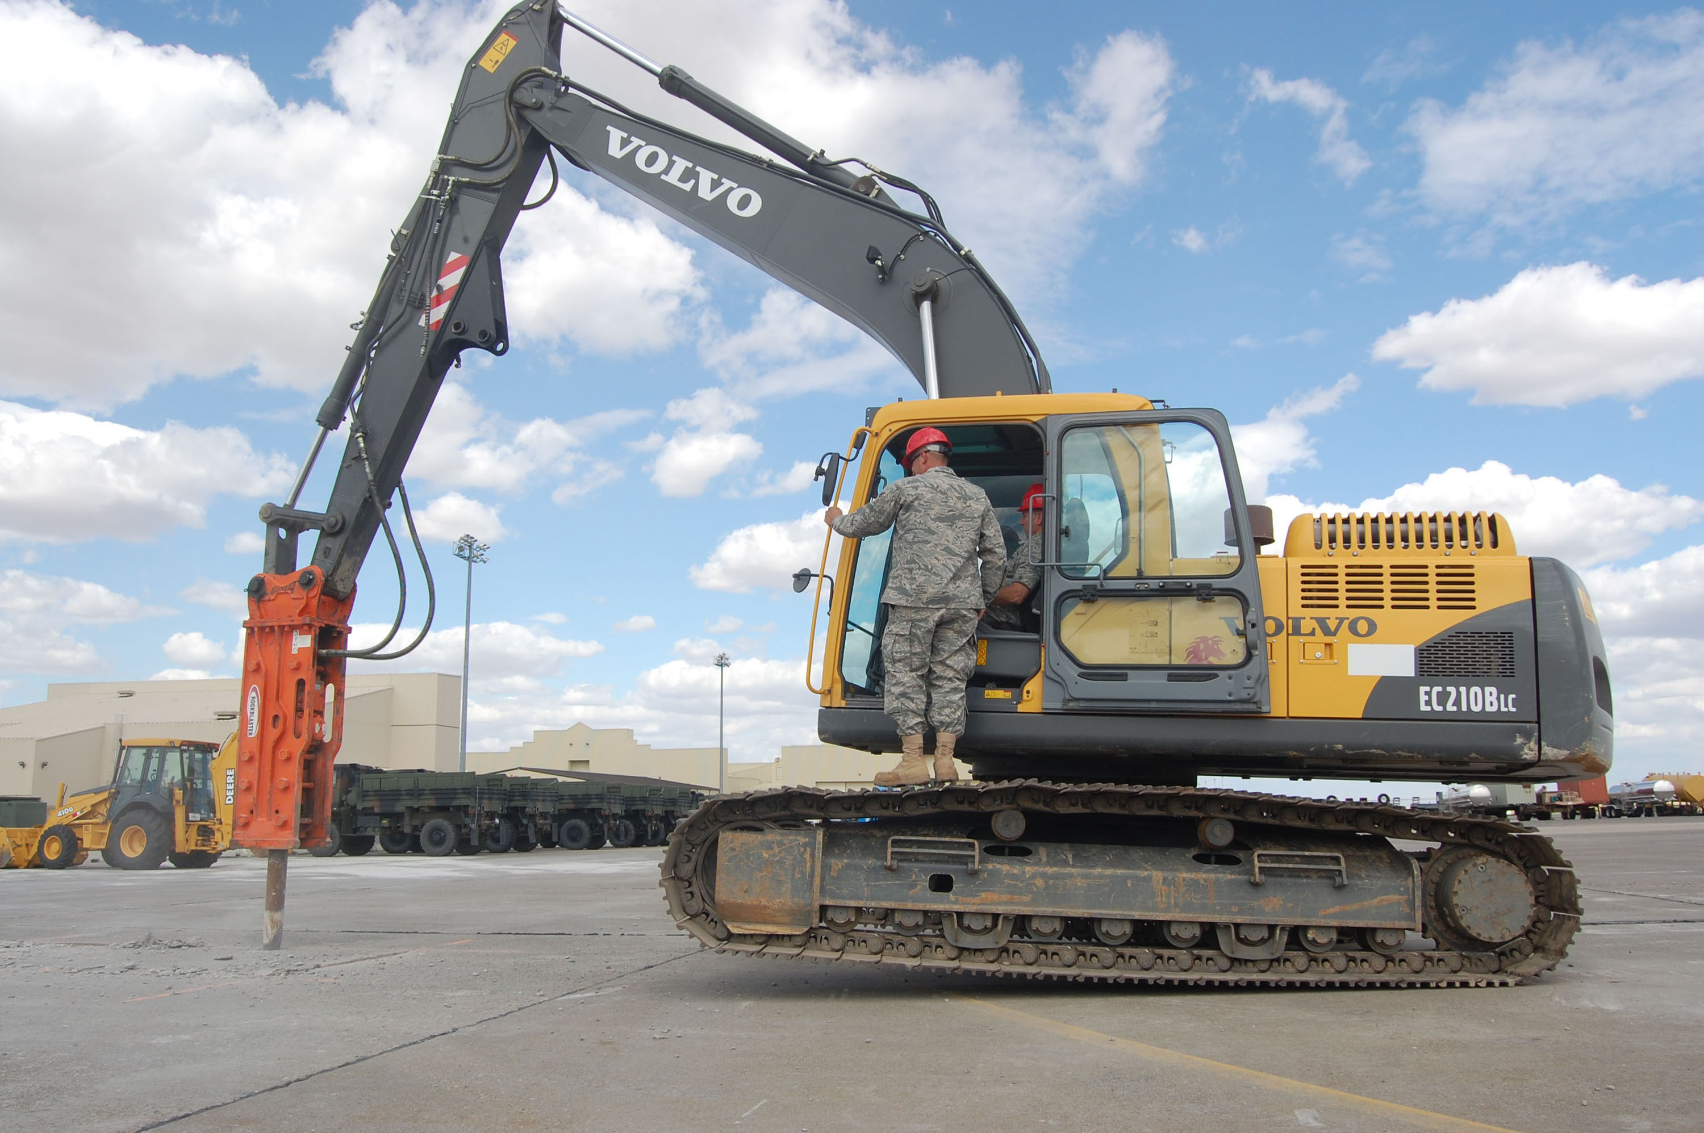
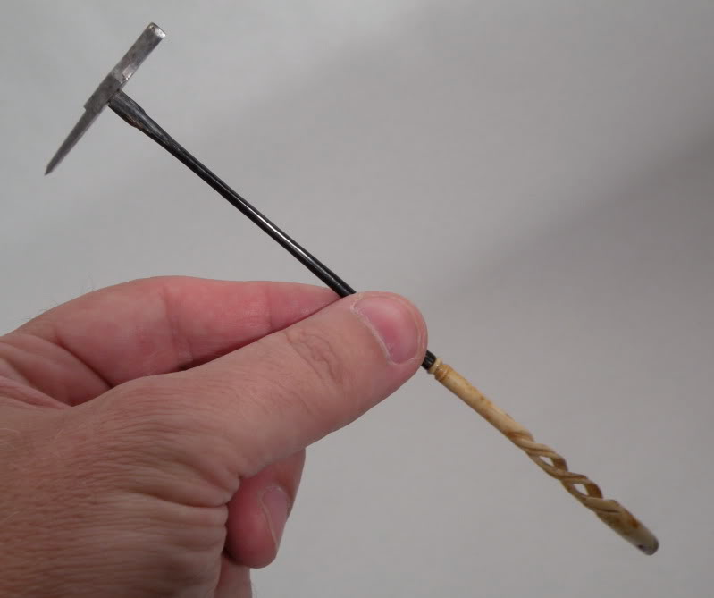
Convex Optimization Tools
versus
Try lightweight options

Slide 67
Convex Optimization Tools
versus
Sometimes work for non-convex problems…
Try lightweight options

Slide 68
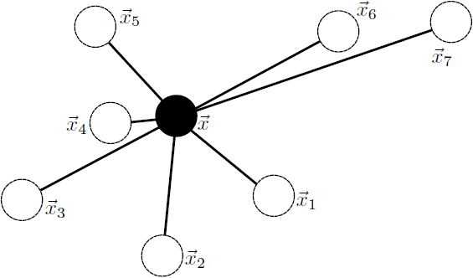
Iteratively Reweighted Least Squares
“Geometric median”
Repeatedly solve linear systems

Slide 69
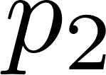
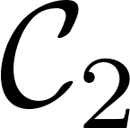
Alternating Projection
d can be a Bregman divergence

Slide 70
Iterative Shrinkage-Thresholding
Decompose as sum of hard part f and easy part g.
FISTA combines with Nesterov descent!
https://blogs.princeton.edu/imabandit/2013/04/11/orf523-ista-and-fista/

Slide 71
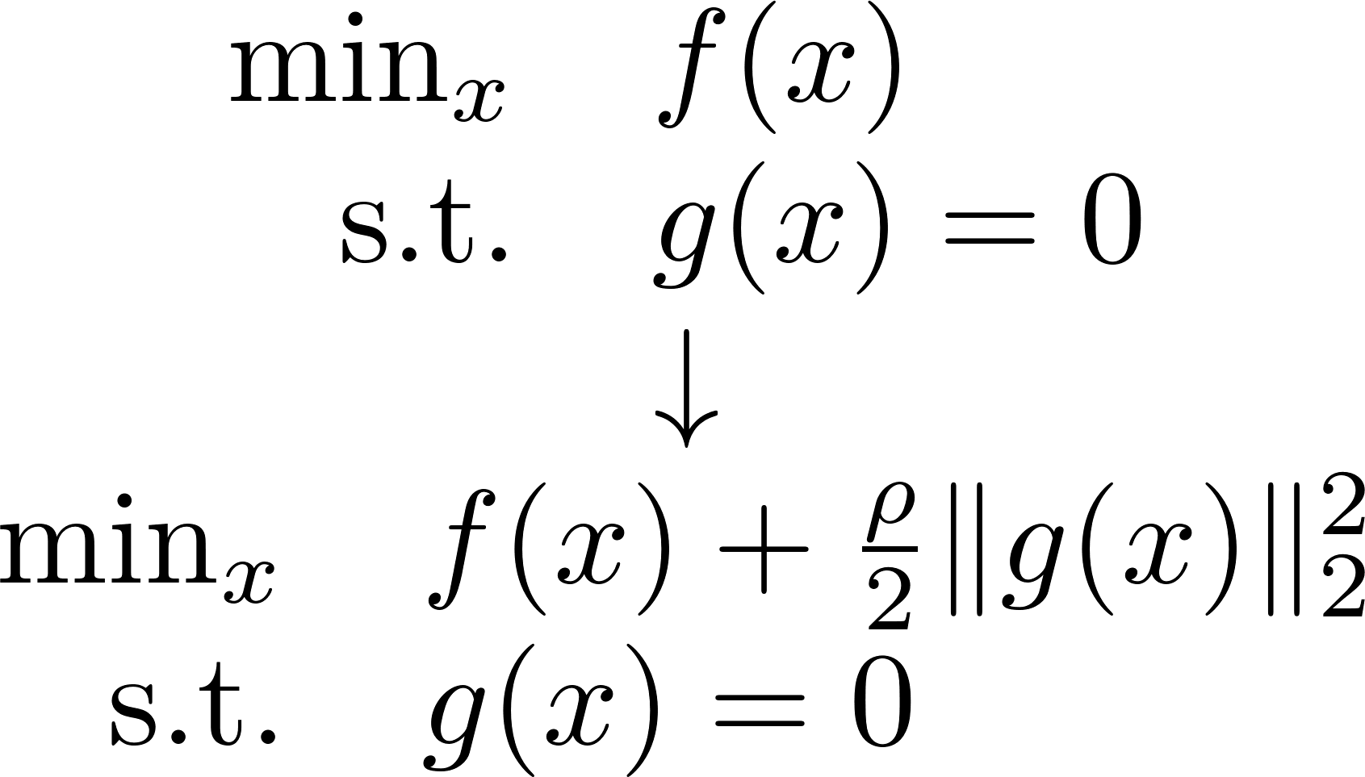
Augmented Lagrangians
Does nothing when constraint is satisfied
Add constraint to objective

Slide 72
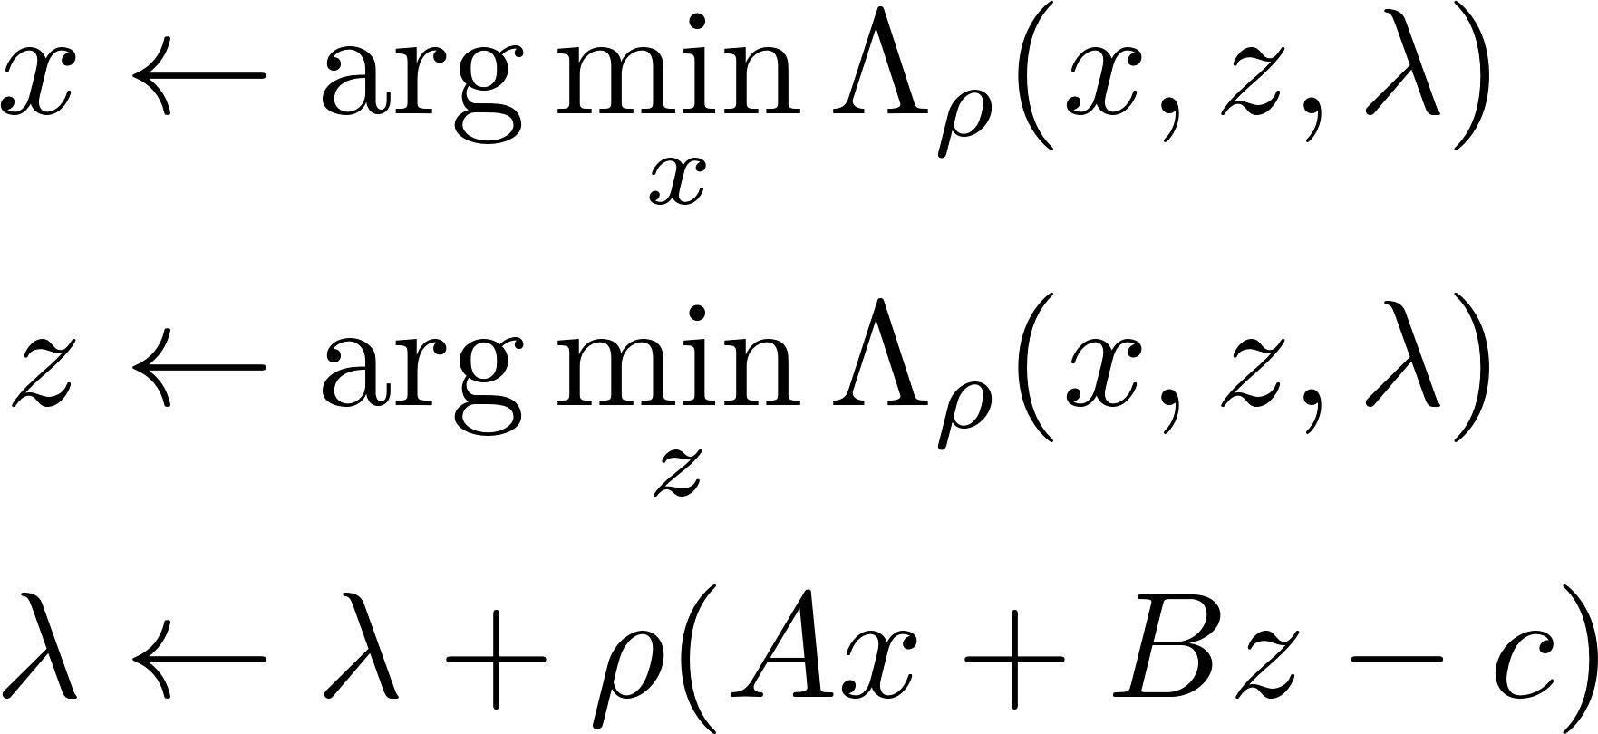
Alternating Direction Method of Multipliers (ADMM)
https://web.stanford.edu/~boyd/papers/pdf/admm_slides.pdf

Slide 73
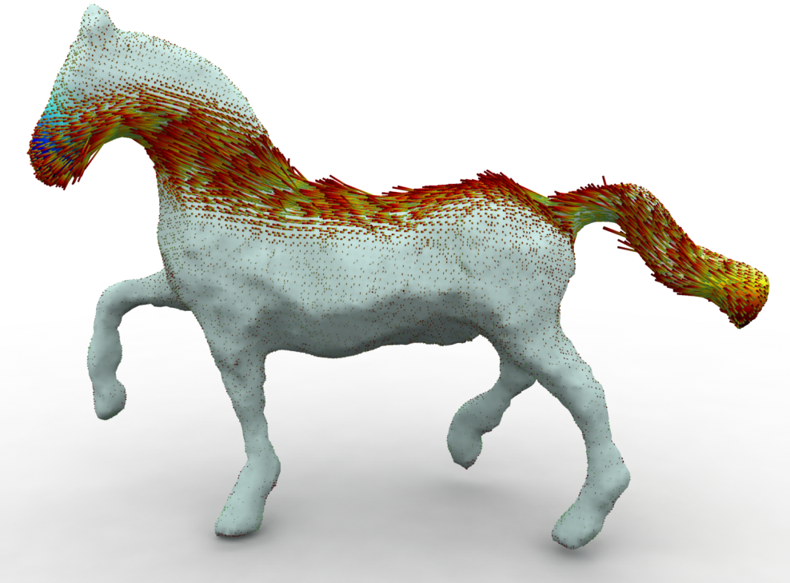
The Art of ADMM “Splitting”
Augmented part
Takes some practice!
Solomon et al. “Earth Mover’s Distances on Discrete Surfaces.” SIGGRAPH 2014.
Want two easy subproblems

Slide 74
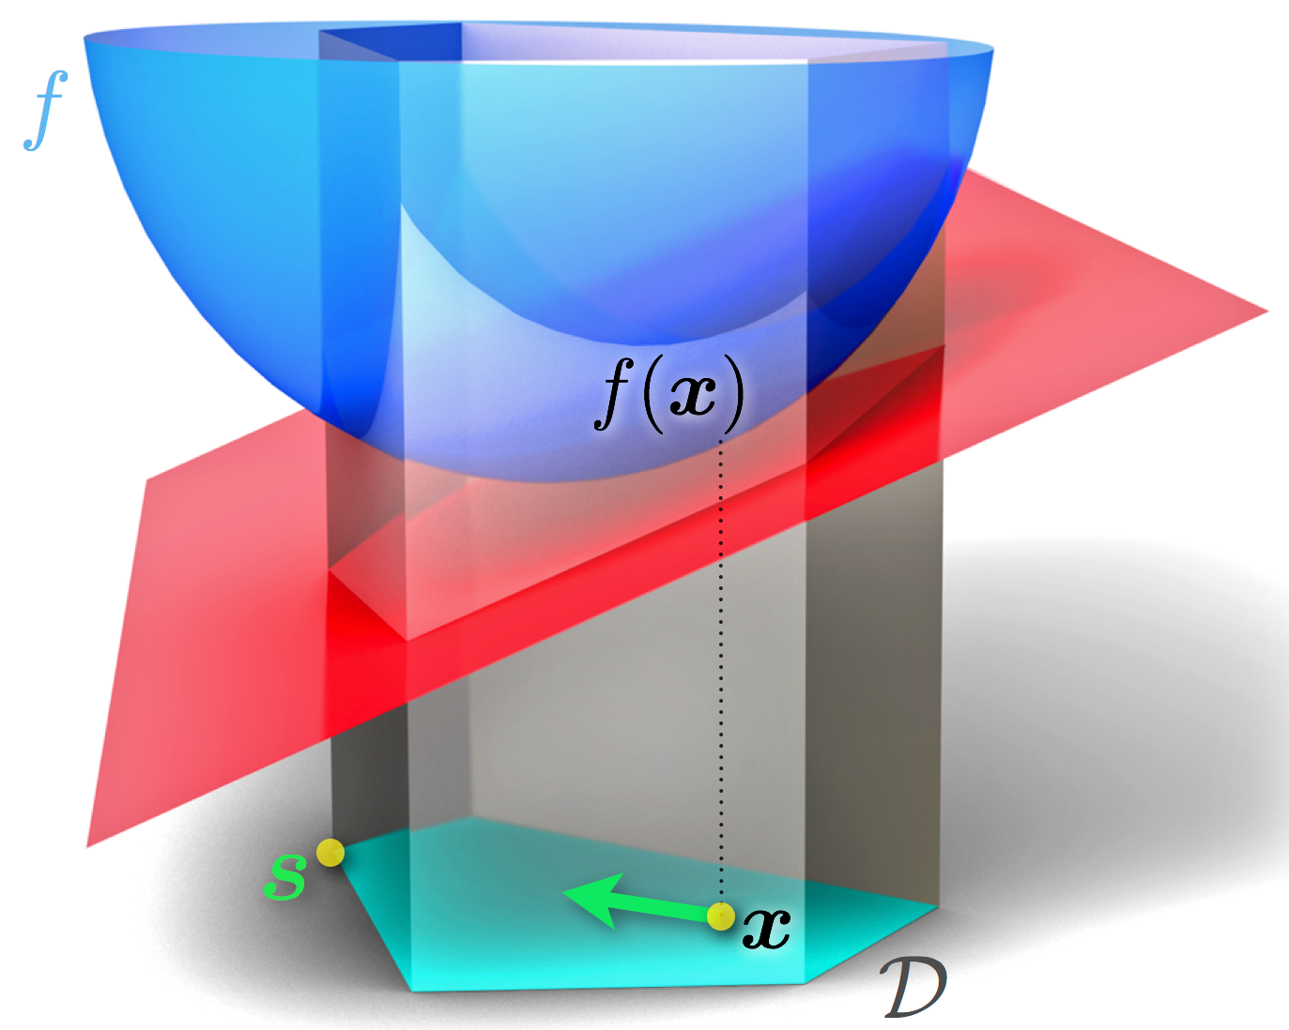
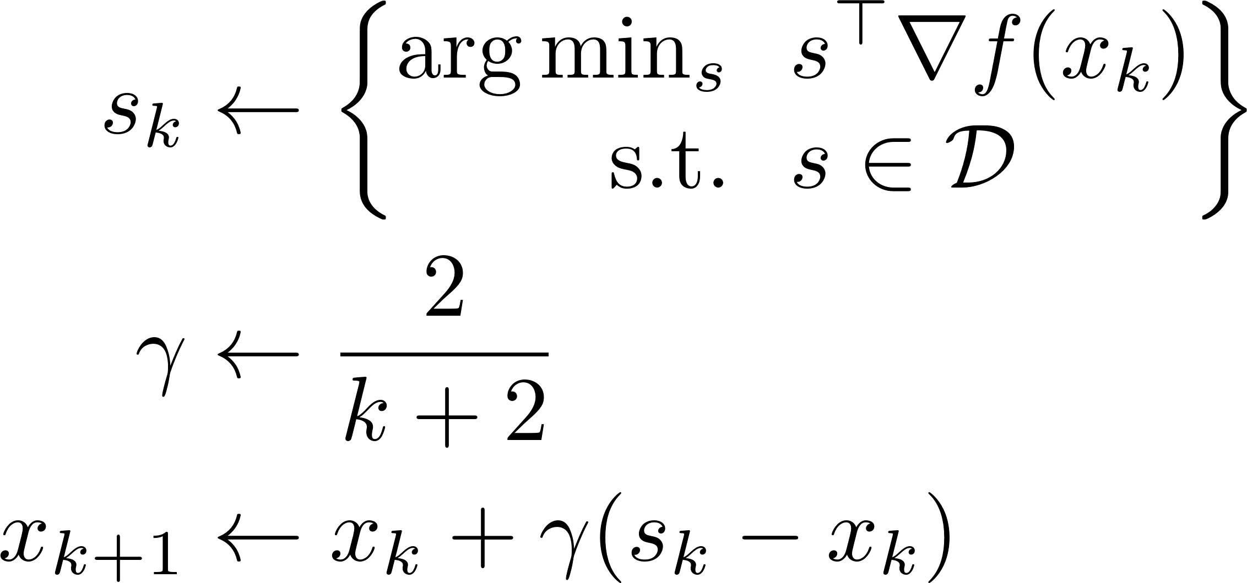
Frank-Wolfe
https://en.wikipedia.org/wiki/Frank%E2%80%93Wolfe_algorithm
Linearize objective, not constraints

