Slide 1


Optimization Techniques for Geometry Processing
-Part II-
Justin Solomon
Princeton University
David Bommes
RWTH Aachen University
Visual Computing Institute

Slide 2
Constrained Optimization

Slide 3





Constrained Optimization
objective function
general form
constraint functions
Mesh Generation and Optimization Group | Prof. Dr. David Bommes

Slide 4


Constrained Optimization
geometric interpretation
Mesh Generation and Optimization Group | Prof. Dr. David Bommes

Slide 5

Constrained Optimization
geometric interpretation
Mesh Generation and Optimization Group | Prof. Dr. David Bommes

Slide 6

Constrained Optimization
geometric interpretation
Mesh Generation and Optimization Group | Prof. Dr. David Bommes

Slide 7

Constrained Optimization
geometric interpretation
Mesh Generation and Optimization Group | Prof. Dr. David Bommes

Slide 8

Constrained Optimization
geometric interpretation
Mesh Generation and Optimization Group | Prof. Dr. David Bommes

Slide 9
Constrained Optimization
geometric interpretation
feasible
region
Mesh Generation and Optimization Group | Prof. Dr. David Bommes

Slide 10
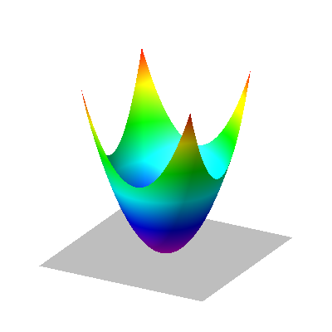

Constrained Optimization
geometric interpretation
feasible
region
Mesh Generation and Optimization Group | Prof. Dr. David Bommes

Slide 11
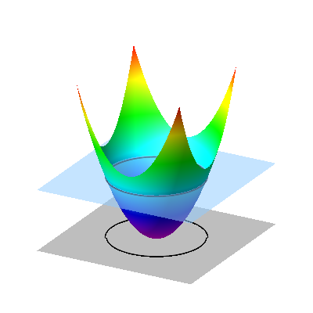
Constrained Optimization
geometric interpretation
feasible
region
isoline
Mesh Generation and Optimization Group | Prof. Dr. David Bommes

Slide 12
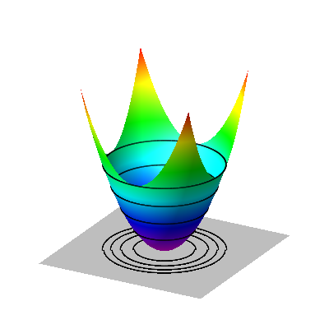
Constrained Optimization
geometric interpretation
feasible
region
Mesh Generation and Optimization Group | Prof. Dr. David Bommes

Slide 13

Constrained Optimization
geometric interpretation
feasible
region
isolines with
Mesh Generation and Optimization Group | Prof. Dr. David Bommes

Slide 14
Constrained Optimization
geometric interpretation
optimal point
feasible
region
isolines with
Mesh Generation and Optimization Group | Prof. Dr. David Bommes

Slide 15
A few words on Convexity
Searching globally optimal solutions usually requires convexity!
vs.
non-convex
convex
Mesh Generation and Optimization Group | Prof. Dr. David Bommes

Slide 16
A few words on Convexity
Searching globally optimal solutions usually requires convexity!
f convex if:
vs.
non-convex
convex
Mesh Generation and Optimization Group | Prof. Dr. David Bommes

Slide 17
A few words on Convexity
Searching globally optimal solutions usually requires convexity!
f convex if:
vs.
non-convex
convex
Mesh Generation and Optimization Group | Prof. Dr. David Bommes

Slide 18


A few words on Convexity
is convex optimization problem if
and all are convex functions
consequences
feasible region is convex set
convex
feasible region
non-convex
feasible region
Mesh Generation and Optimization Group | Prof. Dr. David Bommes

Slide 19


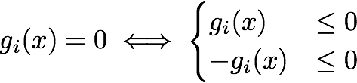
A few words on Convexity
is convex optimization problem if
and all are convex functions
consequences
feasible region is convex set
equality constraints can only be affine, i.e. since
convex
concave
Mesh Generation and Optimization Group | Prof. Dr. David Bommes

Slide 20
A few words on Convexity
is convex optimization problem if
and all are convex functions
consequences
feasible region is convex set
equality constraints can only be affine, i.e. since
convex
&
concave
convex
&
concave
Mesh Generation and Optimization Group | Prof. Dr. David Bommes

Slide 21
Convexity
Important Take Home Message:
Always Search for Convex Formulations
Global Optimum can be Found Efficiently
Mesh Generation and Optimization Group | Prof. Dr. David Bommes

Slide 22
Important (convex)
Problem Classes

Slide 23
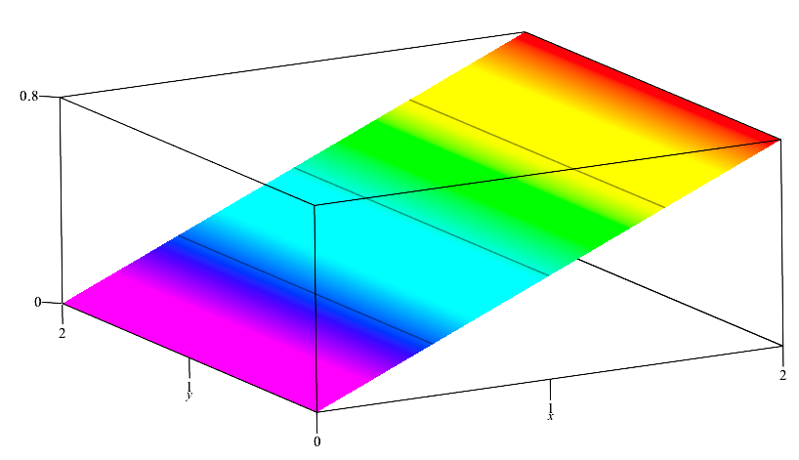


Linear Program (LP)
linear objective
general form
Mesh Generation and Optimization Group | Prof. Dr. David Bommes

Slide 24

Linear Program (LP)
linear objective
general form
linear inequalities
=
intersection of halfspaces
=
polyhedron
optimal point
always on corner
Mesh Generation and Optimization Group | Prof. Dr. David Bommes

Slide 25




Example: Chebyshev Center
Find largest ball inside a polyhedron in
Ball
Ball of radius r is inside halfspace
if
Chebyshev center
}
offset
Mesh Generation and Optimization Group | Prof. Dr. David Bommes

Slide 26

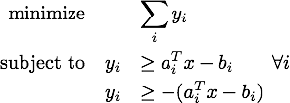

(useful) LP Reformulations
1-norm:
LP
Mesh Generation and Optimization Group | Prof. Dr. David Bommes

Slide 27


(useful) LP Reformulations
1-norm:
-norm:
LP
LP
Mesh Generation and Optimization Group | Prof. Dr. David Bommes

Slide 28

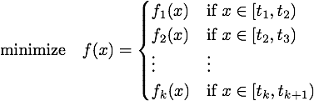

(useful) LP Reformulations
(convex) piecewise linear function:
LP
approximate arbitrarily complex convex functions by LP!
(e.g. Outer Approximation)
works in
Mesh Generation and Optimization Group | Prof. Dr. David Bommes

Slide 29


Quadratic Program (QP)
positive semidefinite
quadratic objective
general form
linear inequalities
=
intersection of halfspaces
=
polyhedron
optimal point
can be anywhere
Mesh Generation and Optimization Group | Prof. Dr. David Bommes

Slide 30



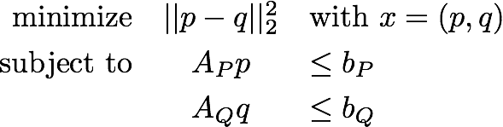
Example QP
Distance between polyhedra:
QP
Mesh Generation and Optimization Group | Prof. Dr. David Bommes

Slide 31


Second-Order Cone Program (SOCP)
general form
Mesh Generation and Optimization Group | Prof. Dr. David Bommes

Slide 32
Second-Order Cone Program (SOCP)
general form
Mesh Generation and Optimization Group | Prof. Dr. David Bommes

Slide 33
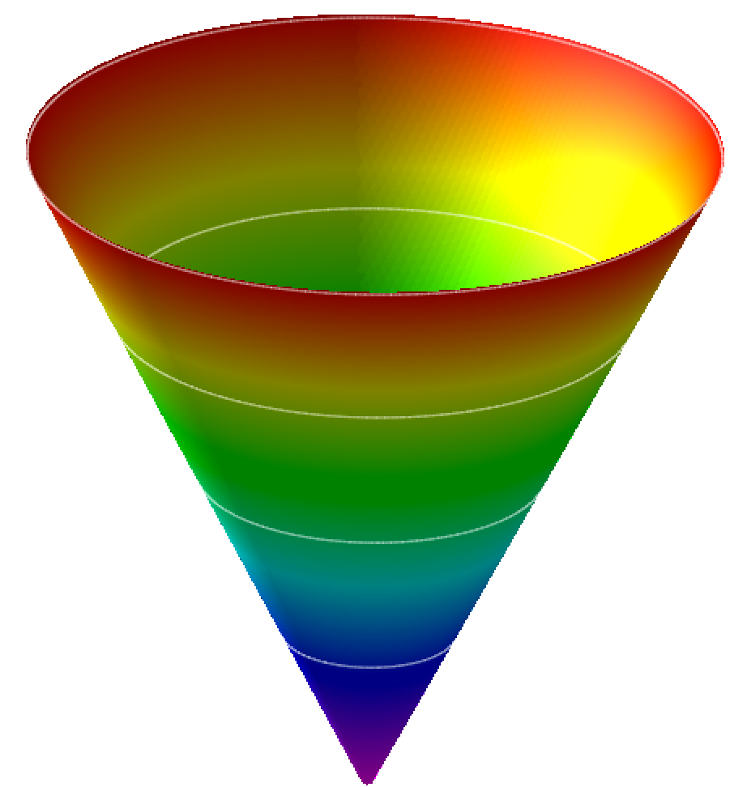

Second-Order Cone Program (SOCP)
general form
example constraint:
Mesh Generation and Optimization Group | Prof. Dr. David Bommes

Slide 34
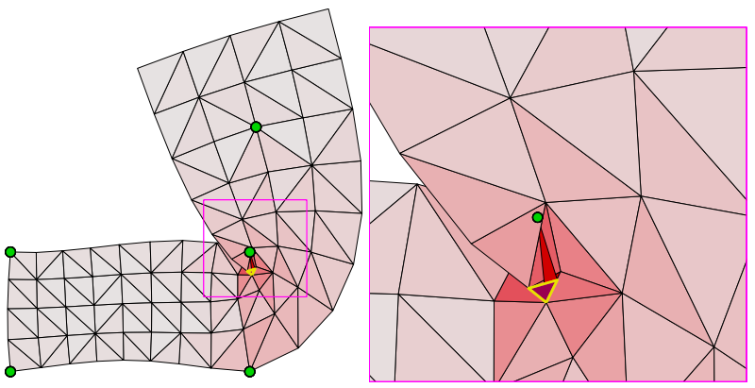

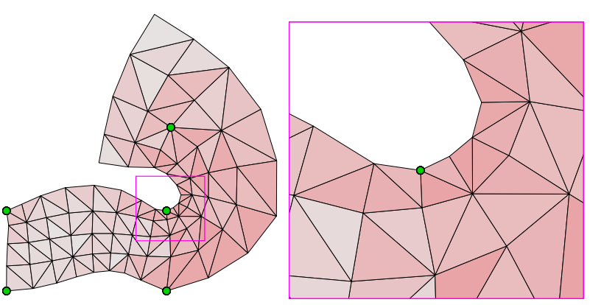
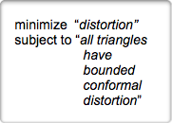
Example SOCP
Bounded (conformal) distortion mappings in 2D [Lipman 2012]:
deform
non-convex constraint but
approximation by SOCP possible!
LSCM
BD-LSCM
Mesh Generation and Optimization Group | Prof. Dr. David Bommes

Slide 35

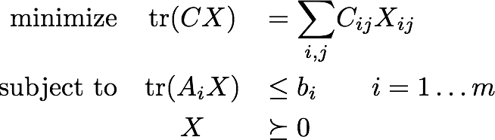

Semidefinite Program (SDP)
general form
linear function in
matrix space
with
(symmetric nxn matrices)
X is required to be
positive semidefinite
Mesh Generation and Optimization Group | Prof. Dr. David Bommes

Slide 36
Example SDP
Mesh Generation and Optimization Group | Prof. Dr. David Bommes

Slide 37
Finding Minima

Slide 38




First-Order Optimality Conditions
Necessary condition for minimum of
Langrangian:
Karush-Kuhn-Tucker (KKT)
conditions for minimum
  Stationarity:
  Primal feasibility:
  Dual feasibility:
  Complementary slackness:
without constraints just
Mesh Generation and Optimization Group | Prof. Dr. David Bommes

Slide 39





First-Order Optimality Conditions
Necessary condition for minimum of
Langrangian:
Karush-Kuhn-Tucker (KKT)
conditions for minimum
  Stationarity:
  Primal feasibility:
  Dual feasibility:
  Complementary slackness:
active
Recall Lagrange Multiplier
inactive
Mesh Generation and Optimization Group | Prof. Dr. David Bommes

Slide 40
Algorithms

Slide 41
Active Set Method

Slide 42


Active Set Method
Assume feasible
Initialize Active Set
While KKT not satisfied
  Optimize with equality constraints of A
  if constraint gets violated, activate it
Mesh Generation and Optimization Group | Prof. Dr. David Bommes

Slide 43


Active Set Method
Assume feasible
Initialize Active Set
While KKT not satisfied
  Optimize with equality constraints of A
  if constraint gets violated, activate it
Mesh Generation and Optimization Group | Prof. Dr. David Bommes

Slide 44
Active Set Method
Assume feasible
Initialize Active Set
While KKT not satisfied
  Optimize with equality constraints of A
  if constraint gets violated, activate it
Mesh Generation and Optimization Group | Prof. Dr. David Bommes

Slide 45
Active Set Method
Assume feasible
Initialize Active Set
While KKT not satisfied
  Optimize with equality constraints of A
  if constraint gets violated, activate it
Mesh Generation and Optimization Group | Prof. Dr. David Bommes

Slide 46

Active Set Method
Assume feasible
Initialize Active Set
While KKT not satisfied
  Optimize with equality constraints of A
  if constraint gets violated, activate it
  if Lagrange multiplier gets negative deactivate corresponding constraint
active set methods iterate on
the boundary of the feasible region
Mesh Generation and Optimization Group | Prof. Dr. David Bommes

Slide 47



How to find feasible starting point?
Given
Corresponding (Phase 1) Feasibility Problem:
t
also constrained problem
but for arbitrary
choose
Mesh Generation and Optimization Group | Prof. Dr. David Bommes

Slide 48
How to find feasible starting point?
Given
Corresponding (Phase 1) Feasibility Problem:
also constrained problem
but for arbitrary
choose
terminate as soon as t < 0 !!!
Mesh Generation and Optimization Group | Prof. Dr. David Bommes

Slide 49
Active Set Method
Many (sophisticated) variants
  primal, dual, primal-dual, …
Many specializations
  LP (e.g. simplex algorithm), QP, NLP, …
Good choice if
  few constraints
  warmstart desired
Disadvantage
  sometimes requires huge number of iterations
Mesh Generation and Optimization Group | Prof. Dr. David Bommes

Slide 50
Interior Point Method

Slide 51

Interior Point Method
Sometimes called Barrier Method
Barrier function
u
u=0
Mesh Generation and Optimization Group | Prof. Dr. David Bommes

Slide 52

Interior Point Method
Sometimes called Barrier Method
Barrier function
Idea:
u
u=0
constrained
unconstrained
equivalent
Mesh Generation and Optimization Group | Prof. Dr. David Bommes

Slide 53
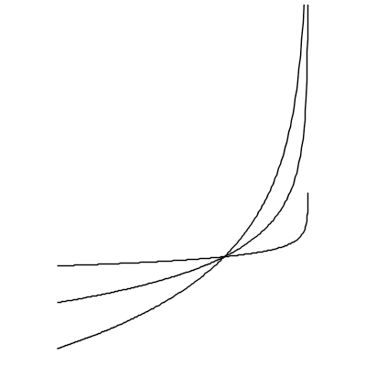
Barrier Function
Logarithmic Barrier (smooth and convex approximation)
How to choose t?
 | large t | small t
accuracy | + | -
convergence | - | +
t=10
t=2
u
u=0
t=1
Mesh Generation and Optimization Group | Prof. Dr. David Bommes

Slide 54



Simple Interior Point Method
Assume feasible ,
Iteratively solve (unconstrained)
and update
stop when
interior point method follows path
through interior of the feasible region
Mesh Generation and Optimization Group | Prof. Dr. David Bommes

Slide 55
Interior Point Method
Many (sophisticated) variants
  primal, dual, primal-dual, …
  adaptive choice of t
Many specializations
  LP, QP, NLP, …
Good choice if
  large scale (sparse) problem with many constraints
  non-convex feasible region
Disadvantage
  limited warmstart capabilities
Mesh Generation and Optimization Group | Prof. Dr. David Bommes

Slide 56
More Algorithms …

Slide 57
Mixed-Integer Optimization

Slide 58

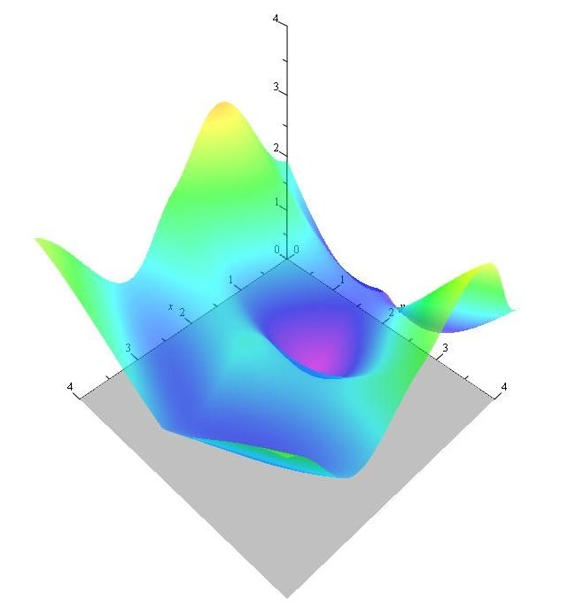
Mixed-Integer Optimization
Minimize objective
local optimum
Feasible region
Mesh Generation and Optimization Group | Prof. Dr. David Bommes

Slide 59

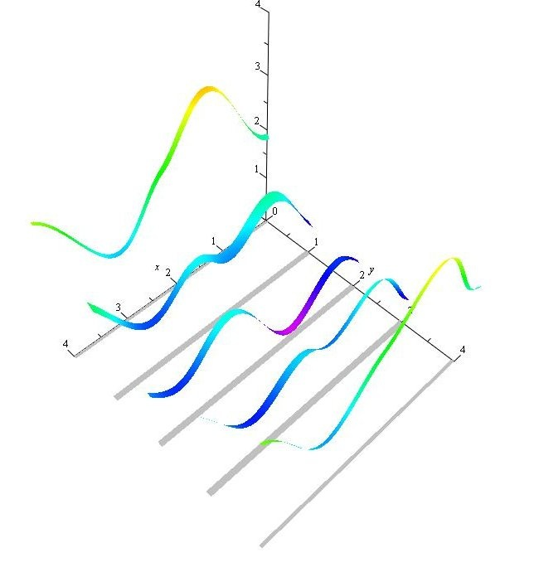
Mixed-Integer Optimization
Minimize objective
local optimum
continuous
vs.
mixed-integer
Feasible region
Feasible region
R x Z
Mesh Generation and Optimization Group | Prof. Dr. David Bommes

Slide 60

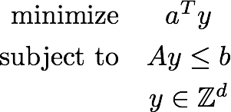
Mixed-Integer Optimization
Integer Linear Program (ILP)
optimal point
Mesh Generation and Optimization Group | Prof. Dr. David Bommes

Slide 61
Branch and Bound

Slide 62

Branch and Bound
Bounding: initially we only know
lower bound
upper bound
Mesh Generation and Optimization Group | Prof. Dr. David Bommes

Slide 63
Branch and Bound
Bounding: initially we only know
Idea: improve bounds by series of continuous problems
lower bound
upper bound
Mesh Generation and Optimization Group | Prof. Dr. David Bommes

Slide 64

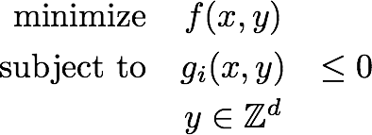
Branch and Bound
Bounding: initially we only know
Idea: improve bounds by series of continuous problems
Continuous Relaxation: assume that all variables are continuous
lower bound
upper bound
MIP
RMIP
0
Mesh Generation and Optimization Group | Prof. Dr. David Bommes

Slide 65
Branch and Bound
Bounding: initially we only know
Idea: improve bounds by series of continuous problems
Continuous Relaxation: assume that all variables are continuous
MIP is restriction of RMIP lower bound
lower bound
upper bound
MIP
RMIP
0
0
Mesh Generation and Optimization Group | Prof. Dr. David Bommes

Slide 66
Branch and Bound
Bounding: initially we only know
Idea: improve bounds by series of continuous problems
Continuous Relaxation: assume that all variables are continuous
MIP is restriction of RMIP lower bound
How to obtain upper bound? How to improve bounds?
lower bound
upper bound
MIP
RMIP
0
0
Mesh Generation and Optimization Group | Prof. Dr. David Bommes

Slide 67






Branch and Bound
cut off non-integer neighborhood of
Branching:
select
improve lower bound
0
Mesh Generation and Optimization Group | Prof. Dr. David Bommes

Slide 68
Branch and Bound
active node
Mesh Generation and Optimization Group | Prof. Dr. David Bommes

Slide 69
Branch and Bound
active node
finished node
lower bound: min{ }
Mesh Generation and Optimization Group | Prof. Dr. David Bommes

Slide 70

Branch and Bound
active node
finished node
feasible node
lower bound: min{ }
Mesh Generation and Optimization Group | Prof. Dr. David Bommes

Slide 71
Branch and Bound
active node
finished node
feasible node
lower bound: min{ }
0
upper bound
Mesh Generation and Optimization Group | Prof. Dr. David Bommes

Slide 72
Branch and Bound
active node
finished node
feasible node
lower bound: min{ }
upper bound: min{ }
0
upper bound
Mesh Generation and Optimization Group | Prof. Dr. David Bommes

Slide 73
Branch and Bound
active node
finished node
feasible node
lower bound: min{ }
upper bound: min{ }
pruning
if > upper bound
(or infeasible)
Mesh Generation and Optimization Group | Prof. Dr. David Bommes

Slide 74
Branch and Bound
active node
finished node
feasible node
lower bound: min{ }
upper bound: min{ }
pruning
if > upper bound
(or infeasible)
Mesh Generation and Optimization Group | Prof. Dr. David Bommes

Slide 75
Branch and Bound
active node
finished node
feasible node
lower bound: min{ }
upper bound: min{ }
terminate when min{ }-min{ } < epsilon
global optimum if RMIP convex!
Mesh Generation and Optimization Group | Prof. Dr. David Bommes

Slide 76
Branch and Bound
Node Selection Strategies
  Depth-First Search
  Best-First Search (w.r.t. lower bound)
  Dynamic heuristics
Branching Strategies
  Maximum Infeasibility — most undecided first (close to .5)
  Strong Branching — best improvement of lower bound
  Pseudo Reduced Cost — approximation of strong branching
  Dynamic heuristics
Mesh Generation and Optimization Group | Prof. Dr. David Bommes

Slide 77
Example: Branch and Bound
Integer Linear Program (ILP)
Mesh Generation and Optimization Group | Prof. Dr. David Bommes

Slide 78
Example: Branch and Bound
Integer Linear Program (ILP)
Mesh Generation and Optimization Group | Prof. Dr. David Bommes

Slide 79
Example: Branch and Bound
Integer Linear Program (ILP)
infeasible
Mesh Generation and Optimization Group | Prof. Dr. David Bommes

Slide 80
Example: Branch and Bound
Integer Linear Program (ILP)
infeasible
Mesh Generation and Optimization Group | Prof. Dr. David Bommes

Slide 81
Example: Branch and Bound
Integer Linear Program (ILP)
infeasible
Mesh Generation and Optimization Group | Prof. Dr. David Bommes

Slide 82
Example: Branch and Bound
Integer Linear Program (ILP)
infeasible
Mesh Generation and Optimization Group | Prof. Dr. David Bommes

Slide 83
Example: Branch and Bound
Integer Linear Program (ILP)
infeasible
Mesh Generation and Optimization Group | Prof. Dr. David Bommes

Slide 84
Example: Branch and Bound
Integer Linear Program (ILP)
infeasible
Mesh Generation and Optimization Group | Prof. Dr. David Bommes

Slide 85
Example: Branch and Bound
Integer Linear Program (ILP)
infeasible
Mesh Generation and Optimization Group | Prof. Dr. David Bommes

Slide 86
Example: Branch and Bound
Integer Linear Program (ILP)
infeasible
Mesh Generation and Optimization Group | Prof. Dr. David Bommes

Slide 87
Example: Branch and Bound
Integer Linear Program (ILP)
infeasible
Mesh Generation and Optimization Group | Prof. Dr. David Bommes

Slide 88
Example: Branch and Bound
Integer Linear Program (ILP)
infeasible
Mesh Generation and Optimization Group | Prof. Dr. David Bommes

Slide 89
Example: Branch and Bound
Integer Linear Program (ILP)
infeasible
Mesh Generation and Optimization Group | Prof. Dr. David Bommes

Slide 90
Example: Branch and Bound
Integer Linear Program (ILP)
infeasible
Mesh Generation and Optimization Group | Prof. Dr. David Bommes

Slide 91
Example: Branch and Bound
Integer Linear Program (ILP)
infeasible
Mesh Generation and Optimization Group | Prof. Dr. David Bommes

Slide 92
Example: Branch and Bound
Integer Linear Program (ILP)
infeasible
prune
optimal solution!
Mesh Generation and Optimization Group | Prof. Dr. David Bommes

Slide 93
GP Example
Parametrization Based
Quad Meshing

Slide 94
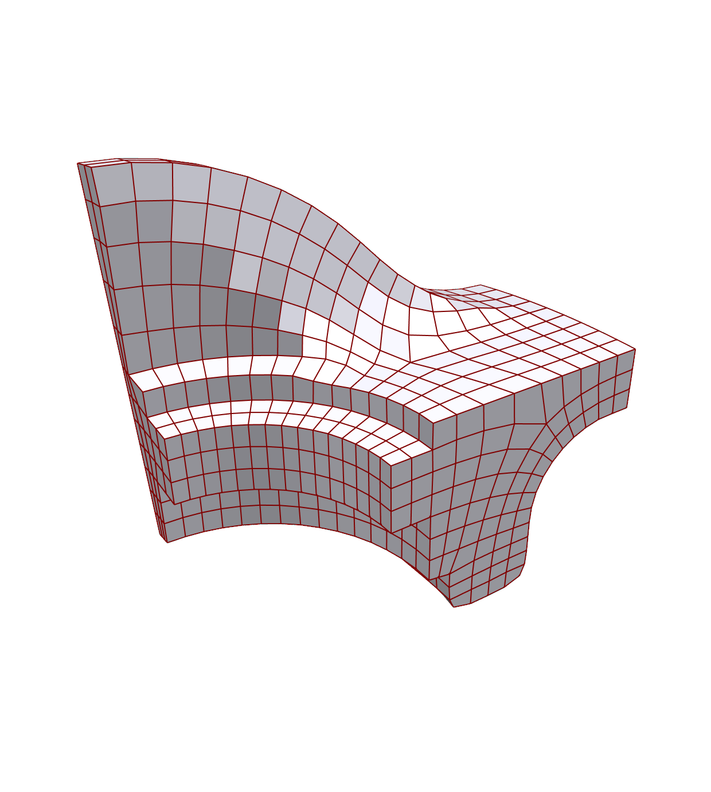
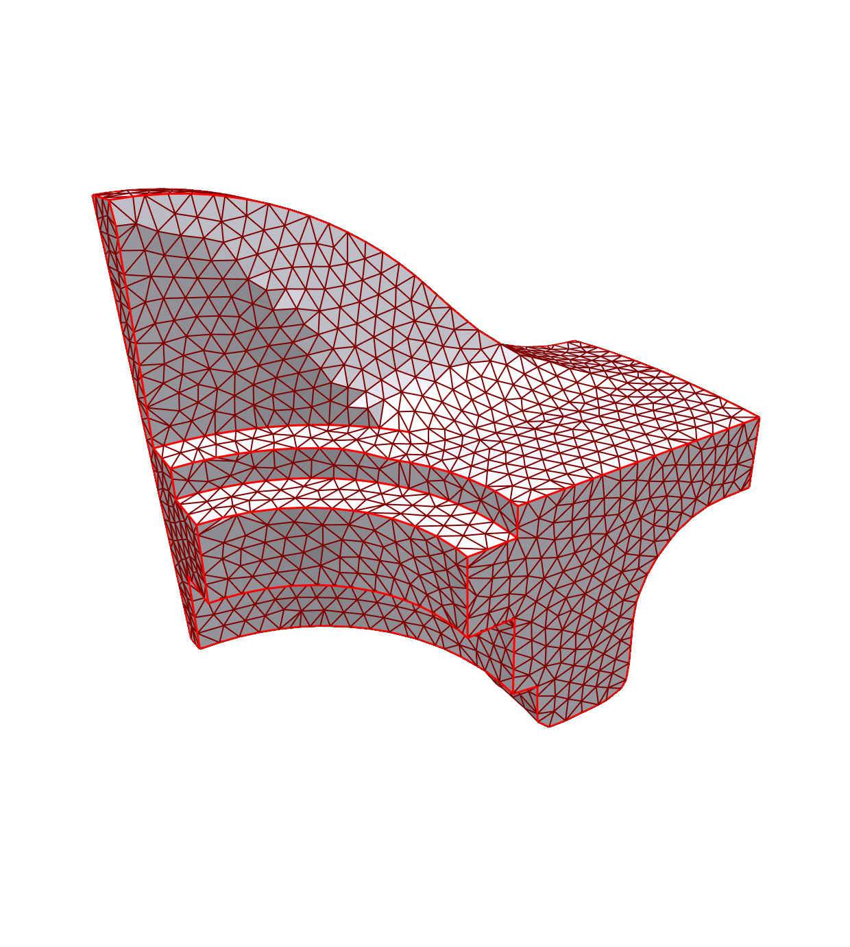
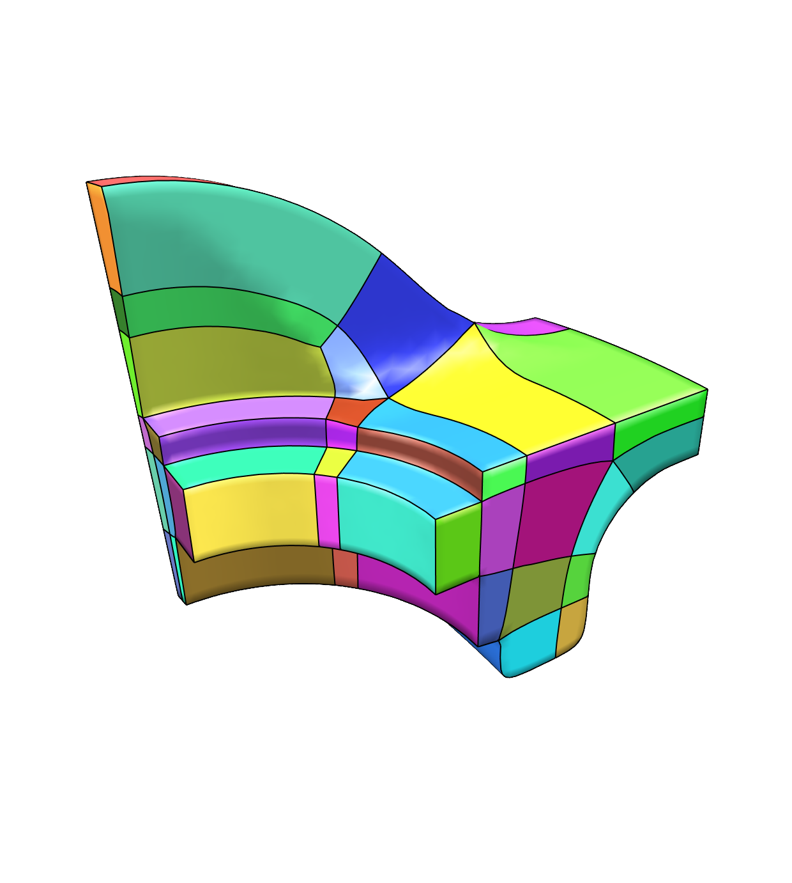
Quad Meshing / Layouting
Quad
Mesh
Triangle
Mesh
Quad
Layout
Mesh Generation and Optimization Group | Prof. Dr. David Bommes

Slide 95
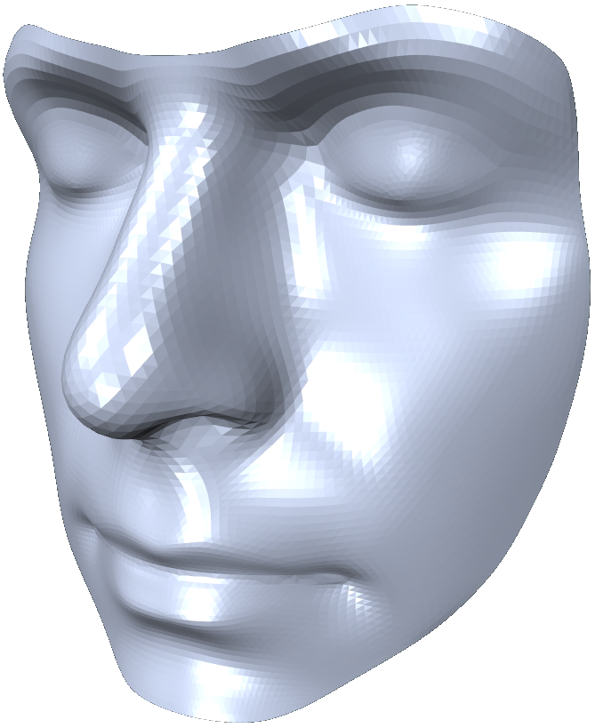
Base Idea
Mesh Generation and Optimization Group | Prof. Dr. David Bommes

Slide 96
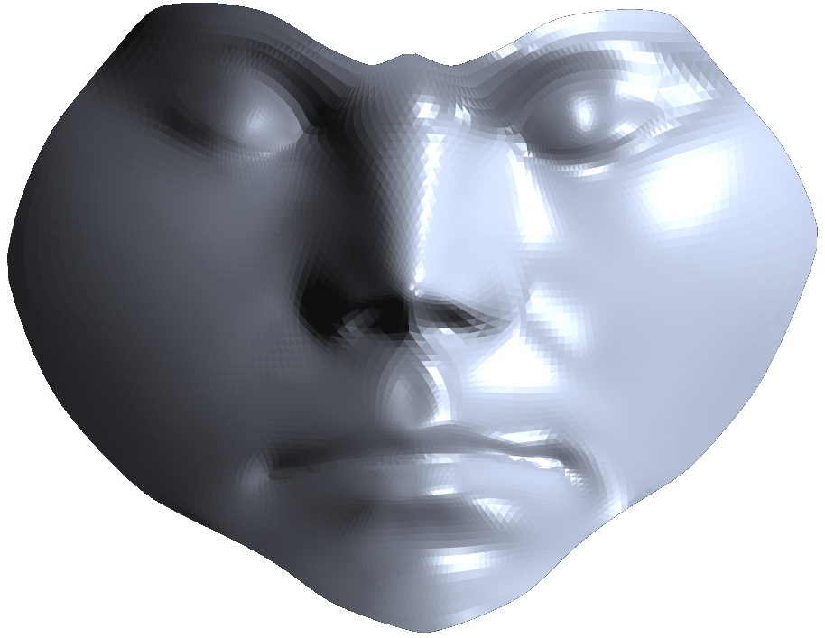
Base Idea
f
Mesh Generation and Optimization Group | Prof. Dr. David Bommes

Slide 97
Base Idea
v
f
0 2 4 6 8 10 12 …
0 2 4 6 8 10 12 …
u
Mesh Generation and Optimization Group | Prof. Dr. David Bommes

Slide 98
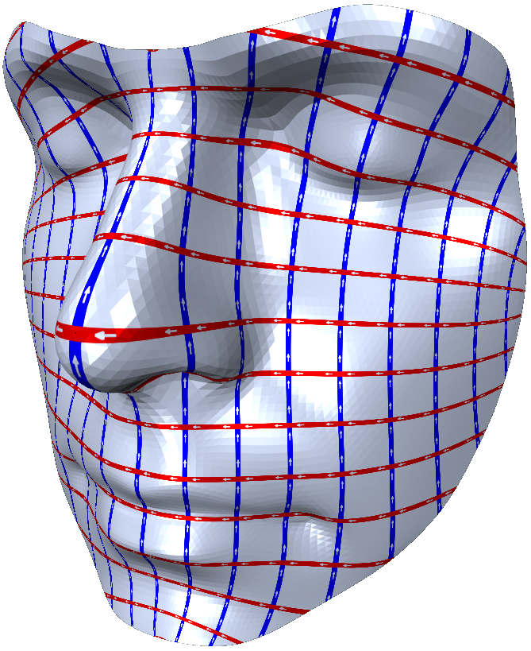
Base Idea
v
f
0 2 4 6 8 10 12 …
f ⁻¹
0 2 4 6 8 10 12 …
u
Mesh Generation and Optimization Group | Prof. Dr. David Bommes

Slide 99
Integer-Grid Maps
(IGM)

Slide 100
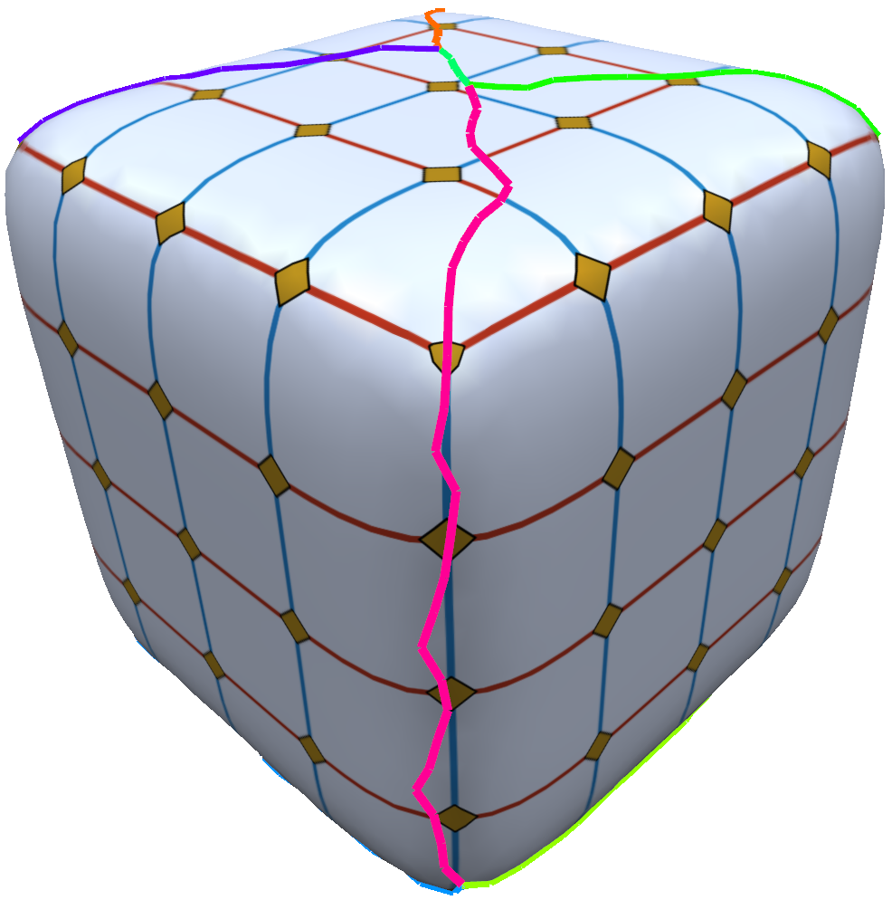
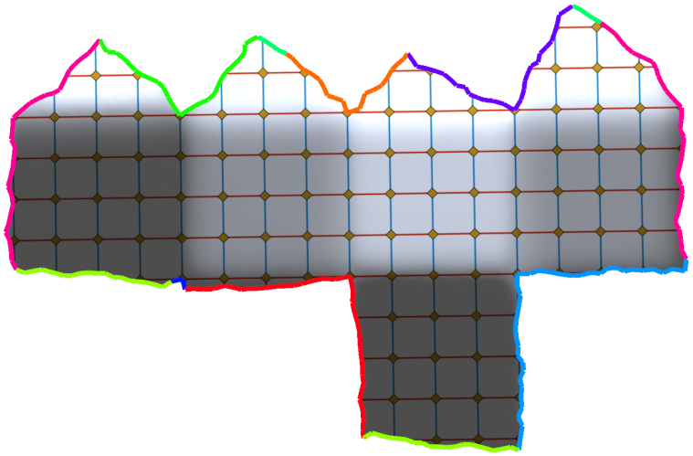
Integer-Grid Maps
v
f
continuity at cut?
0 2 4 6 8 10 12 …
f ⁻¹
0 2 4 6 8 10 12 …
u
Mesh Generation and Optimization Group | Prof. Dr. David Bommes

Slide 101
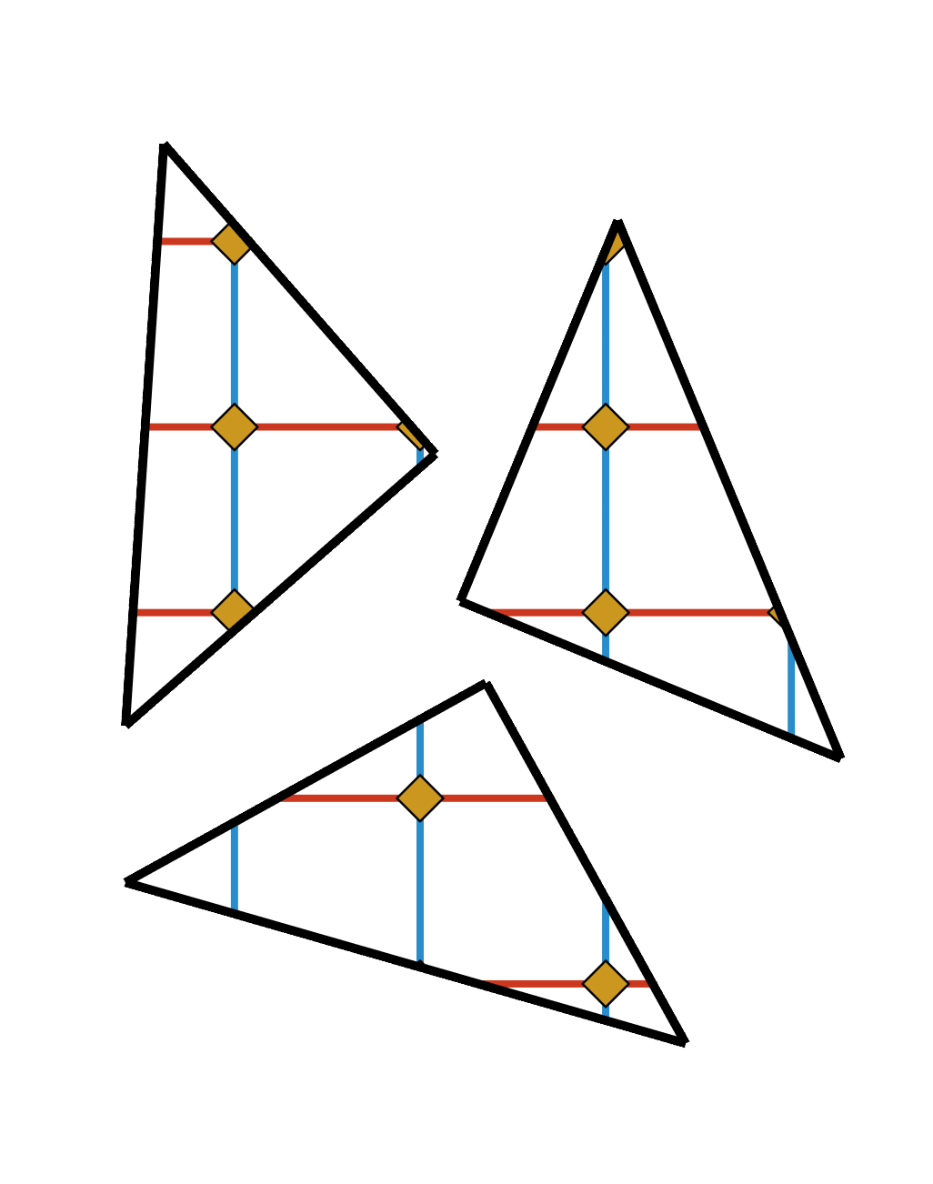
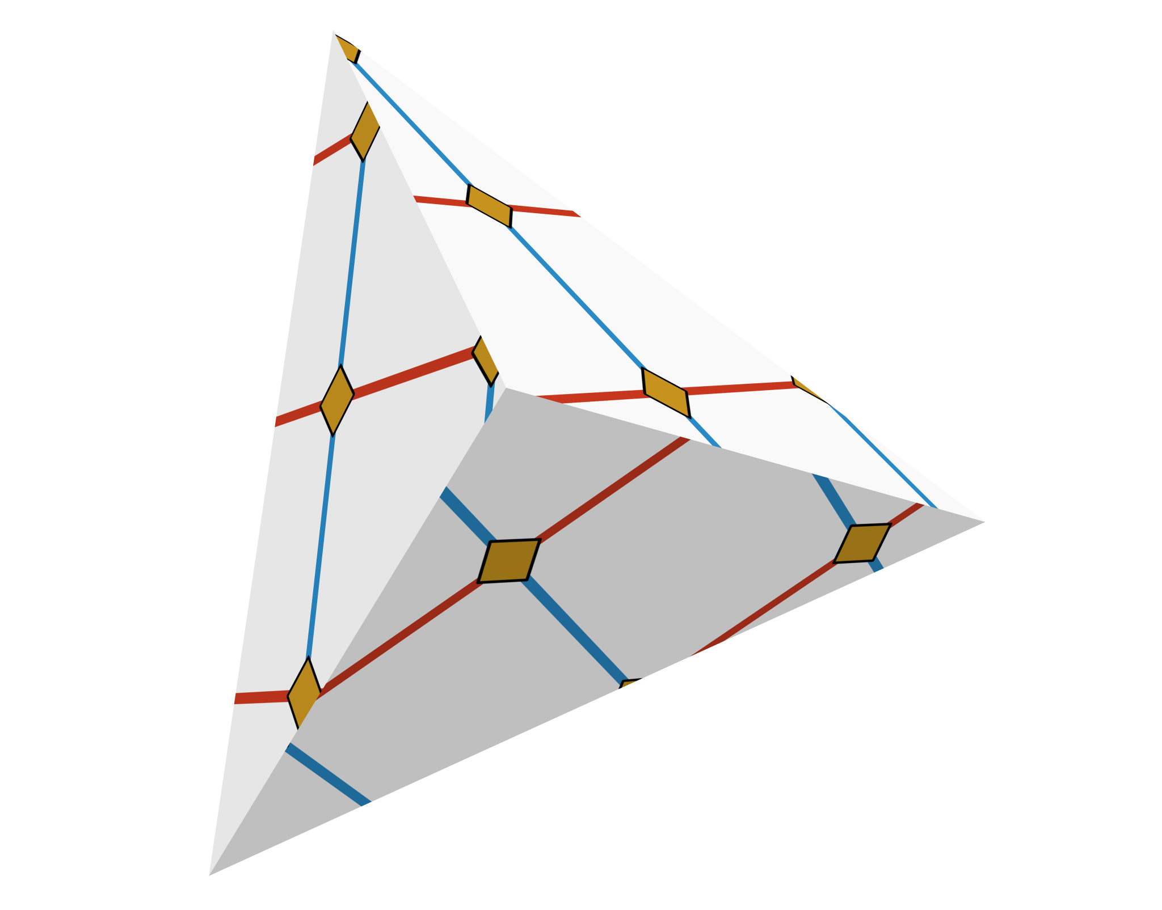
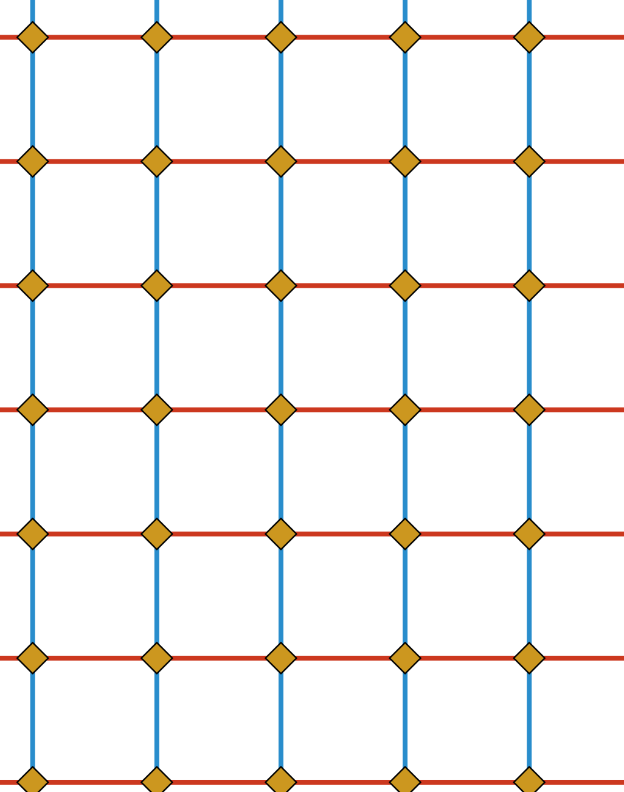
Local Conditions of IGM
f
f ⁻¹
Mesh Generation and Optimization Group | Prof. Dr. David Bommes

Slide 102
Local Conditions of IGM
Transition function per edge:
f
f ⁻¹
Mesh Generation and Optimization Group | Prof. Dr. David Bommes

Slide 103
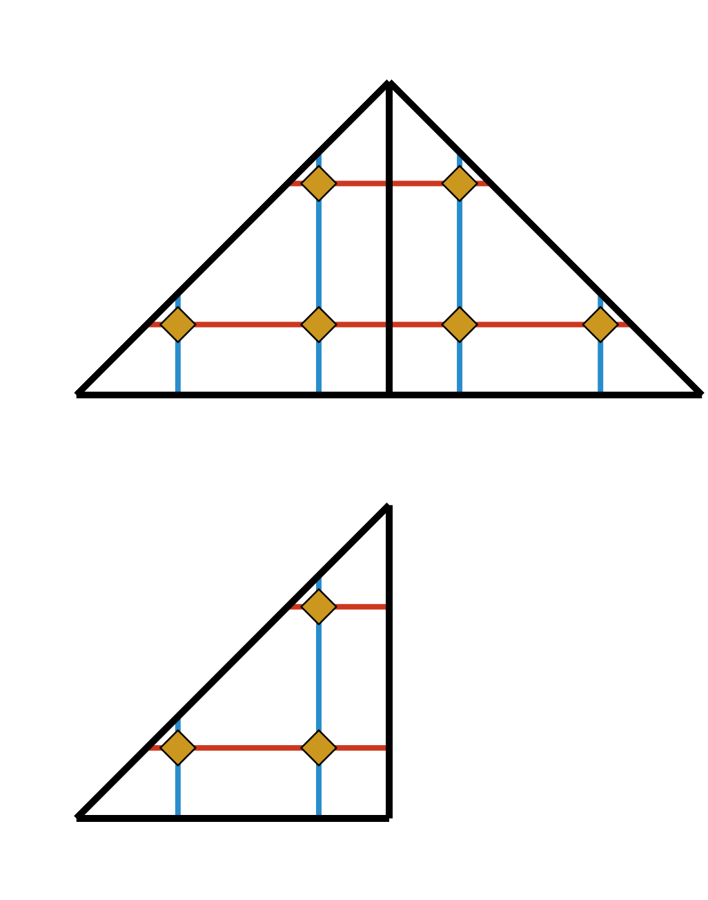
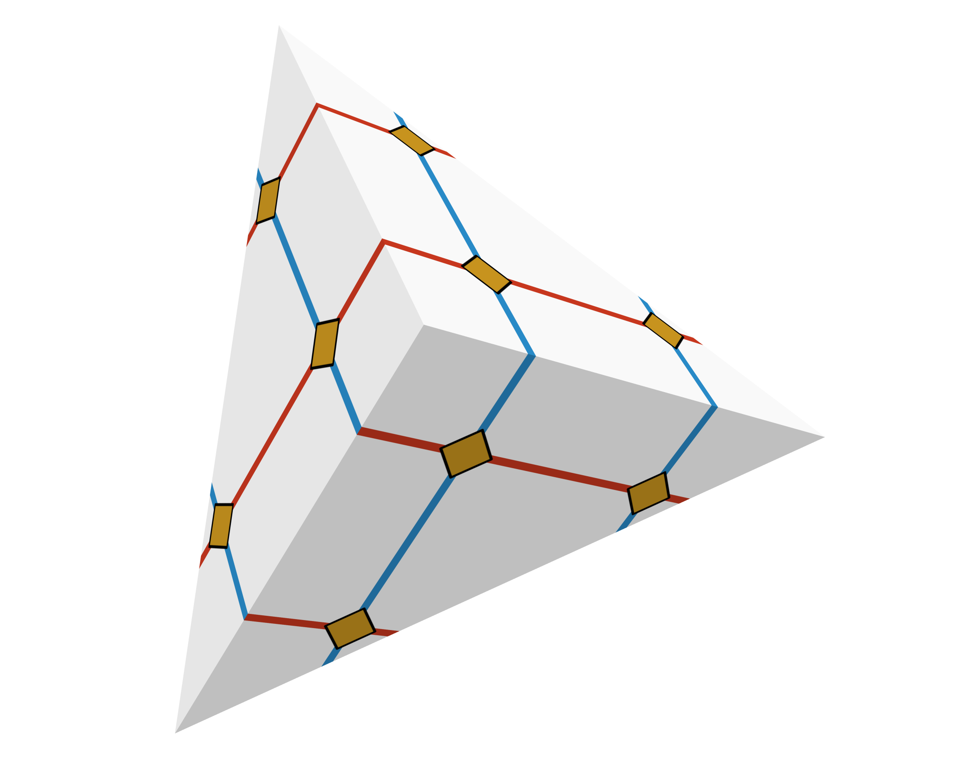
Local Conditions of IGM
Transition function per edge:
f
f ⁻¹
Mesh Generation and Optimization Group | Prof. Dr. David Bommes

Slide 104
Local Conditions of IGM
Transition function per edge:
f
f ⁻¹
Mesh Generation and Optimization Group | Prof. Dr. David Bommes

Slide 105

Local Conditions of IGM
Transition function per edge:
f
f ⁻¹
Mesh Generation and Optimization Group | Prof. Dr. David Bommes

Slide 106
Local Conditions of IGM
Transition function per edge:
f
f ⁻¹
Mesh Generation and Optimization Group | Prof. Dr. David Bommes

Slide 107
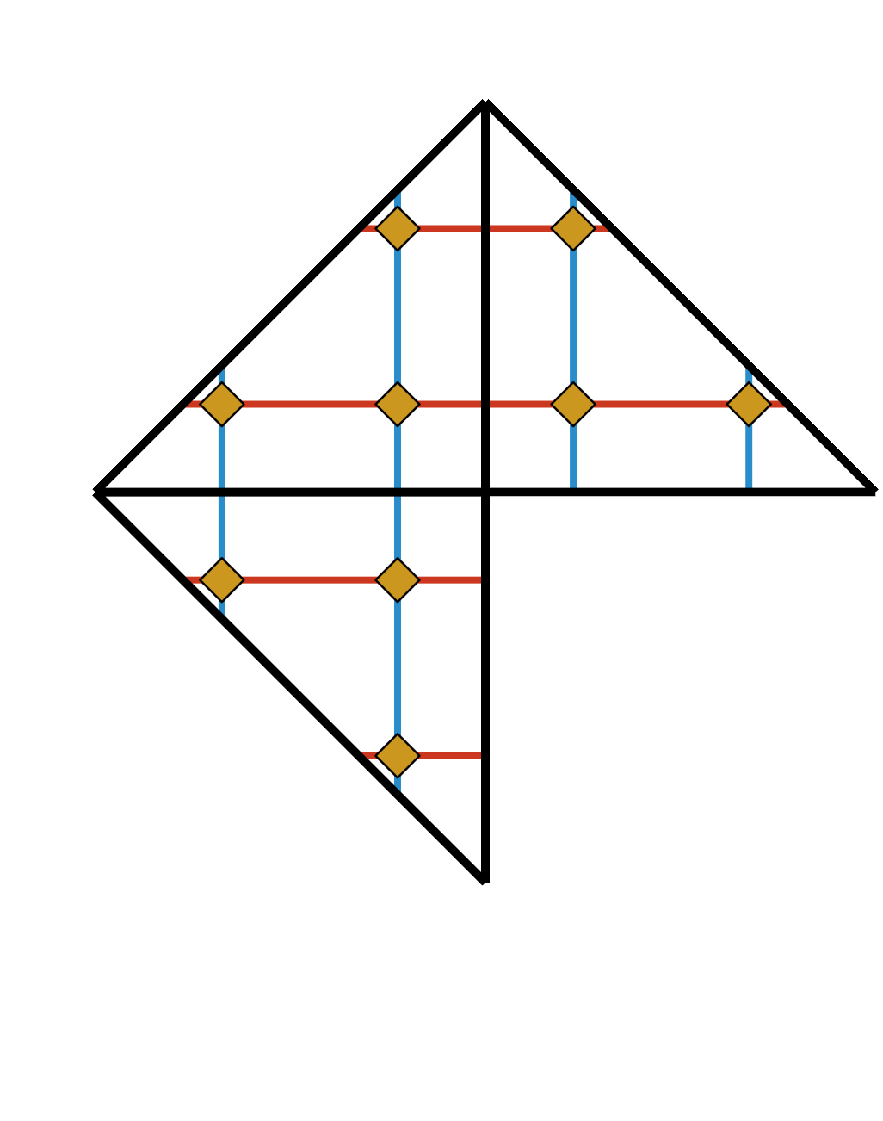
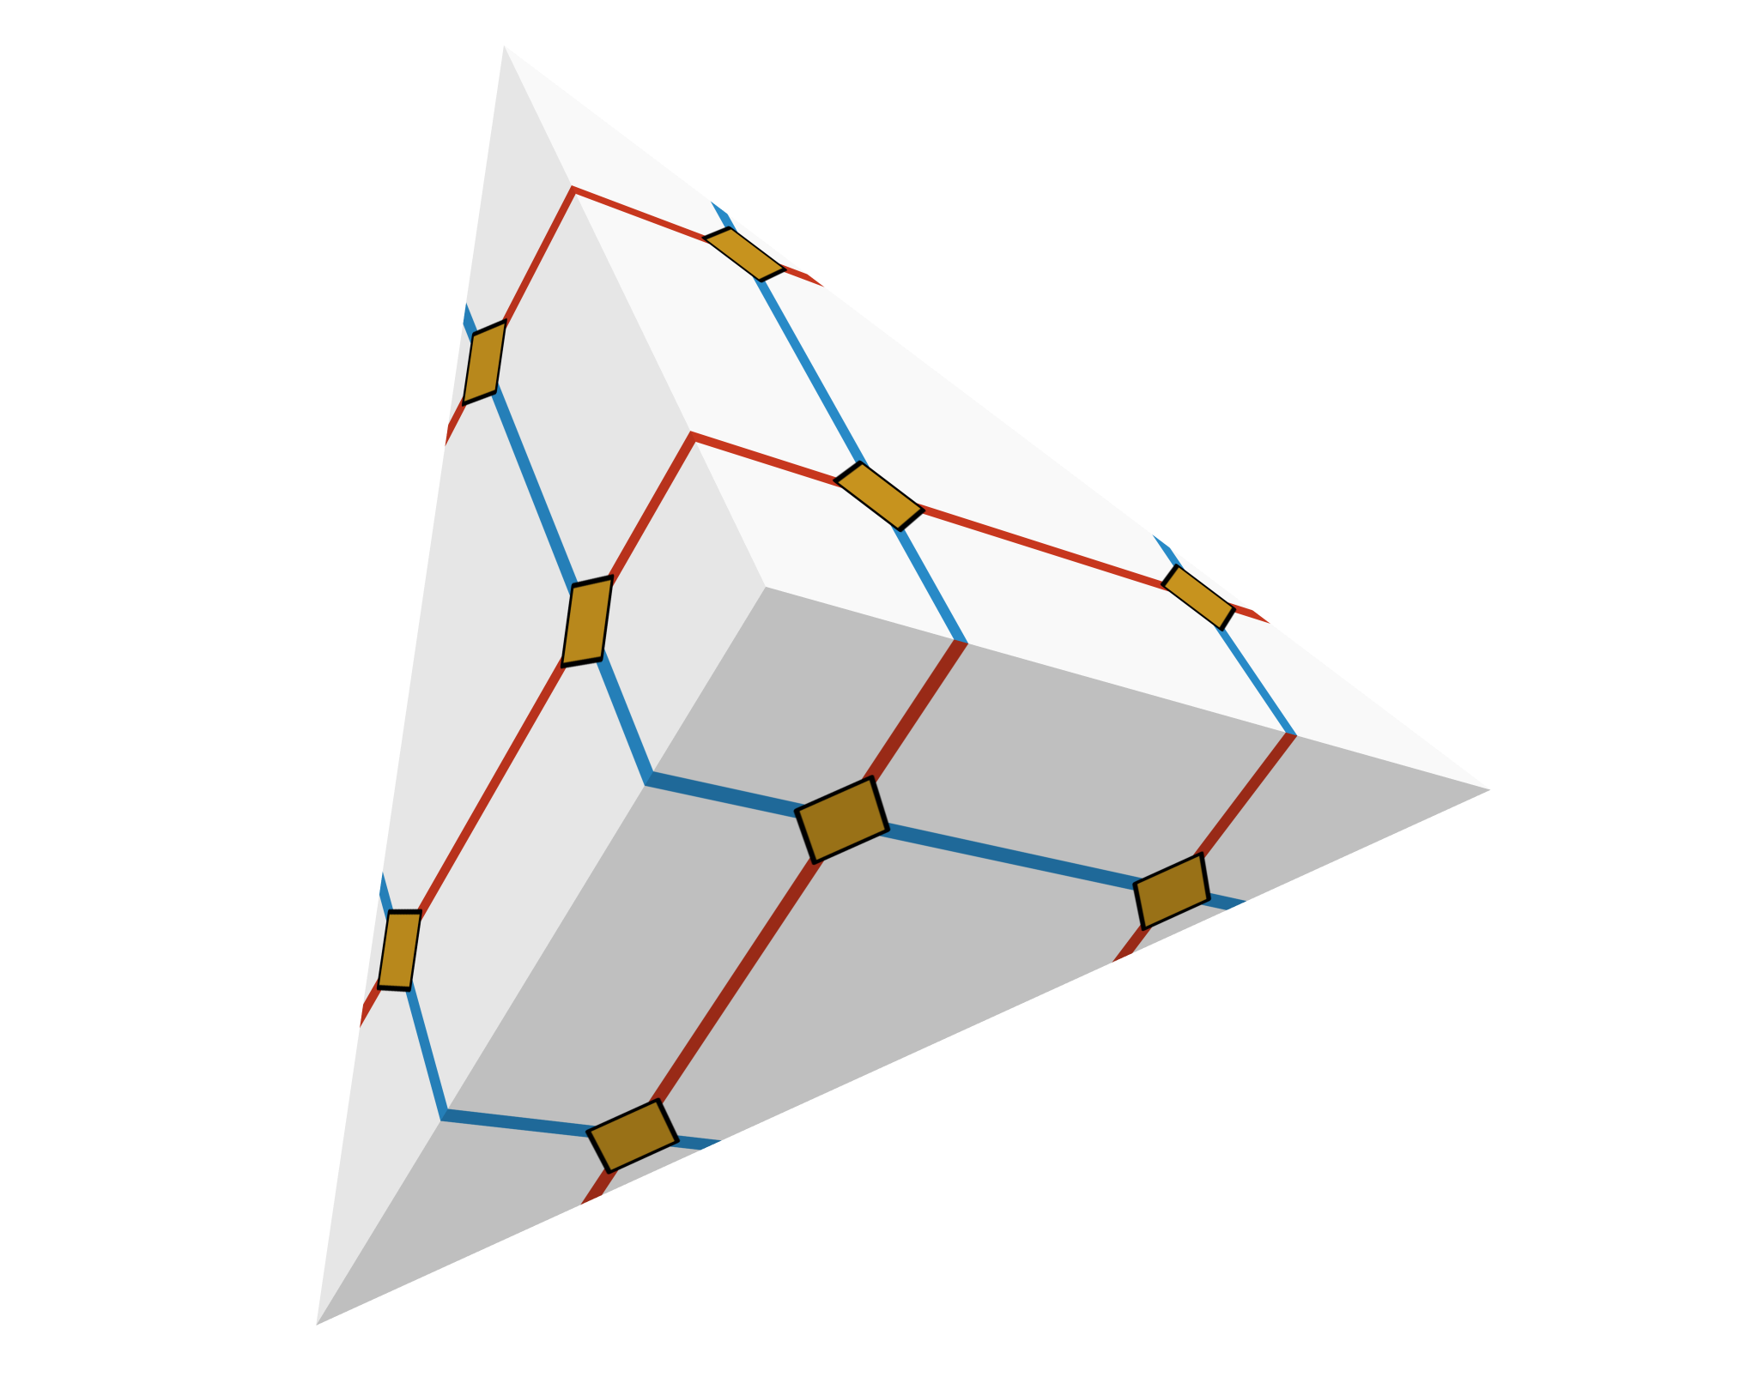
Local Conditions of IGM
Transition function per edge:
f
f ⁻¹
Mesh Generation and Optimization Group | Prof. Dr. David Bommes

Slide 108
Local Conditions of IGM
Transition function per edge:
f
f ⁻¹
Mesh Generation and Optimization Group | Prof. Dr. David Bommes

Slide 109
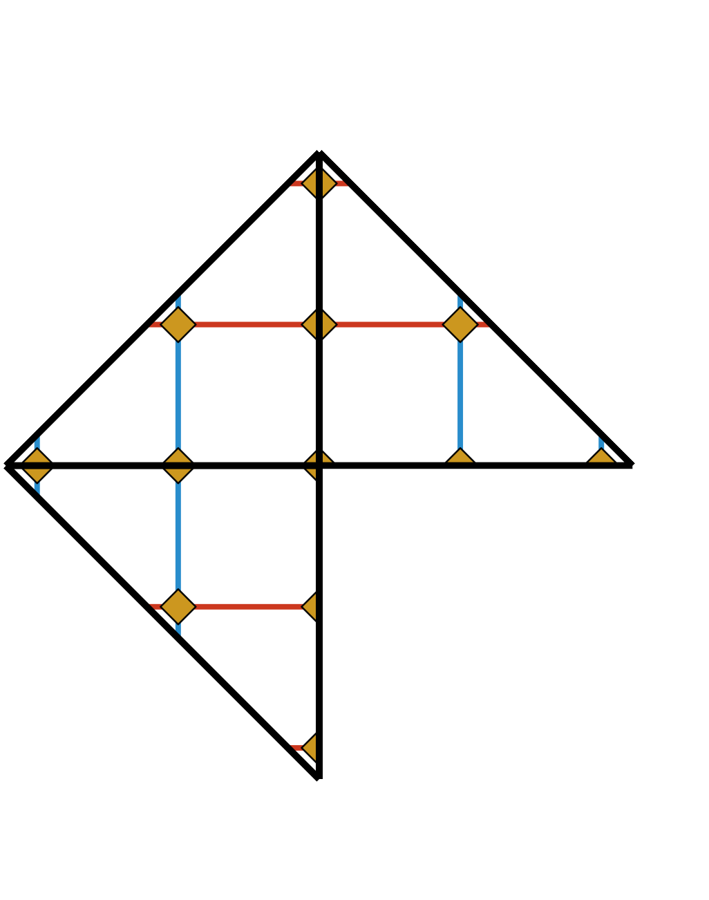
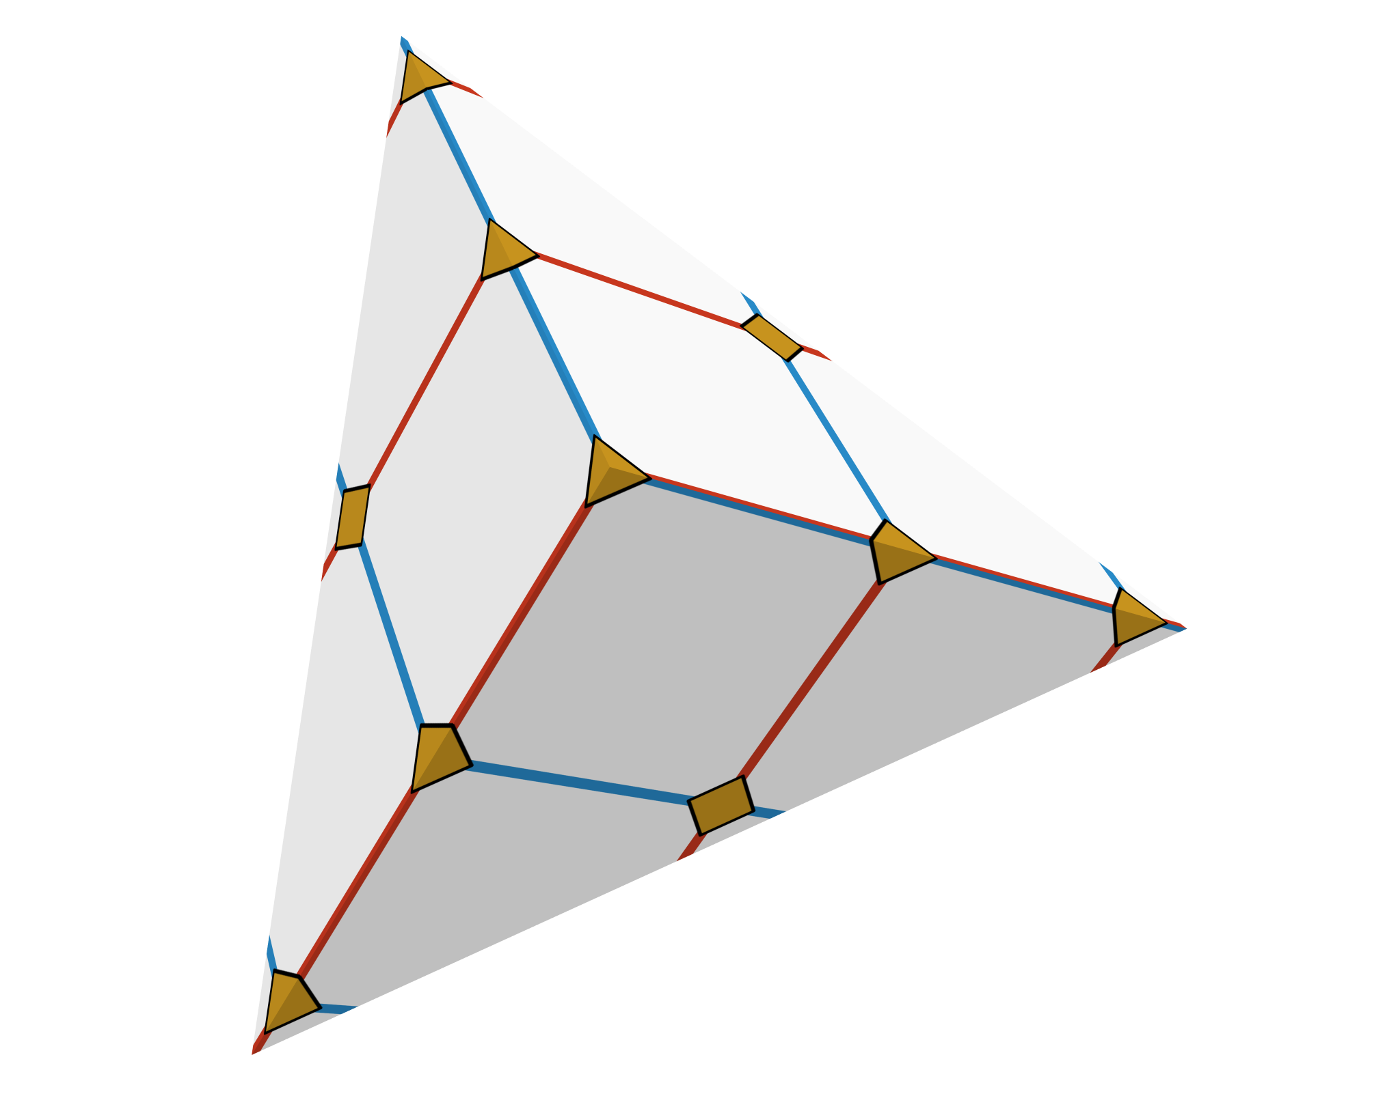
Local Conditions of IGM
Transition function per edge:
Singularities at integer positions:
f
f ⁻¹
Mesh Generation and Optimization Group | Prof. Dr. David Bommes

Slide 110
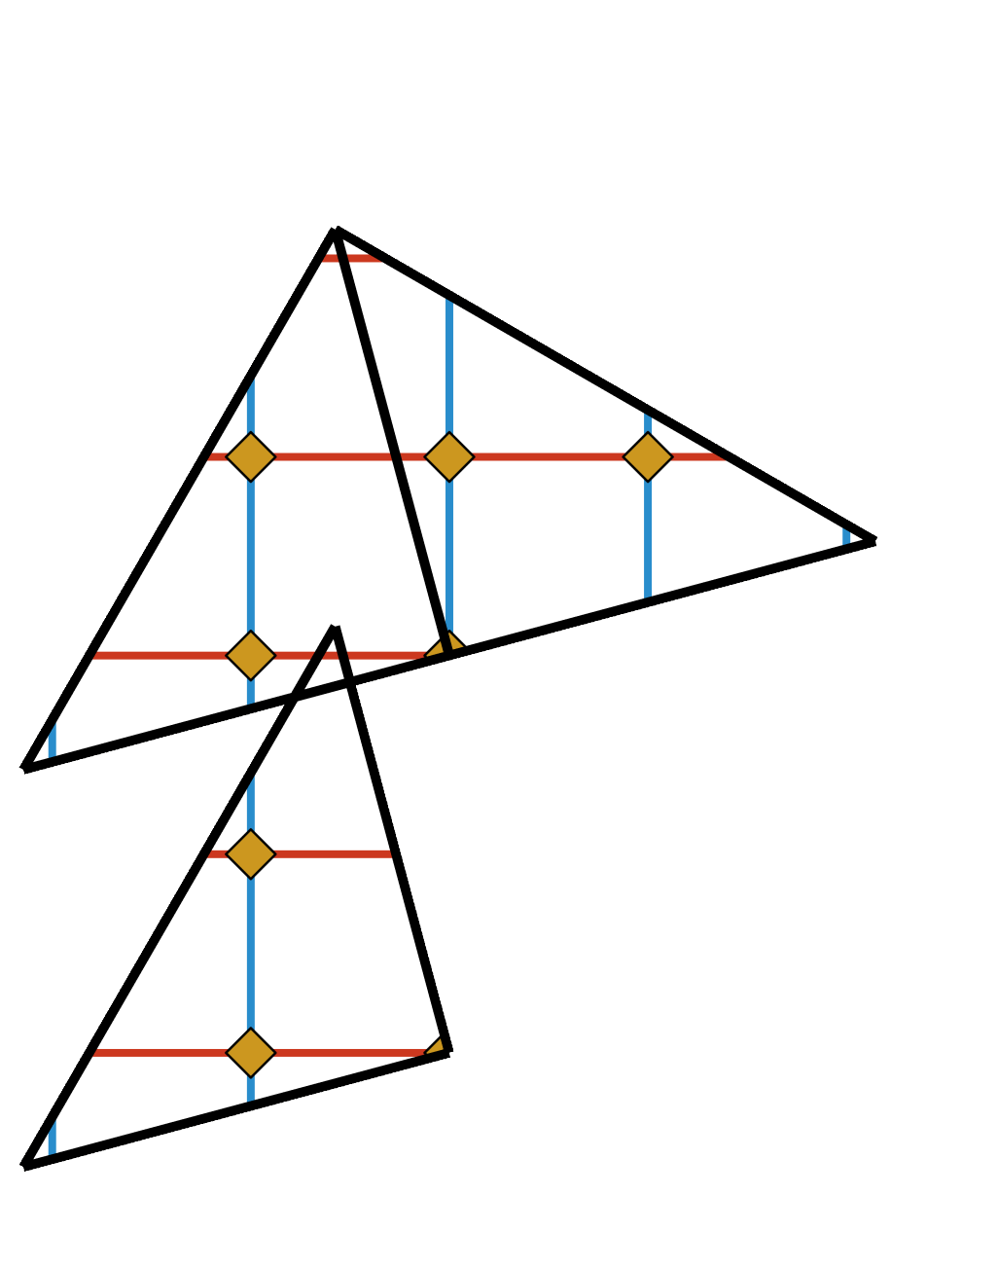
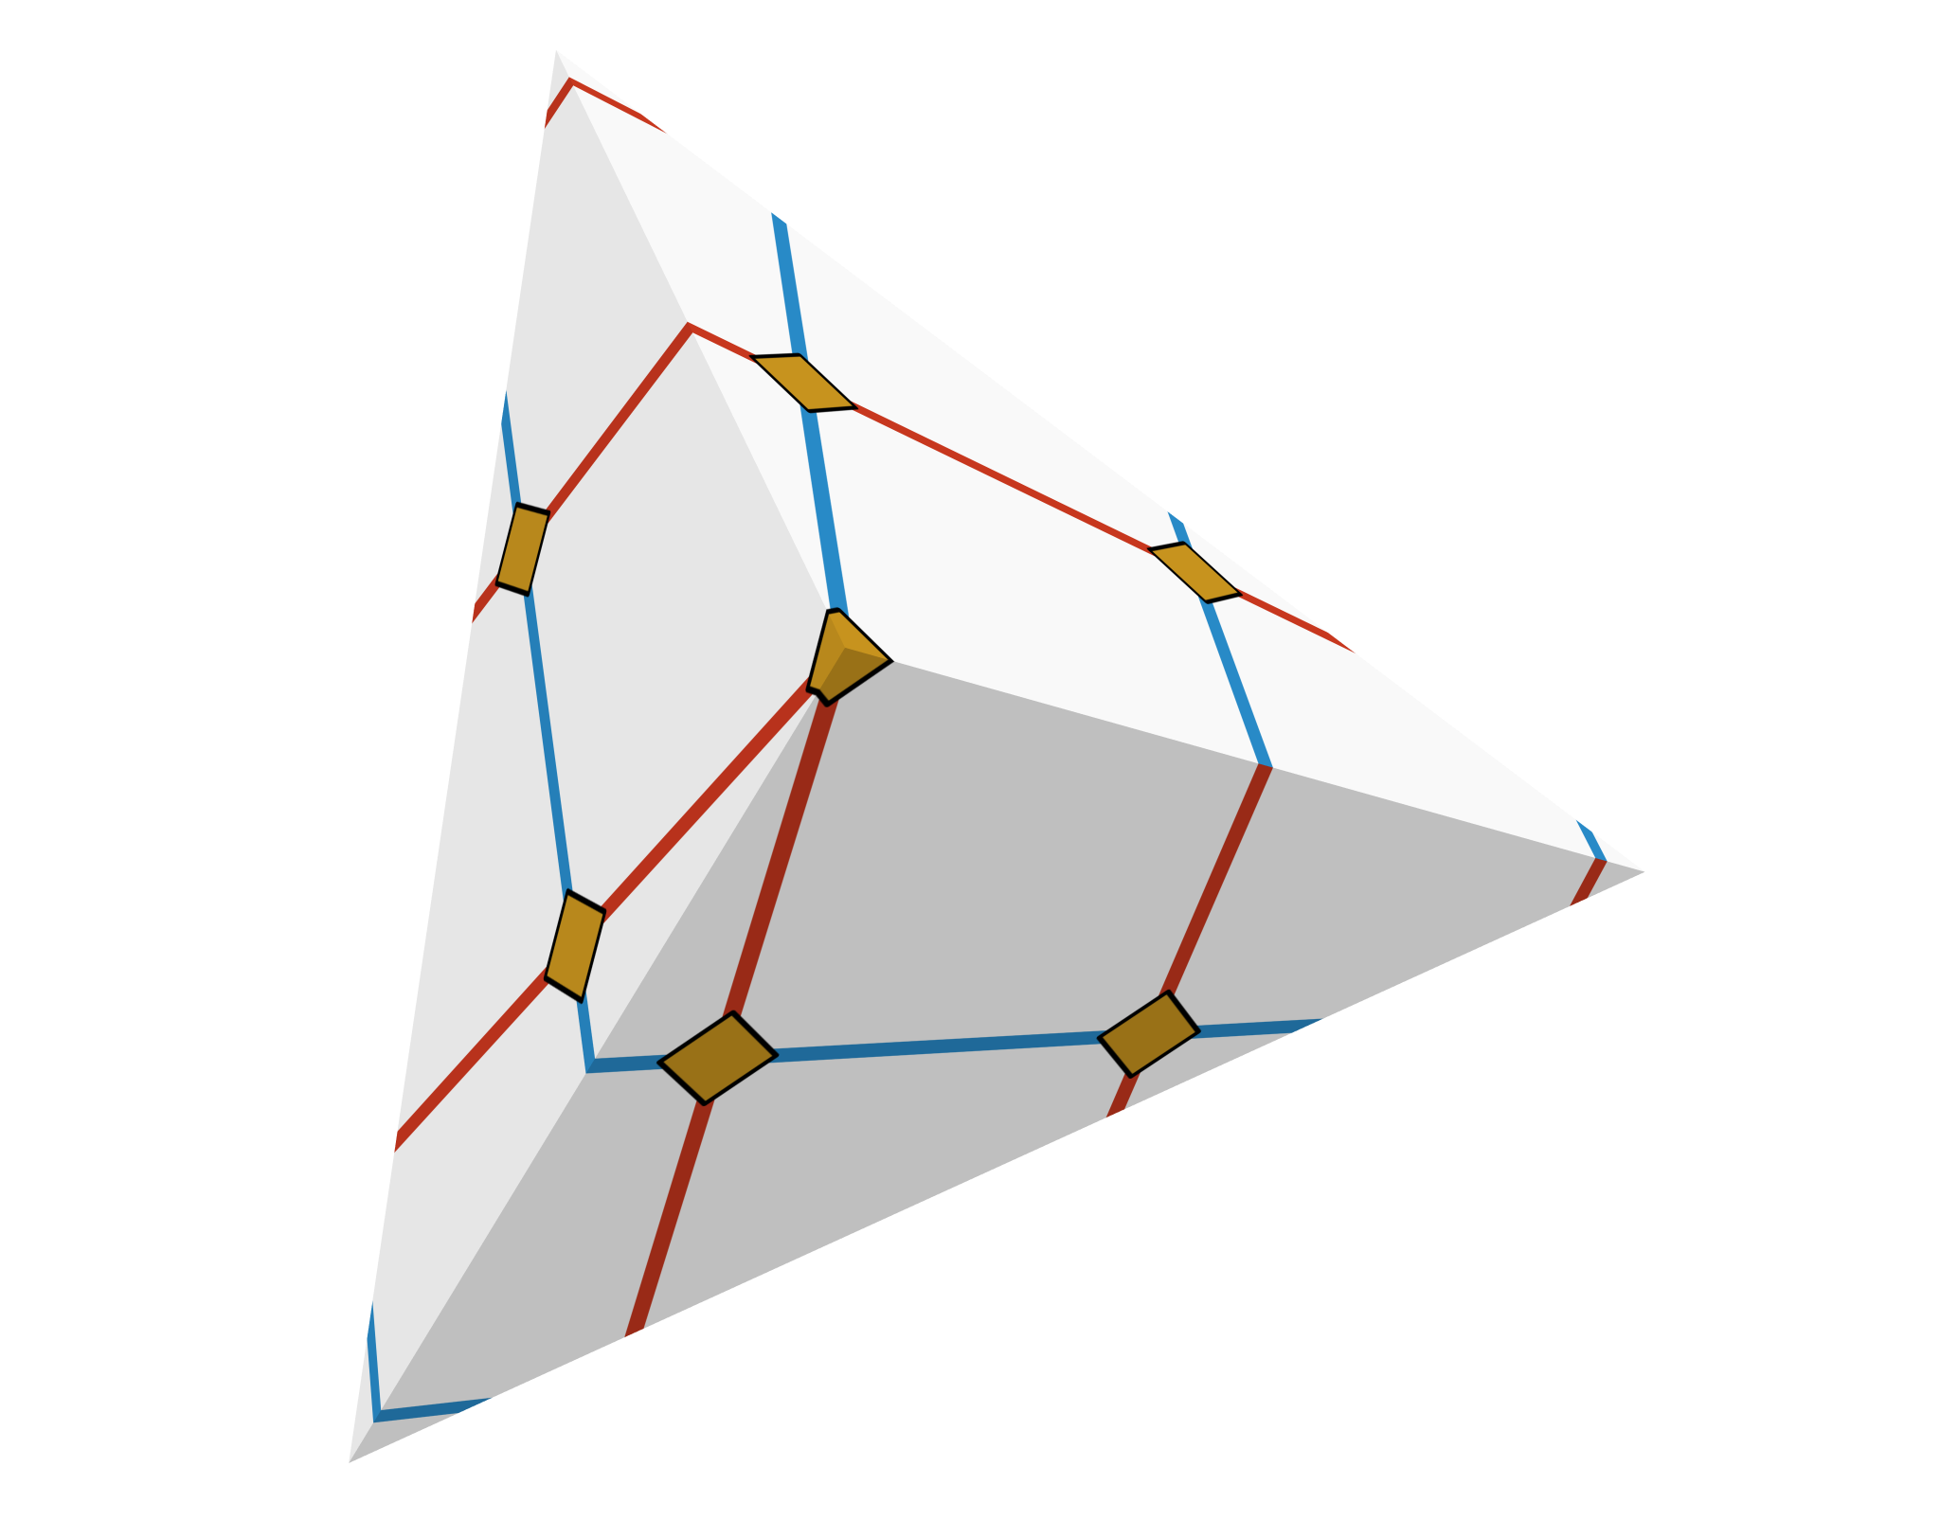
Local Conditions of IGM
Transition function per edge:
Singularities at integer positions:
f
f ⁻¹
Mesh Generation and Optimization Group | Prof. Dr. David Bommes

Slide 111
Local Conditions of IGM
Transition function per edge:
Singularities at integer positions:
f
f ⁻¹
Mesh Generation and Optimization Group | Prof. Dr. David Bommes

Slide 112
Local Conditions of IGM
Transition function per edge:
Singularities at integer positions:
f
f ⁻¹
Mesh Generation and Optimization Group | Prof. Dr. David Bommes

Slide 113
Local Conditions of IGM
Transition function per edge:
Singularities at integer positions:
f
f ⁻¹
Mesh Generation and Optimization Group | Prof. Dr. David Bommes

Slide 114
Local Conditions of IGM
Transition function per edge:
Singularities at integer positions:
f
f ⁻¹
Mesh Generation and Optimization Group | Prof. Dr. David Bommes

Slide 115
Local Conditions of IGM
Transition function per edge:
Singularities at integer positions:
f
f ⁻¹
Mesh Generation and Optimization Group | Prof. Dr. David Bommes

Slide 116
Local Conditions of IGM
Transition function per edge:
Singularities at integer positions:
f
f ⁻¹
Mesh Generation and Optimization Group | Prof. Dr. David Bommes

Slide 117
Local Conditions of IGM
Transition function per edge:
Singularities at integer positions:
f
f ⁻¹
Mesh Generation and Optimization Group | Prof. Dr. David Bommes

Slide 118
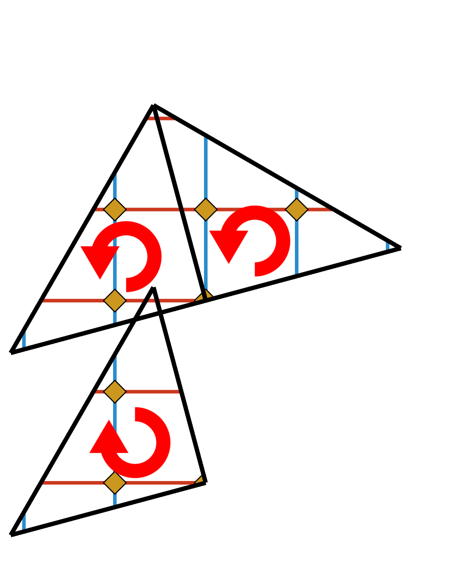
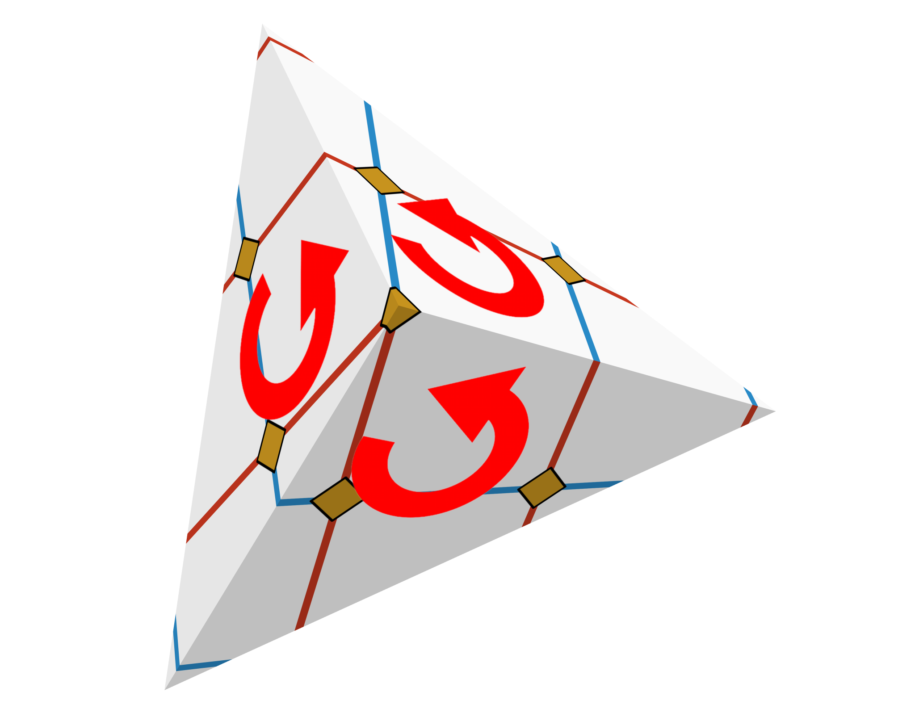
Local Conditions of IGM
Transition function per edge:
Singularities at integer positions:
f
f ⁻¹
Mesh Generation and Optimization Group | Prof. Dr. David Bommes

Slide 119
Local Conditions of IGM
Transition function per edge:
Singularities at integer positions:
Consistent orientation:
for all triangle images (u,v,w)
f
f ⁻¹
Mesh Generation and Optimization Group | Prof. Dr. David Bommes

Slide 120
Local Conditions of IGM
Transition function per edge:
Singularities at integer positions:
Consistent orientation:
for all triangle images (u,v,w)
non-linear + integer
f
f ⁻¹
non-linear + non-convex
Mesh Generation and Optimization Group | Prof. Dr. David Bommes

Slide 121
Efficient Search for Integer-Grid Maps

Slide 122
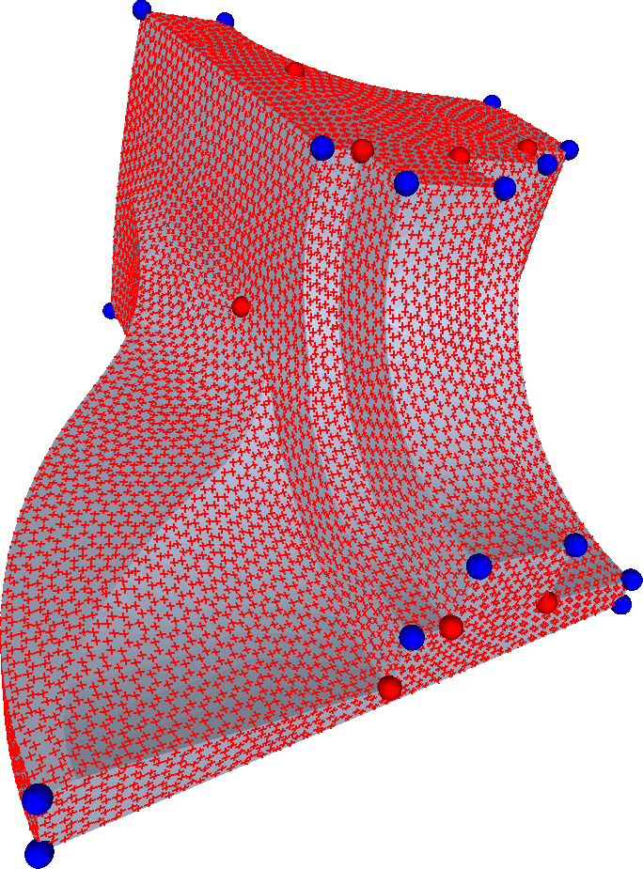
Splitting Approach
Smooth curvature
aligned cross field
(Approximation + Regularity)
Mesh Generation and Optimization Group | Prof. Dr. David Bommes

Slide 123
Splitting Approach
Smooth curvature
aligned cross field
(Approximation + Regularity)
Mesh Generation and Optimization Group | Prof. Dr. David Bommes

Slide 124
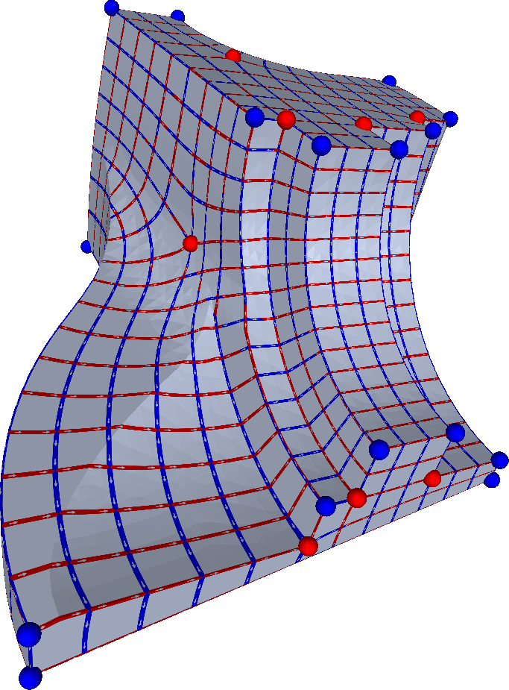
Splitting Approach
Smooth curvature
aligned cross field
(Approximation + Regularity)
IGM guided by
cross field
(Quad Consistency)
Mesh Generation and Optimization Group | Prof. Dr. David Bommes

Slide 125
Local Conditions of IGM
Transition function per edge:
Singularities at integer positions:
Consistent orientation:
for all triangle images (u,v,w)
non-linear + integer
cross field
non-linear + non-convex
Mesh Generation and Optimization Group | Prof. Dr. David Bommes

Slide 126

Local Conditions of IGM
Transition function per edge:
Singularities at integer positions:
Consistent orientation:
for all triangle images (u,v,w)
linear + integer
non-linear + integer
cross field
non-linear + non-convex
Mesh Generation and Optimization Group | Prof. Dr. David Bommes

Slide 127
Local Conditions of IGM
Transition function per edge:
Singularities at integer positions:
Consistent orientation:
for all triangle images (u,v,w)
linear + integer
non-linear + integer
cross field
known
non-linear + non-convex
Mesh Generation and Optimization Group | Prof. Dr. David Bommes

Slide 128
Local Conditions of IGM
Transition function per edge:
Singularities at integer positions:
Consistent orientation:
for all triangle images (u,v,w)
Integer-Grid Map
via
Mixed-Integer Quadratic Programming
linear + integer
non-linear + integer
cross field
known
SOCP or linear BD [Lipman 2012]
non-linear + non-convex
Mesh Generation and Optimization Group | Prof. Dr. David Bommes

Slide 129
Efficient Search for Integer-Grid Maps
Branch and cut successful if
  convex relaxation
  low-dimensional
  well-behaved relaxation
Mesh Generation and Optimization Group | Prof. Dr. David Bommes

Slide 130
Efficient Search for Integer-Grid Maps
Branch and cut successful if
  convex relaxation
  low-dimensional
  well-behaved relaxation
Mesh Generation and Optimization Group | Prof. Dr. David Bommes

Slide 131
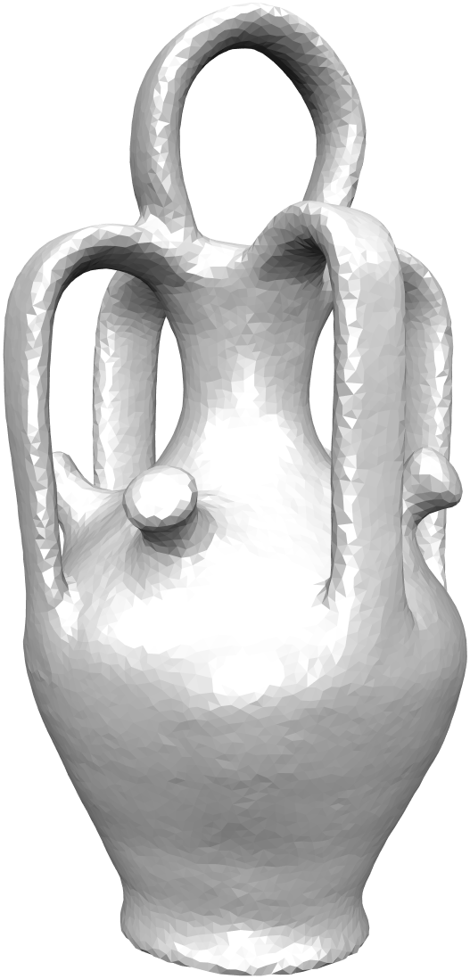
Efficient Search for Integer-Grid Maps
Branch and cut successful if
  convex relaxation
  low-dimensional
  well-behaved relaxation
…
…
…
…
…
…
Each node is instance of
Quadratic Programming!
30k triangles
Mesh Generation and Optimization Group | Prof. Dr. David Bommes

Slide 132
Efficient Search for Integer-Grid Maps
Branch and cut successful if
  convex relaxation
  low-dimensional
  well-behaved relaxation
…
…
…
…
cross field singularities
are sufficient for
discrete search space
…
…
Each node is instance of
Quadratic Programming!
30k triangles
Mesh Generation and Optimization Group | Prof. Dr. David Bommes

Slide 133
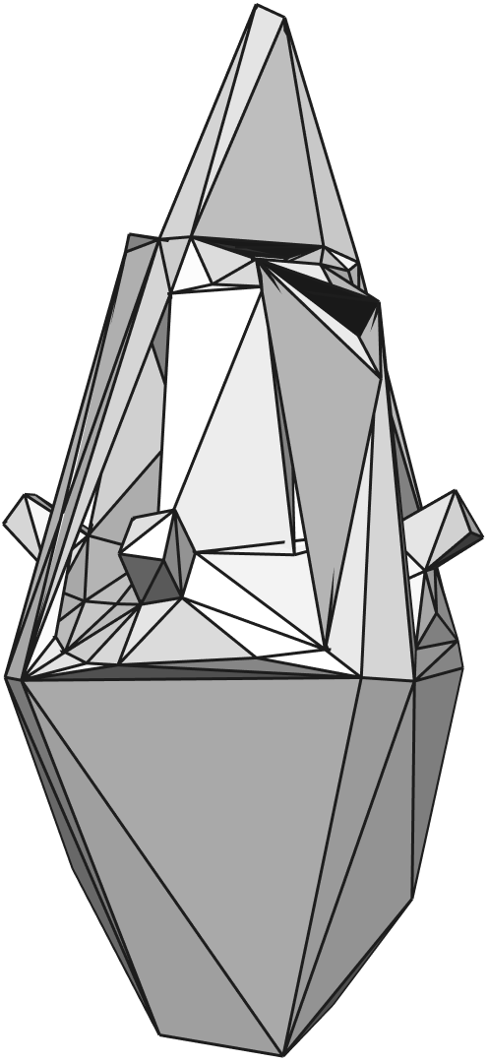
Efficient Search for Integer-Grid Maps
Branch and cut successful if
  convex relaxation
  low-dimensional
  well-behaved relaxation
cross field singularities
are sufficient for
discrete search space
30k triangles
Mesh Generation and Optimization Group | Prof. Dr. David Bommes

Slide 134
Efficient Search for Integer-Grid Maps
Branch and cut successful if
  convex relaxation
  low-dimensional
  well-behaved relaxation
cross field singularities
are sufficient for
discrete search space
30k triangles
Mesh Generation and Optimization Group | Prof. Dr. David Bommes

Slide 135
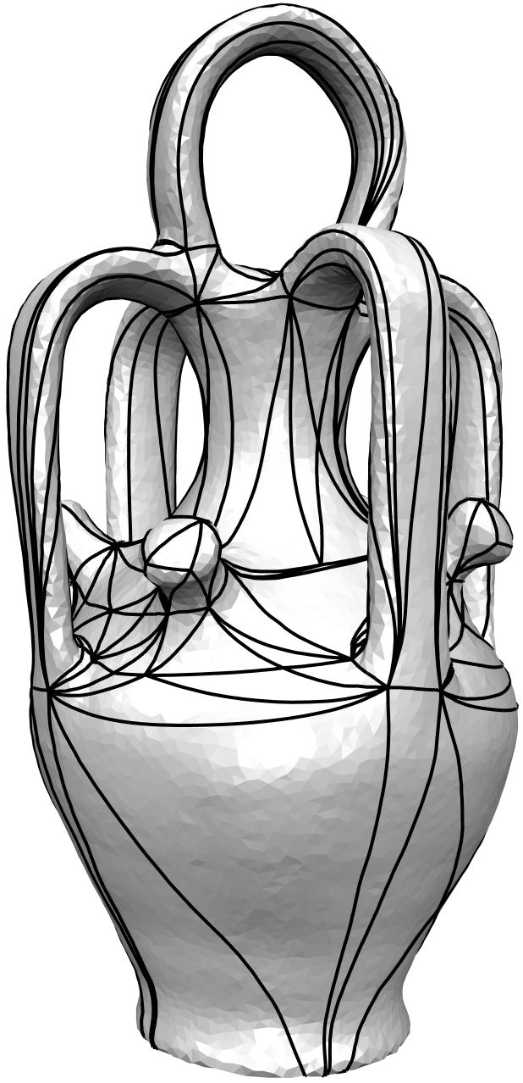
Efficient Search for Integer-Grid Maps
Branch and cut successful if
  convex relaxation
  low-dimensional
  well-behaved relaxation
cross field singularities
are sufficient for
discrete search space
30k triangles
226 triangles
Mesh Generation and Optimization Group | Prof. Dr. David Bommes

Slide 136
Efficient Search for Integer-Grid Maps
Branch and cut successful if
  convex relaxation
  low-dimensional
  well-behaved relaxation
cross field singularities
are sufficient for
discrete search space
30k triangles
226 triangles
Mesh Generation and Optimization Group | Prof. Dr. David Bommes

Slide 137
Efficient Search for Integer-Grid Maps
Branch and cut successful if
  convex relaxation
  low-dimensional
  well-behaved relaxation
Mesh Generation and Optimization Group | Prof. Dr. David Bommes

Slide 138
Efficient Search for Integer-Grid Maps
Branch and cut successful if
  convex relaxation
  low-dimensional
  well-behaved relaxation
Mixed-Integer minimizer :
Minimizer of relaxation:
small
Mesh Generation and Optimization Group | Prof. Dr. David Bommes
Notes:
What this means is that the integer-estimates we get from the continuous relaxation are good or in other words the estimation error is small

Slide 139
Efficient Search for Integer-Grid Maps
Branch and cut successful if
  convex relaxation
  low-dimensional
  well-behaved relaxation
Mixed-Integer minimizer :
Minimizer of relaxation:
small
Recall that singularities get mapped to integer positions!
Mesh Generation and Optimization Group | Prof. Dr. David Bommes

Slide 140
Efficient Search for Integer-Grid Maps
Branch and cut successful if
  convex relaxation
  low-dimensional
  well-behaved relaxation
Mesh Generation and Optimization Group | Prof. Dr. David Bommes

Slide 141
Efficient Search for Integer-Grid Maps
Branch and cut successful if
  convex relaxation
  low-dimensional
  well-behaved relaxation
Mesh Generation and Optimization Group | Prof. Dr. David Bommes

Slide 142
Efficient Search for Integer-Grid Maps
Branch and cut successful if
  convex relaxation
  low-dimensional
  well-behaved relaxation
  start with initial relaxation
  add spacer constraint if
  geodesic distance between
  two singularities is less than 1
Mesh Generation and Optimization Group | Prof. Dr. David Bommes

Slide 143
Efficient Search for Integer-Grid Maps
Branch and cut successful if
  convex relaxation
  low-dimensional
  well-behaved relaxation
  start with initial relaxation
  add spacer constraint if
  geodesic distance between
  two singularities is less than 1
Mesh Generation and Optimization Group | Prof. Dr. David Bommes

Slide 144
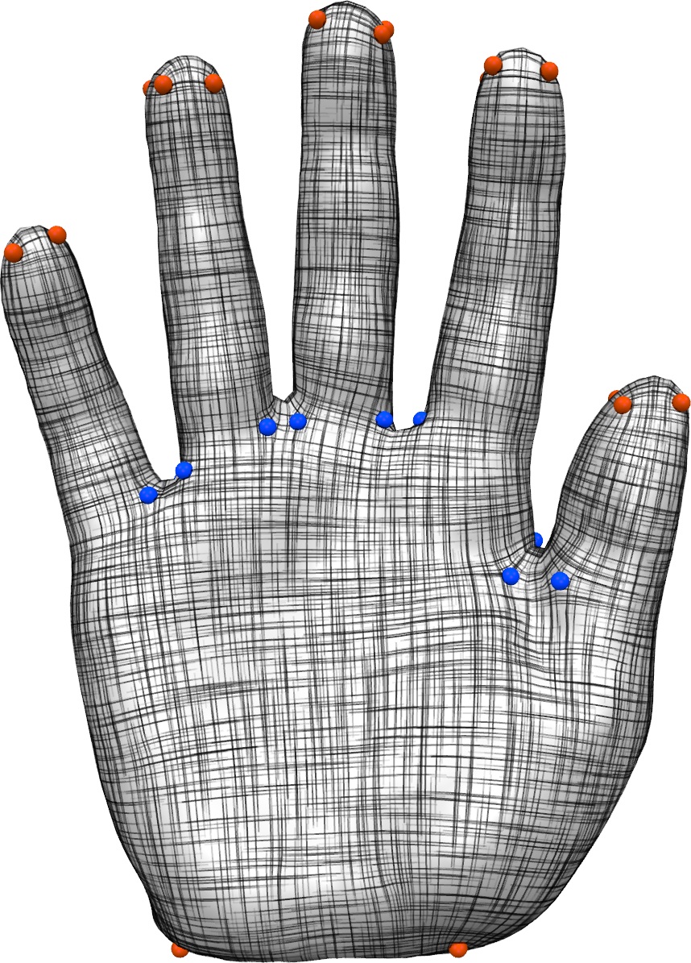
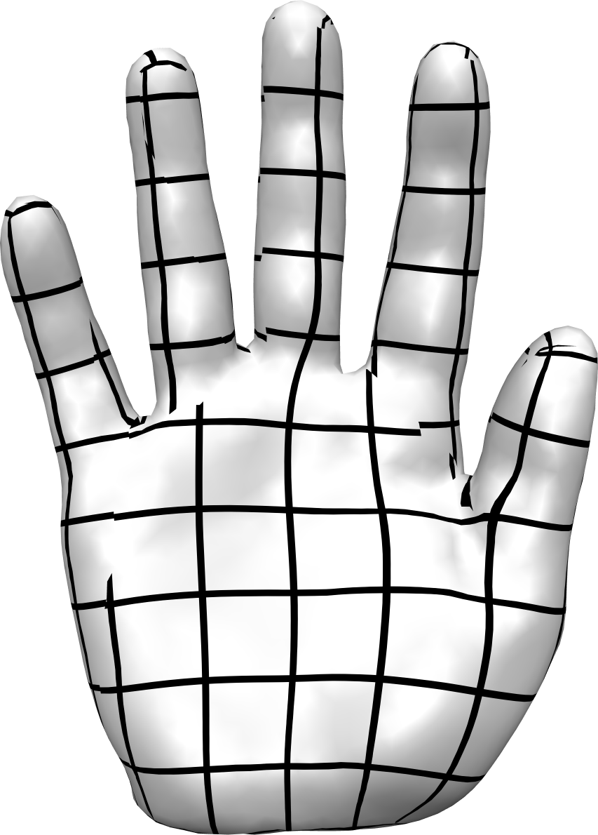
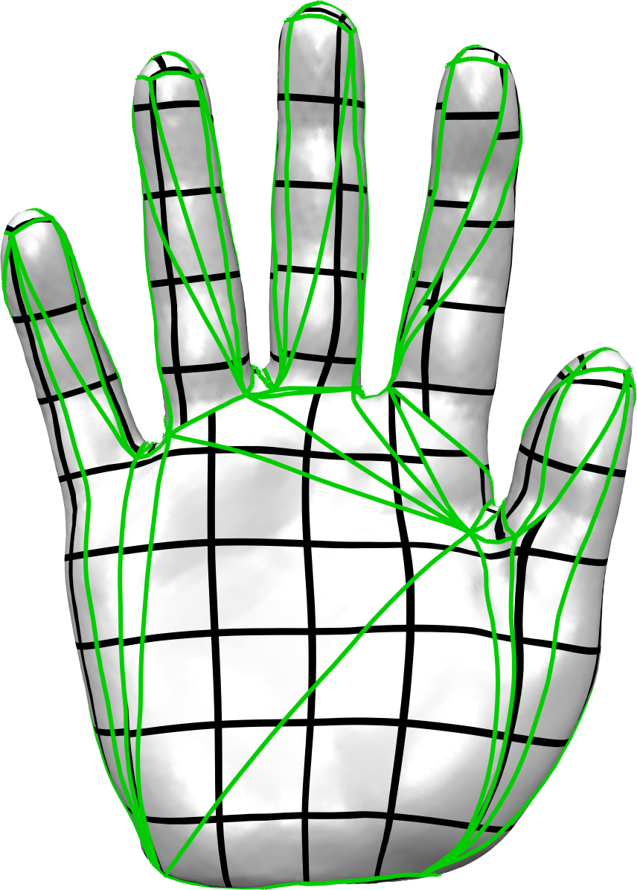
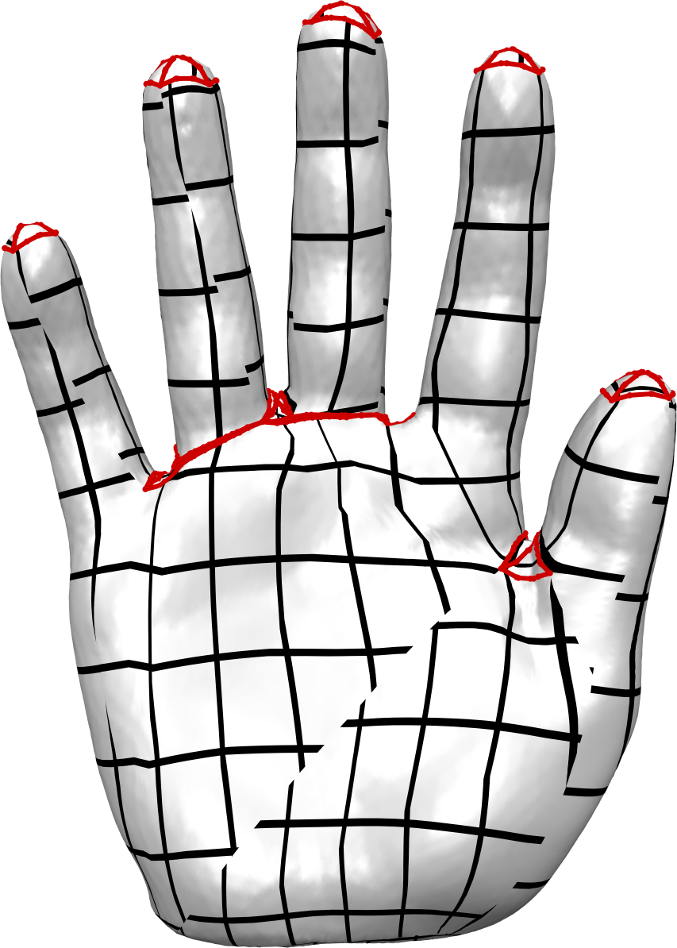
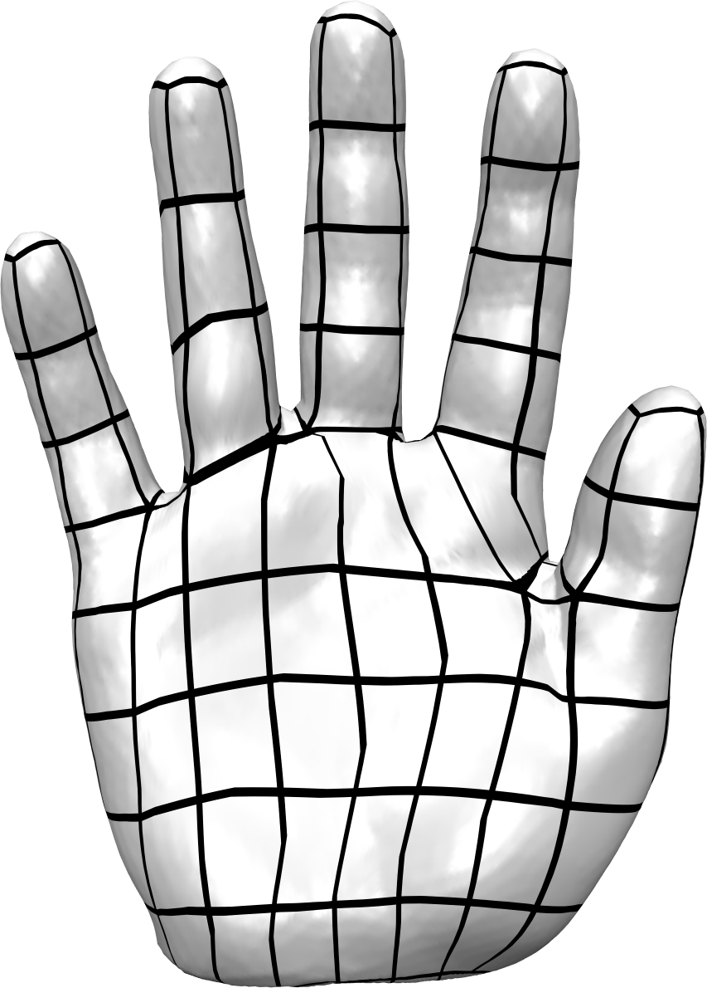
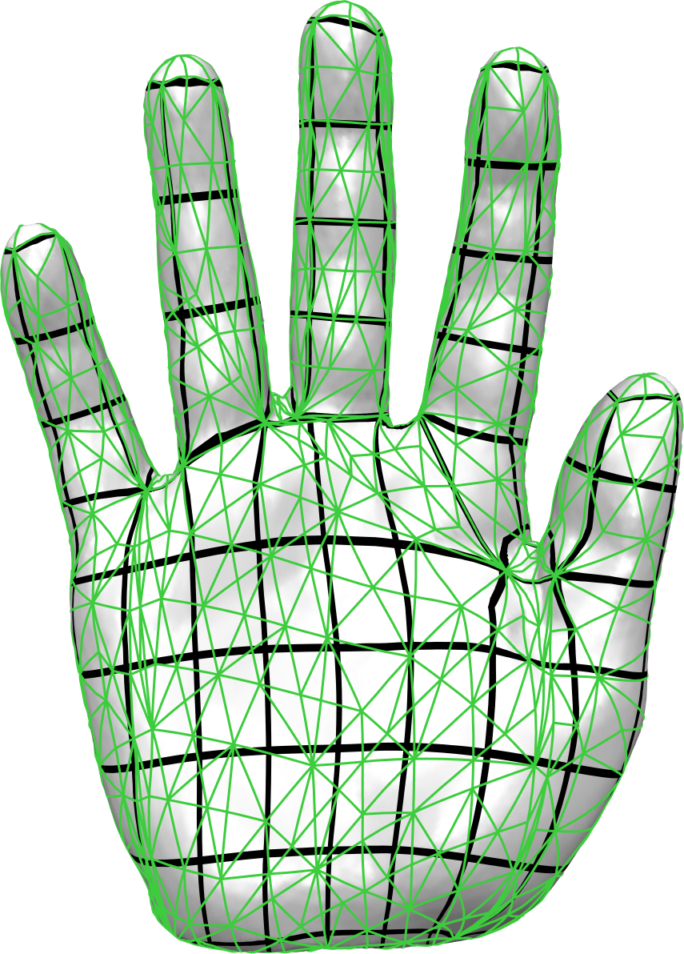

Algorithm Overview
Mesh Generation and Optimization Group | Prof. Dr. David Bommes

Slide 145




Results
200k triangles
= 4 minutes
Mesh Generation and Optimization Group | Prof. Dr. David Bommes

Slide 146





Quad Layouts
Mesh Generation and Optimization Group | Prof. Dr. David Bommes

Slide 147
Summary
Omnipresence of Optimization in Geometry Processing
Unconstrained Optimization
Equality Constrained Optimization
Inequality Constrained Optimization
Mixed-Integer Optimization
Importance of Convexity
Mesh Generation and Optimization Group | Prof. Dr. David Bommes

Slide 148



Outlook
Further Reading
S. Boyd and L. Vandenberghe
Convex Optimization
Cambridge University Press, 2004.
J. Nocedal and S. J. Wright
Numerical Optimization
Springer, 2006.
G. L. Nemhauser and L. A. Wolsey
Integer and Combinatorial Optimization
John Wiley & Sons, 1999.
Get PDF online:
http://stanford.edu/~boyd/cvxbook/
Mesh Generation and Optimization Group | Prof. Dr. David Bommes

Slide 149
Software
Eigen — linear algebra
IPOPT — fast opensource C++ interior point method
Mosek — commercial (convex) optimization in C, Java, Python…
Gurobi — commercial mixed-integer optimization
CPLEX — commercial mixed-integer optimization
Matlab — many algorithms, good for prototyping
CVX — prototyping for convex optimization
CoMISo — unified interface to above algorithms
Mesh Generation and Optimization Group | Prof. Dr. David Bommes

Slide 150
Thank You!

