Slide 1
Variational Time Integrators
Symposium on Geometry Processing Course 2015
Andrew Sageman-Furnas
University of Göttingen

Slide 2

Time Integrator
Differential equations in time describe physical paths
Solve for these paths on the computer
Non-damped, Non-Driven Pendulum

Slide 3
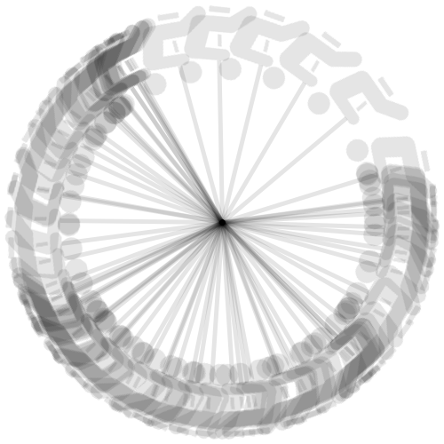
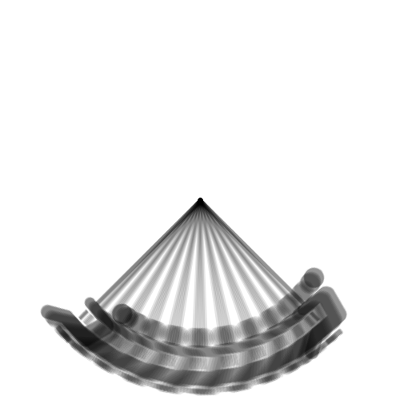
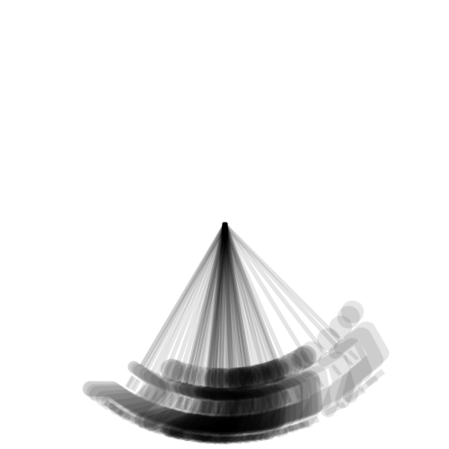
Methods of Time Integration
Non-damped, Non-Driven Pendulum
Explicit
Variational
Implicit
“artificial driving”
“reasonable”
“artificial damping”

Slide 4
Part One:
Reinterpreting Newtonian Mechanics
(what does “variational” mean?)
Part Two:
Why Use Variational Integrators?

Slide 5
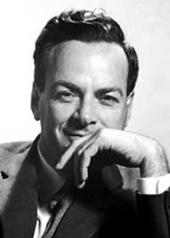
A Butchering of Feynman’s Lecture
http://www.nobelprize.org/nobel_prizes/physics/laureates/1965/feynman-bio.html
Principle of Least Action
(Feynman Lectures on Physics Volume II.19)

Slide 6

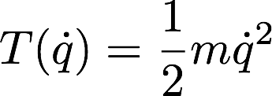


Newtonian Mechanics
Closed mechanical system
Kinetic energy
Potential energy
Total energy

Slide 7


Newtonian Mechanics
A physical path satisfies the vector equation
Worked out using force balancing
Difficult to compute with Cartesian coordinates

Slide 8
Lagrangian Reformulation
Goal:
Derive Newton’s equations from a scalar equation
Why?
  Works in every choice of coordinates
  Highlights variational structure of mechanics
  Energy is easy to write down

Slide 9

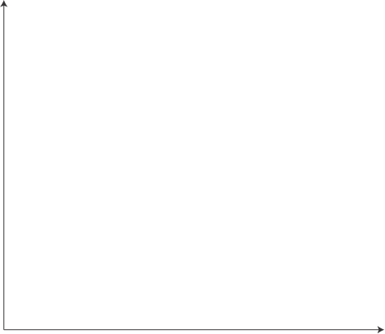


Particle in a Gravitational Field
B
A
“Throw a ball in the air from ( , A) catch at ( , B)”

Slide 10
Particle in a Gravitational Field
B
A
What path does the ball take to get from A to B in a given amount of time?

Slide 11
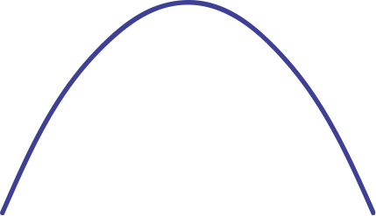

Particle in a Gravitational Field
B
A
Physical path is unique and a parabola

Slide 12
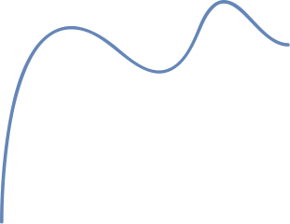

Particle in a Gravitational Field
B
A
...but there are many possible paths

Slide 13
Particle in a Gravitational Field
B
A
How are physical paths special among all paths from A to B?

Slide 14
Hamilton’s Principle of Stationary Action
Physical paths are extremal amongst all paths from A to B of a time integral called the action.

Slide 15
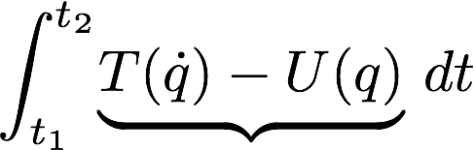


Hamilton’s Principle of Stationary Action
Physical paths are extrema of a time integral called the action
Lagrangian
(Lagrangian is not the total energy
)

Slide 16
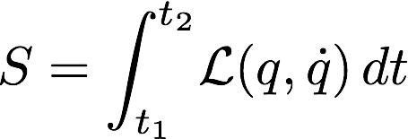

Hamilton’s Principle of Stationary Action
Physical paths extremize the action
...but how we find an extremal path in the space of all paths?
Use Lagrange’s variational calculus

Slide 17



Finding an Extremal Path
1. Action of path
2. Differentiate action
3. Study when
Analogous to regular calculus

Slide 18

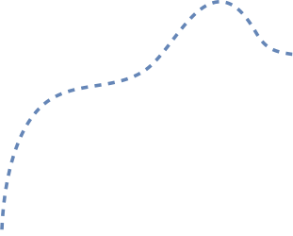



Defining the Variation of an Action
Arbitrary smooth offset
Perturbed curve
Curves share endpoints

Slide 19

Defining the Variation of an Action
First Variation of the Action (in direction eta)
Reduce to single variable calculus!

Slide 20
Defining the Variation of an Action
First Variation of the Action (in direction eta)
Differentiating a given path with respect to all smooth variations reduces to single variable calculus.
Reduce to single variable calculus!

Slide 21

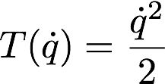
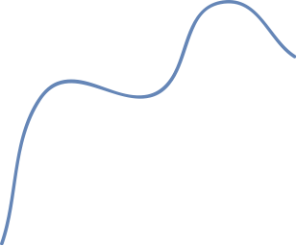
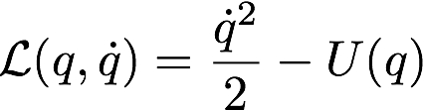
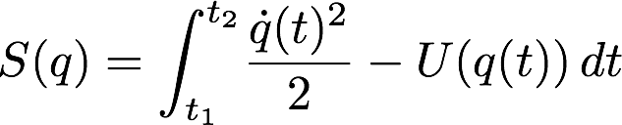
Particle Example: Setup

Slide 22
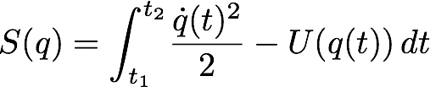

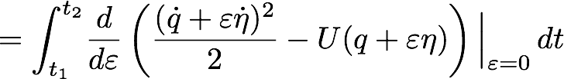
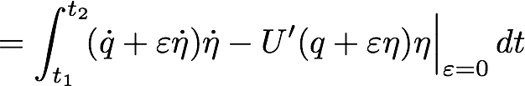
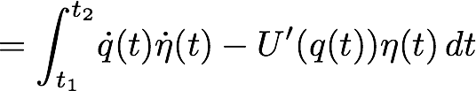
Particle Example: Investigating the Variation

Slide 23
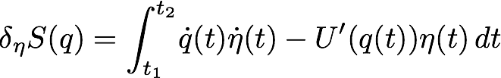
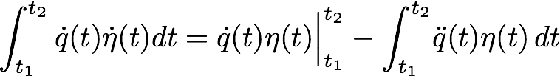
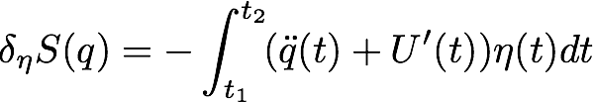
Variational Trick: Essential Integration by Parts
get rid of derivates of the offset
recall offset vanishes at endpoints

Slide 24
Variational Trick: Essential Integration by Parts
Integrate by parts to get rid of the derivatives of the smooth offset.
This requires the offset to vanish at the boundary.

Slide 25
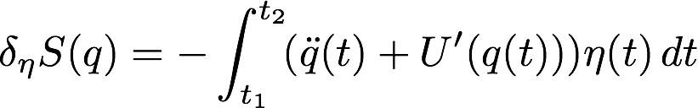


Particle Example: Investigating the Variation
When is
for all offsets

Slide 26

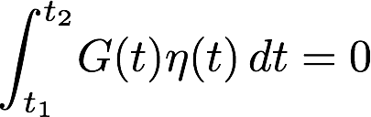
Fundamental Lemma of Variational Calculus
For a continuous function
if
for all smooth functions
with
,
then
vanishes everywhere in the interval.
...believable, but why?

Slide 27

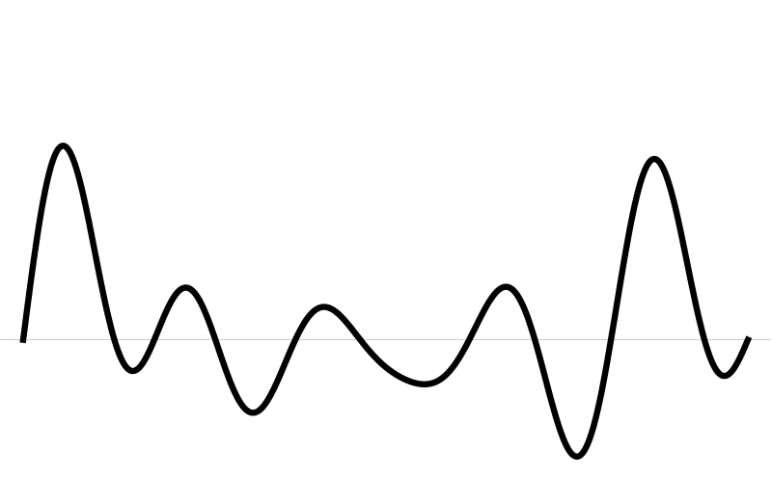
Fundamental Lemma of Variational Calculus
If
for all offsets
zero at
then
vanishes on the interval.
Assume

Slide 28
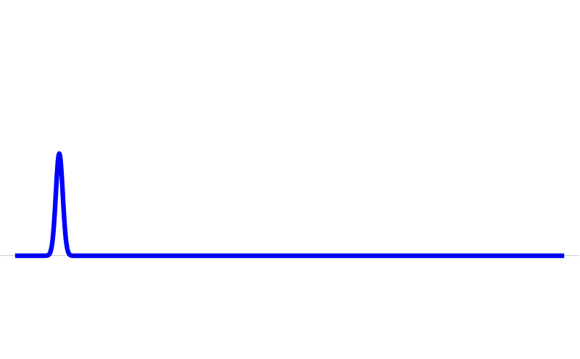
Fundamental Lemma of Variational Calculus
If
for all offsets
zero at
then
vanishes on the interval.

Slide 29
Fundamental Lemma of Variational Calculus
If
for all offsets
zero at
then
vanishes on the interval.

Slide 30
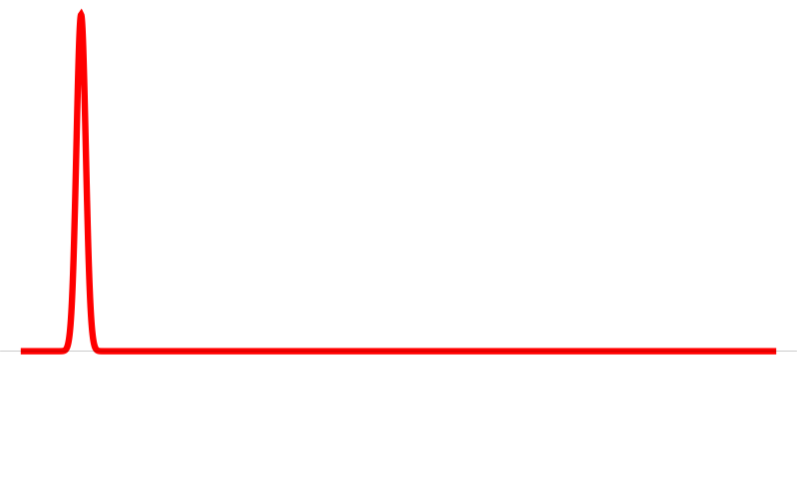

Fundamental Lemma of Variational Calculus
If
for all offsets
zero at
then
vanishes on the interval.

Slide 31
Fundamental Lemma of Variational Calculus
If
for all offsets
zero at
then
vanishes on the interval.

Slide 32
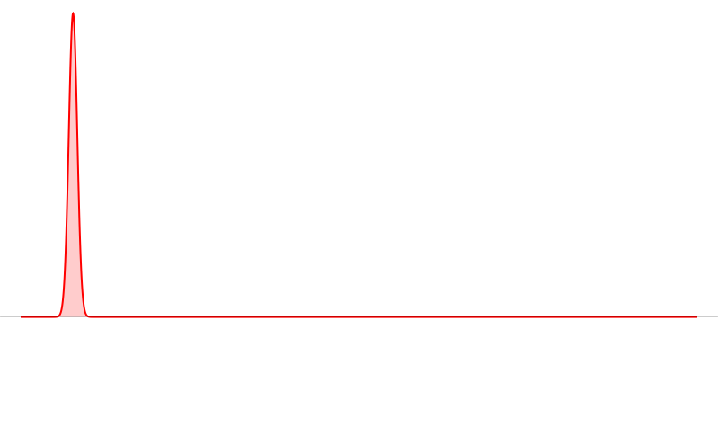
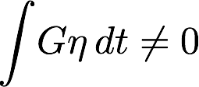
Fundamental Lemma of Variational Calculus
If
for all offsets
zero at
then
vanishes on the interval.

Slide 33
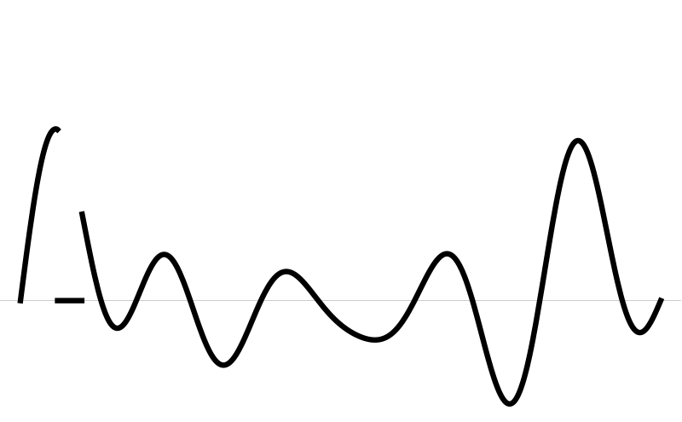
Fundamental Lemma of Variational Calculus
If
for all offsets
zero at
then
vanishes on the interval.
must be zero where
is nonzero

Slide 34
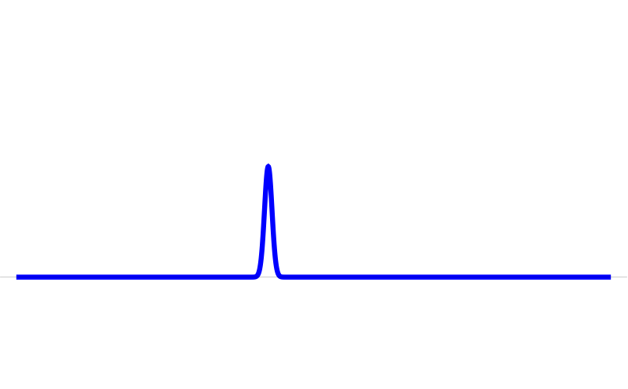
Fundamental Lemma of Variational Calculus
If
for all offsets
zero at
then
vanishes on the interval.
must hold for every choice of

Slide 35
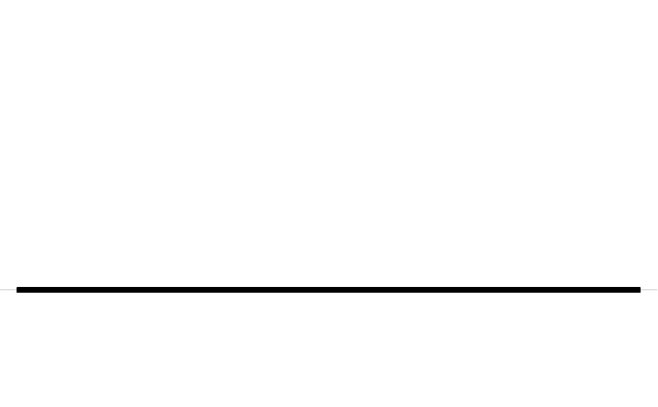
Fundamental Lemma of Variational Calculus
If
for all offsets
zero at
then
vanishes on the interval.
So
vanishes everywhere in the interval.

Slide 36
Particle Example: Deriving Euler-Lagrange Equations
Where were we?
When is
for all offsets

Slide 37

Particle Example: Deriving Euler-Lagrange Equations
Apply Fundamental Lemma
Euler-Lagrange equations

Slide 38
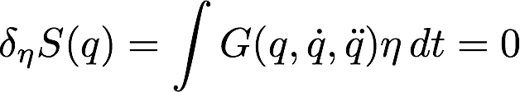
Particle Example: Deriving Euler-Lagrange Equations
Apply the Fundamental Lemma to see when the derivative vanishes
and recover the Euler-Lagrange equations.
Apply Fundamental Lemma
Euler-Lagrange Equations

Slide 39


Particle Example: Lagrangian Reformulation
Euler-Lagrange equations
Wait... this looks familiar!
is Newton’s law
(reinserting mass)
(force is derivative of potential energy)

Slide 40

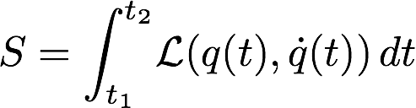
Lagrangian Reformulation Summary
Principle of Stationary Action
A path connecting two points is a physical path precisely when the first derivative of the action is zero.
Lagrangian
Action
Euler-Lagrange Equations
Fundamental Lemma

Slide 41

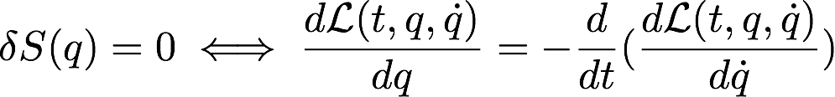
(general) Principle of Stationary Action
“Variational principles” apply to many systems, e.g., special relativity, quantum mechanics, geodesics, etc.
Key is to find Lagrangian
Fundamental Lemma
so general Euler-Lagrange equations are the equations of interest

Slide 42
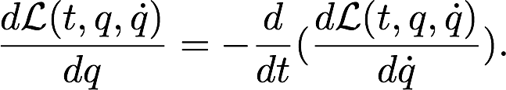
(general) Principle of Stationary Action
“Variational principles” apply to many systems, e.g., special relativity, quantum mechanics, geodesics, etc.
The Euler-Lagrange equations for a general Lagrangian are
Key is to find Lagrangian
Fundamental Lemma
so general Euler-Lagrange equations are the equations of interest

Slide 43
Noether’s Theorem
Continuous symmetries of the Lagrangian imply conservation laws for the physical system.
Continuous Symmetry
Conserved Quantity
Translational | Linear momentum
Rotational (one dimensional) | Angular momentum
Time | Total energy

Slide 44
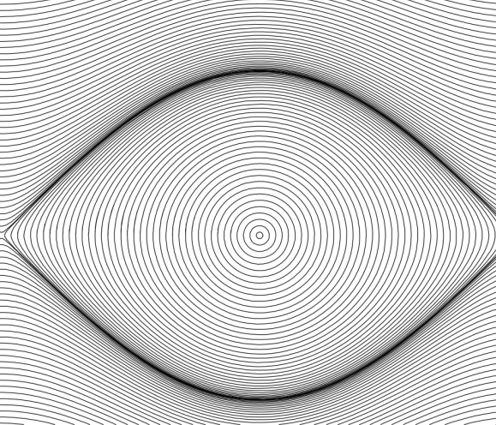

Lagrangian Paths are Symplectic
momentum
(mass x velocity)
energy levels
position

Slide 45
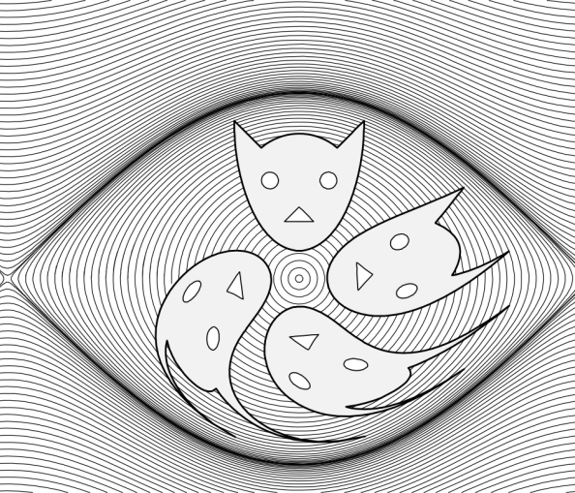
Lagrangian Paths are Symplectic
Image from Hairer, Lubich, and Wanner 2006
momentum
(mass x velocity)
energy levels
position
in 2D equivalent to area conservation in phase space
(in higher dimensions implies volume conservation)

Slide 46
Variational Time Integrators
Discretize Lagrangian
Discrete Hamilton’s Principle
Apply Variational Principle
Arrive at Discrete Equations of Motion
(as opposed to discretizing equations directly)

Slide 47
Discrete Noether’s Theorem
Discretize Lagrangian
Arrive at Discrete Equations of Motion
Continuous symmetries of the discrete Lagrangian imply conserved quantities throughout entire discrete motion.
(for not too large time steps)

Slide 48
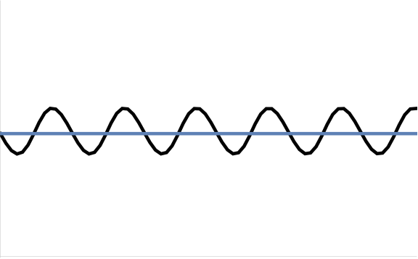
Discrete Variational Integrators are Symplectic
... time is now discrete, so total energy is not conserved.
But, discrete symplectic structure guarantees bounded oscillation around true energy level
(for not too large time steps)
energy
true conserved energy
time

Slide 49
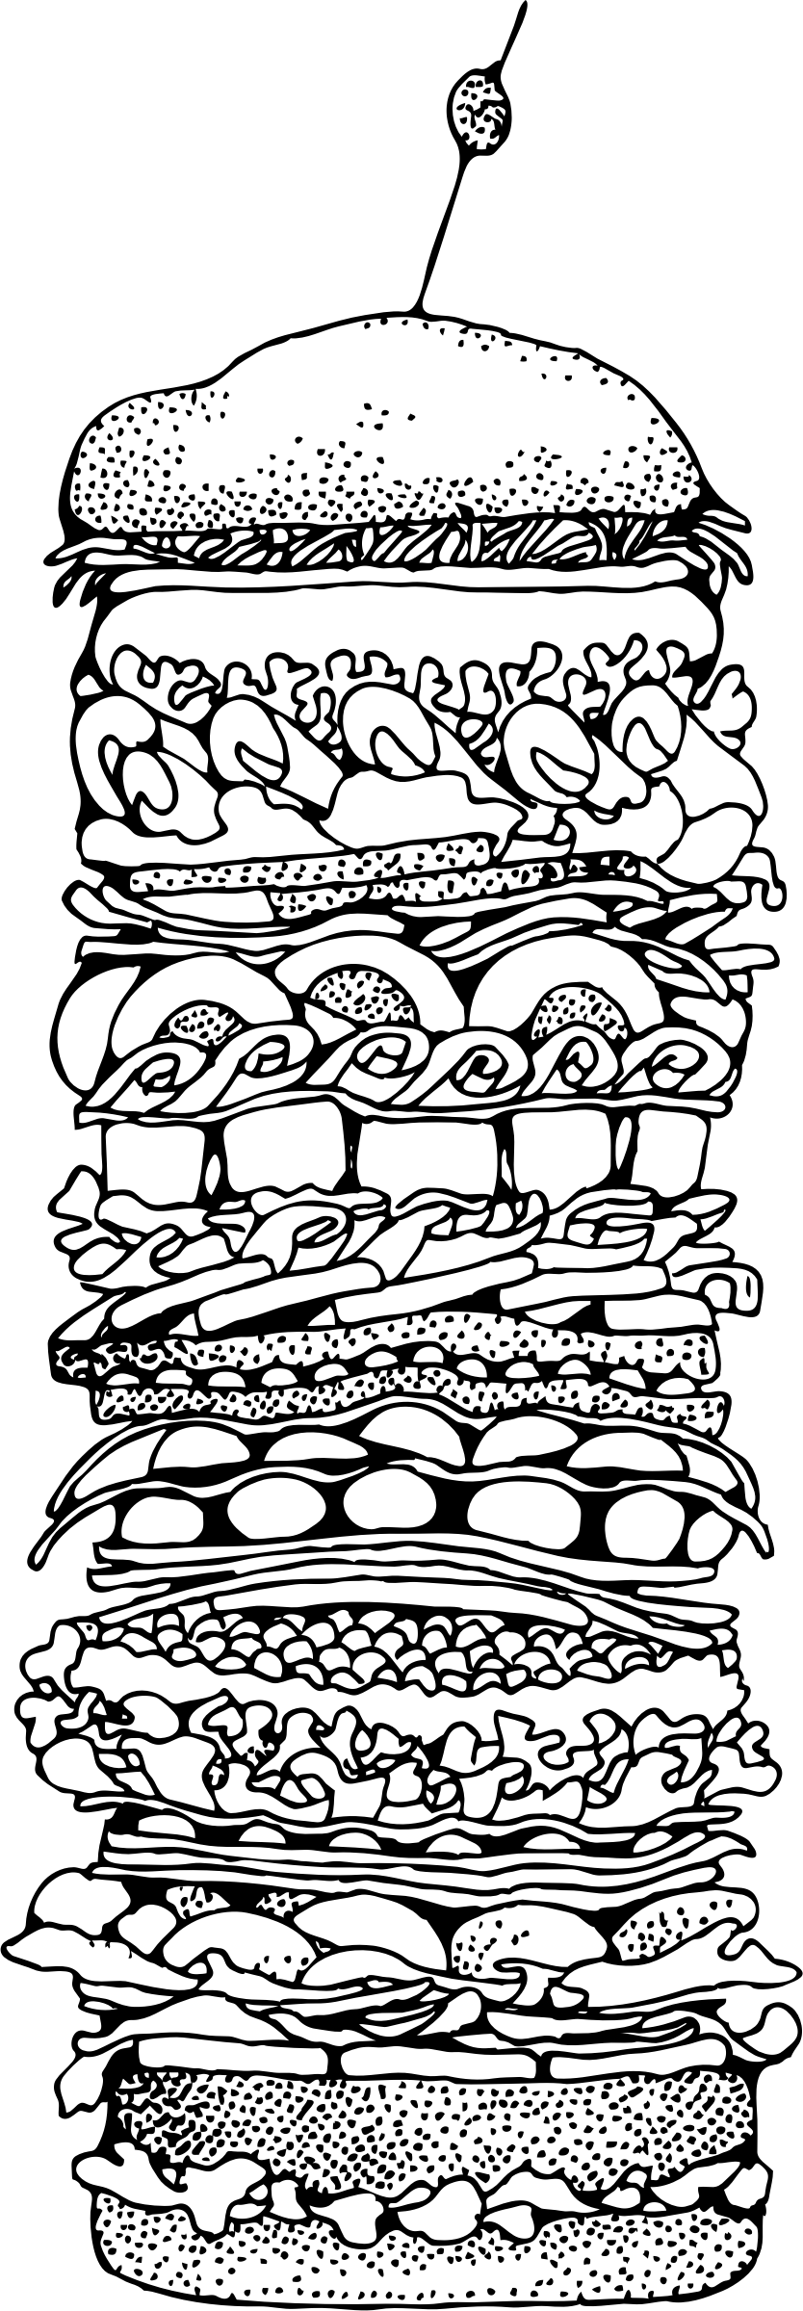
LUNCH
BREAK
image from openclipart.org

Slide 50
Part Two:
Why Use Variational Integrators?

Slide 51
Quick Recap
Physical paths are extremal amongst all paths from A to B of the action integral
B
A
Action is the integral of the Lagrangian, kinetic minus potential energy
Symmetries of Lagrangian and symplectic structure give rise to conservation laws

Slide 52
Variational Time Integrators
Discretize Action (integral of Lagrangian)
Discrete Hamilton’s Principle
Apply Variational Principle
Arrive at Discrete Equations of Motion
(as opposed to discretizing equations directly)

Slide 53
Discrete Noether’s Theorem
Discretize Lagrangian
Arrive at Discrete Equations of Motion
Continuous symmetries of discrete Lagrangian imply conserved quantities throughout entire discrete motion,
e.g., conservation of linear and angular momentum
(for not too large time steps)

Slide 54
Discrete Variational Integrators are Symplectic
... time is now discrete, so total energy is not conserved.
But, discrete symplectic structure guarantees bounded oscillation around true energy level
(for not too large time steps)
energy
true conserved energy
time

Slide 55
Discrete Variational Integrators are Symplectic
... time is now discrete, so total energy is not conserved.
But, discrete symplectic structure guarantees bounded oscillation around true energy level
Variational integrators are symplectic and vice versa. Both equivalent terms are used.
(for not too large time steps)
energy
true conserved energy
time

Slide 56
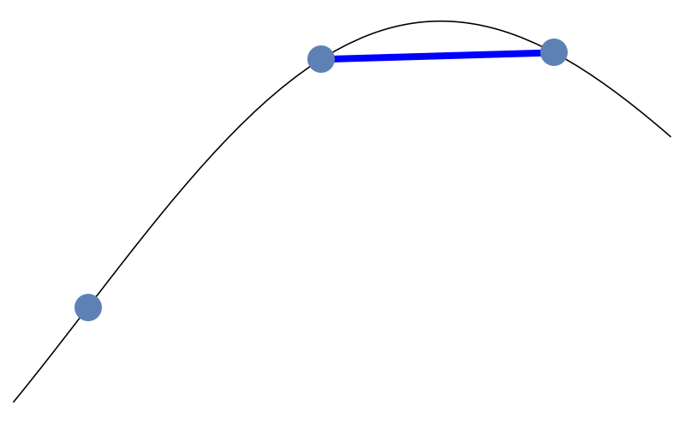
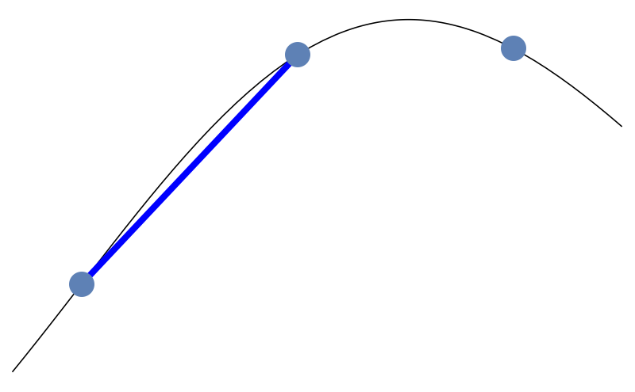
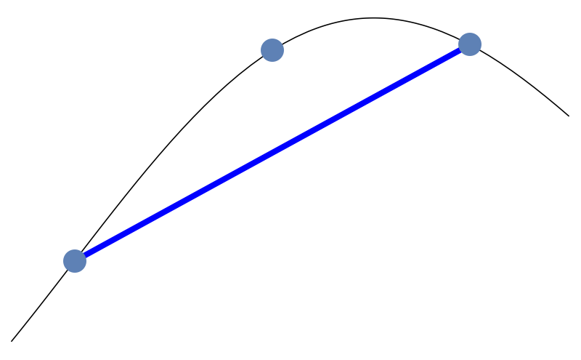
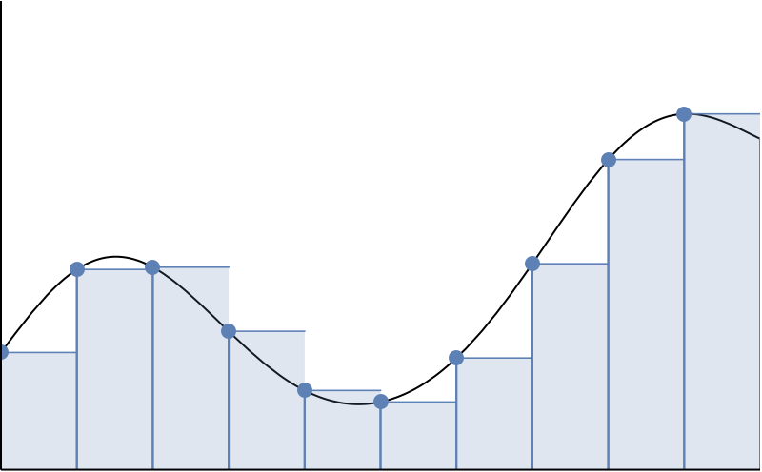
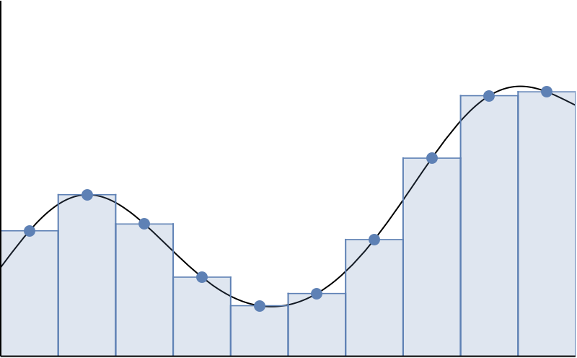
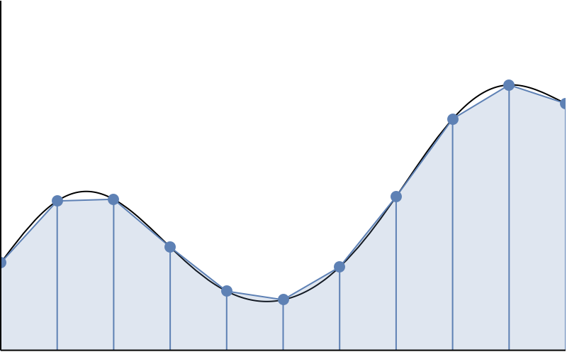
Building a Variational Time Integrator
1. Choose a finite difference scheme for
, e.g.,
forward
backward
central
2. Choose a quadrature rule to integrate action, e.g.,
rectangular
midpoint
trapezoid
3. Apply variational principle

Slide 57

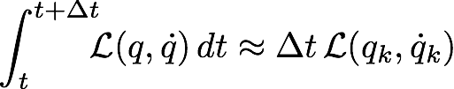
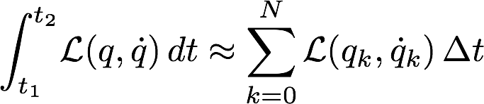
Discrete Variational Principle Example
forward
rectangular

Slide 58
Discrete Variational Principle Example
forward
Choose a finite difference scheme and quadrature rule and write down the discrete action sum.
rectangular

Slide 59
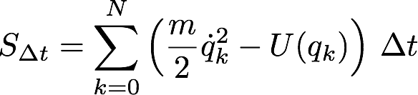


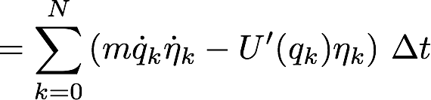

Discrete Variational Principle Example

Slide 60




Discrete Variational Principle Example
get rid of derivates of the offset
Summation by Parts
recall offset vanishes at boundary

Slide 61




Discrete Variational Principle Example
shift index

Slide 62

Discrete Variational Principle Example
(discrete) Fundamental Lemma of Calculus of Variations
discrete Euler-Lagrange
Recall:

Slide 63




Discrete Variational Integrator Scheme
forward
Symplectic (variational) Euler

Slide 64


Discrete Variational Integrator Scheme
discrete Euler-Lagrange
Use
and
forward
(left) rectangular
Semi-implicit Euler
Symplectic Euler Method A

Slide 65

Discrete Variational Integrator Scheme
discrete Euler-Lagrange
Use
and
backward
(left) rectangular
Semi-implicit Euler
Symplectic Euler Method B

Slide 66
Time Integration Schemes
Great... we know how to derive a variational integrator, but what other integrators are there?
Where do they come from?
Why are they used?
How do they compare?

Slide 67


First Order Integration Schemes
Explicit Euler
Use (forward) first order Taylor approximation of motion

Slide 68

First Order Integration Schemes
Explicit Euler
use Newton’s law

Slide 69
First Order Integration Schemes
Explicit Euler
Cheap to compute -- explicit dependence of variables
but
adds artificial driving
“unstable” for large time steps
(drastically deviates from true trajectories)

Slide 70

Explicit Euler
step size in seconds

Slide 71










Explicit: Time Step Refinement
step size in seconds

Slide 72
First Order Integration Schemes
Explicit (forward) Euler
Implicit (backward) Euler
motion “implicitly” depends on variables

Slide 73
First Order Integration Schemes
Implicit Euler
“stable” for large time steps
(stays close to true trajectories)
but
adds artificial damping
more expensive -- nonlinear solve for implicit variables

Slide 74
Implicit Euler
step size in seconds

Slide 75





Implicit: Time Step Refinement
step size in seconds

Slide 76
First Order Integration Schemes
Symplectic Euler Method A
Symplectic Euler Method B
also called “semi-implicit” Euler methods

Slide 77
First Order Integration Schemes
Symplectic Euler Methods, e.g.,
as cheap as Explicit Euler
bounded energy oscillation
(little artificial damping/driving)
conserved linear and angular momentum
also unstable for very large time steps

Slide 78
Symplectic Euler (Method B)
step size in seconds

Slide 79





Symplectic: Time Step Refinement
step size in seconds

Slide 80

Phase Space (energy levels)
implicit
momentum
(mass x velocity)
symplectic
explicit
position

Slide 81





Energy Landscape Under Step Refinement
explicit
symplectic
true energy
implicit

Slide 82

Energy Landscape Near Time Zero
explicit
symplectic
true energy
implicit

Slide 83
Very Small Time Step
explicit
symplectic
implicit

Slide 84









Large Time Steps: Symplectic vs Implicit
Sym
Imp
Symplectic unstable region shown in largest time step
Implicit is stable, but damping is time step dependent

Slide 85
Three Integrators Summary
Explicit
Variational
Implicit
cheap
cheap
more expensive
artificial driving
good energy
artificial damping
unstable
unstable for large
stable
momenta conserved

Slide 86
Three Integrators Summary
Variational Integrators
cheap
good energy
momenta conserved
Explicit
Variational
Implicit
but (can’t have it all!)
cheap
cheap
more expensive
unstable for large
artificial driving
good energy
artificial damping
unstable
unstable for large
stable
momenta conserved

Slide 87


Damped Systems
Want to include non-conservative forces, too
Systems with non-conservative forces satisfy the
Lagrange-D’Alembert Principle
integral of force in direction of variation, eta
variation of action in direction eta
modification of Principle of Stationary Action

Slide 88
Damped Systems
Lagrange-D’Alembert Principle
Discretize using Variational Principle with:
forward
rectangular
(Forced Symplectic Euler Method)

Slide 89






Discrete Lagrange-D’Alembert Principle
Forced Symplectic Euler Method B
e.g., air resistance

Slide 90






Variational Damped Pendulum
30% damped
non-damped
behavior independent of step size
(within stable region)

Slide 91






Variational Damped Pendulum
non-damped
80% damped
30% damped
behavior independent of step size
(within stable region)

Slide 92






30% Damped Pendulum
Variational
step size
independent
Implicit
step size
dependent

Slide 93
30% Damped Pendulum
Forced Variational Integrators
Variational
cheap
step size
independent
good energy behavior
behavior independent of step size (in stable region)
Implicit
step size
dependent
Essential for rough previews often done in Computer Graphics

Slide 94


Higher Order Variational Integrators
Recall:
zeroth order quadrature
forward
rectangular
yields first order integration scheme
Generically:
order quadrature yields
order integrator

Slide 95
Higher Order Variational Integrators
Recall:
zeroth order quadrature
Variational Integrators
exist of all orders
forward
rectangular
order quadrature yields
yields first order integration scheme
order integrator
Generically:
order quadrature yields
order integrator

Slide 96
Some Well Known Variational Integrators
(of second order)
Use:
forward
trapezoid
Derive:
Störmer-Verlet Method

Slide 97
Some Well Known Variational Integrators
(of second order)
Use:
forward
midpoint
Derive:
Implicit Midpoint Method
(algebraic miracle, zeroth yields second order)

Slide 98

Comparison of First and Second Order Integrators
Image from Hairer, Lubich, and Wanner 2006

Slide 99
Summary: Variational Time Integrators
No more difficult to implement
... but have many advantages ...

Slide 100
Summary: Variational Time Integrators
Discrete Principle of Stationary Action
Symplectic structure guarantees
good energy behavior
energy
Noether’s theorem guarantees
conservation of momenta
time
Forced systems have behavior independent of step size
(for stable time steps)

Slide 101
Questions?

Slide 102
(very incomplete list of) further reading
Principle of Least Action
Feynman Lectures on Physics II.19
http://www.feynmanlectures.caltech.edu/II_19.html
Geometric Numerical Integration: Structure-preserving Algorithms for Ordinary Differential Equations. Hairer E, Lubich C, Wanner G. Springer; 2002.
Variational integrators.
West, Matthew (2004) Dissertation (Ph.D.), California Institute of Technology.
Geometric, variational integrators for computer animation.
L. Kharevych, Weiwei Yang, Y. Tong, E. Kanso, J. E. Marsden, P. Schröder, and M. Desbrun. 2006. In Proceedings of the 2006 ACM SIGGRAPH/Eurographics symposium on Computer animation (SCA '06).
Speculative parallel asynchronous contact mechanics.
Samantha Ainsley, Etienne Vouga, Eitan Grinspun, and Rasmus Tamstorf. 2012.
ACM Trans. Graph. 31, 6, Article 151 (November 2012), 8 pages. DOI=10.1145/2366145.2366170

Slide 103



Details of Movies Shown
Pendulum assumptions:
mass equals length equals one
initial conditions
movies at 16 fps

