Slide 1
Spectral Processing
Misha Kazhdan
[Taubin, 1995] A Signal Processing Approach to Fair Surface Design
[Desbrun, et al., 1999] Implicit Fairing of Arbitrary Meshes…
[Vallet and Levy, 2008] Spectral Geometry Processing with Manifold Harmonics
[Bhat et al., 2008] Fourier Analysis of the 2D Screened Poisson Equation…
And much, much, much, more…

Slide 2
Outline
Motivation
Laplacian Spectrum
Applications
Conclusion

Slide 3
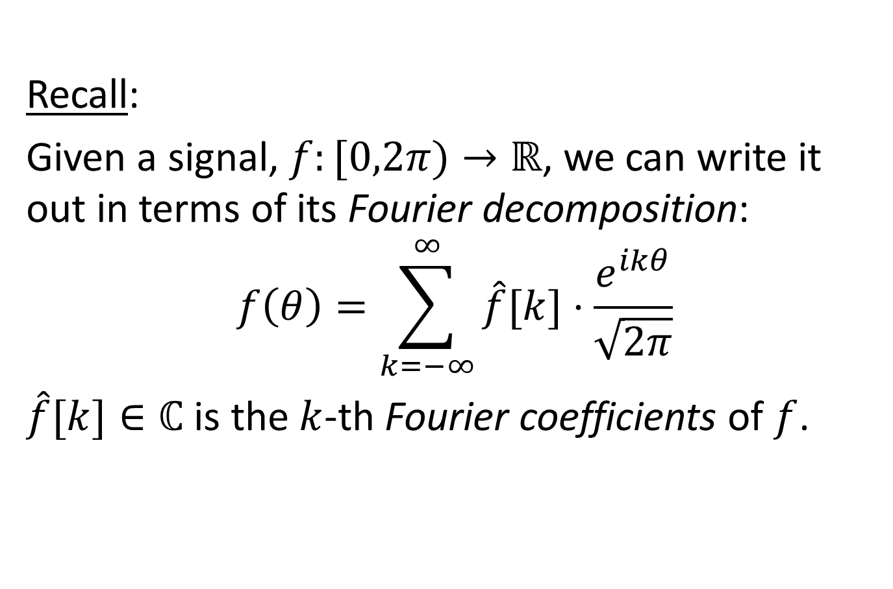
Motivation
Recall:
Given a signal, $f:[0,2π)→ℝ$, we can write it out in terms of its Fourier decomposition:
$$f\left(θ\right)=\sum_{k=−∞}^{∞}{\hat{f}[k]⋅\frac{e^{ikθ}}{\sqrt{2π}}}$$
$\hat{f}[k]∈ℂ$ is the $k$-th Fourier coefficients of $f$.

Slide 4
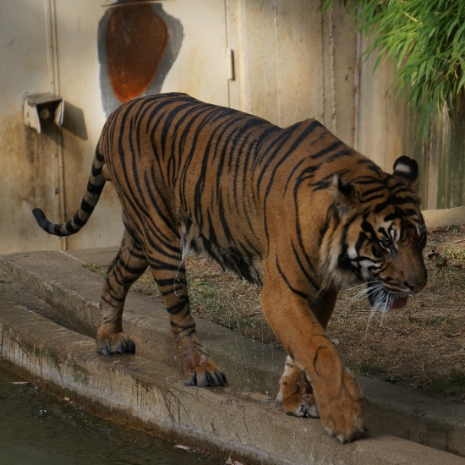




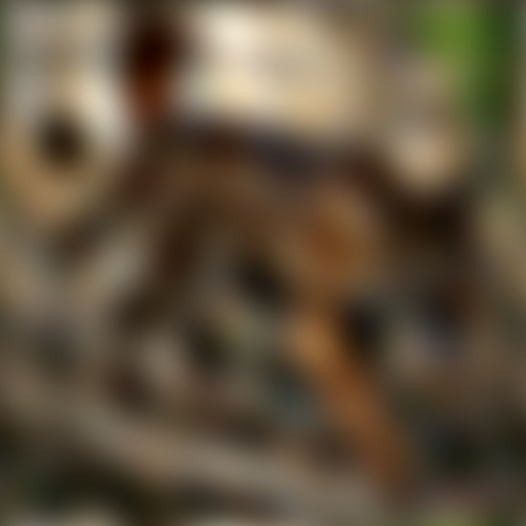
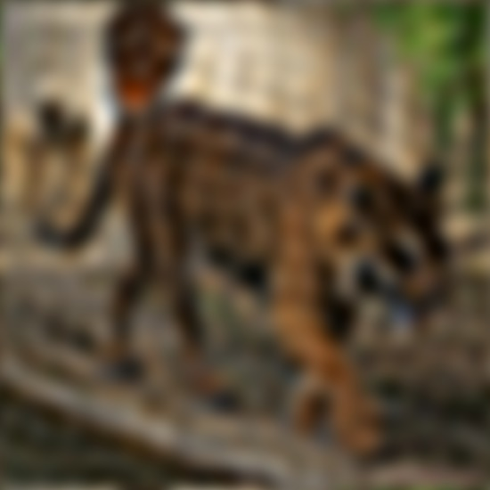













Motivation
$$f\left(θ\right)=\sum_{k=−∞}^{∞}{\hat{f}[k]⋅\frac{e^{ikθ}}{\sqrt{2π}}}$$
Frequency Decomposition:
  For smaller $N∈ℤ$, the finite sum:
  $$f_{N}\left(θ\right)=\sum_{k=−N}^{N}{\hat{f}[k]⋅\frac{e^{ikθ}}{\sqrt{2π}}}$$
  represents the lower frequency
  components of $f$.
$$N=0$$
$$N=1$$
$$N=2$$
$$N=4$$
$$N=8$$
$$N=16$$
$$N=32$$
$$N=64$$
$$N=128$$

Slide 5
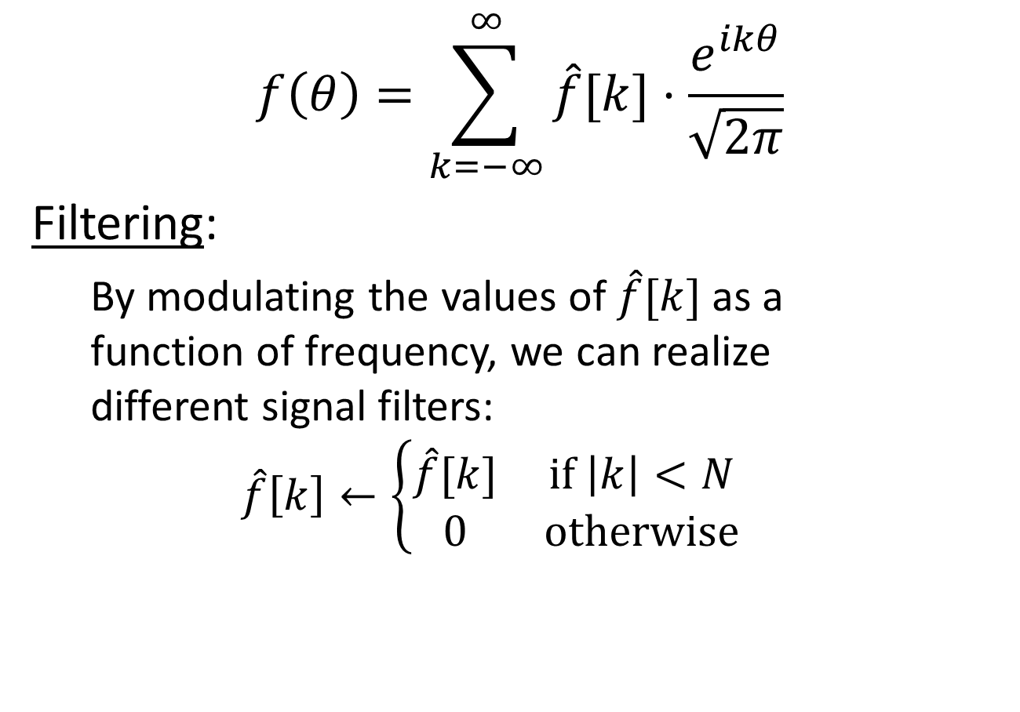
Motivation
$$f\left(θ\right)=\sum_{k=−∞}^{∞}{\hat{f}[k]⋅\frac{e^{ikθ}}{\sqrt{2π}}}$$
Filtering:
  By modulating the values of $\hat{f}[k]$ as a
  function of frequency, we can realize
  different signal filters:
  $$\hat{f}\left[k\right]←\left\{\begin{matrix}\hat{f}[k] & if \left|k\right|<N \\ 0 & otherwise\end{matrix}\right.$$

Slide 6

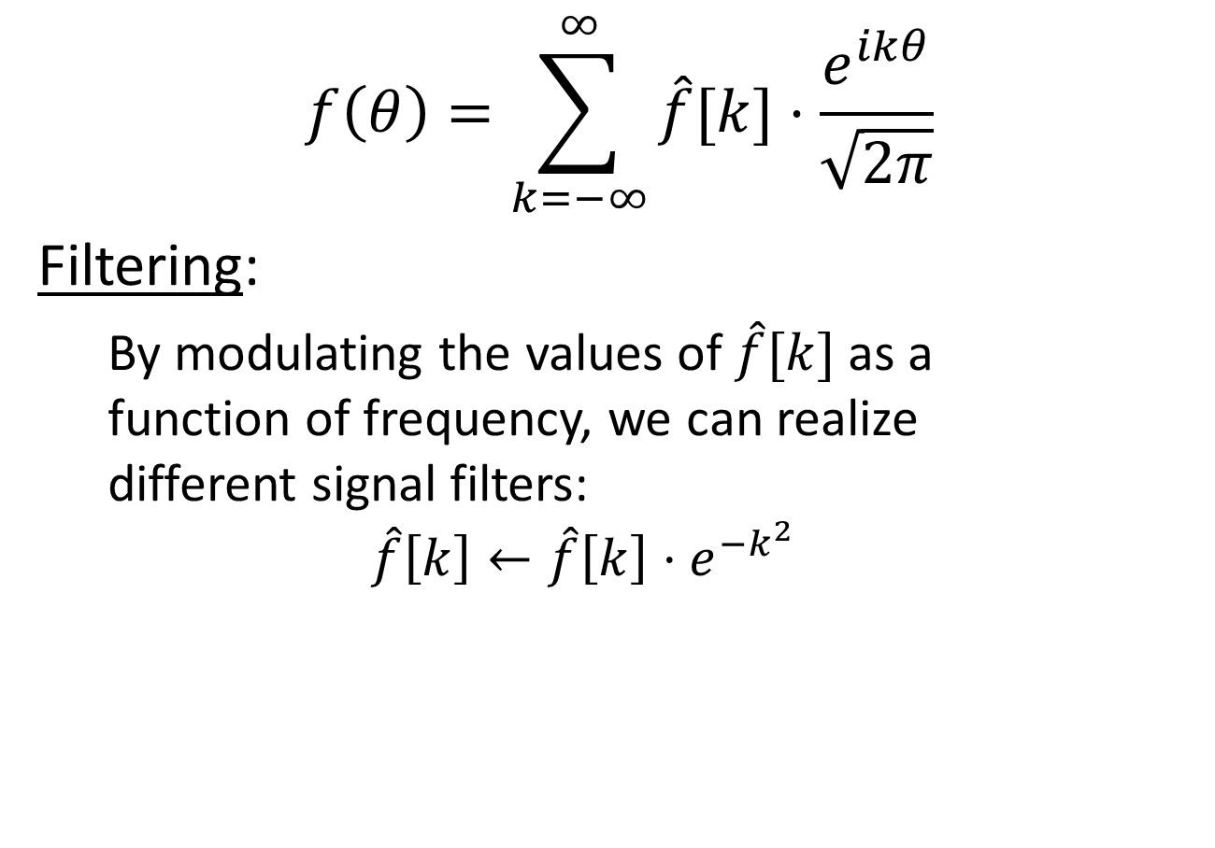
Motivation
$$f\left(θ\right)=\sum_{k=−∞}^{∞}{\hat{f}[k]⋅\frac{e^{ikθ}}{\sqrt{2π}}}$$
Filtering:
  By modulating the values of $\hat{f}[k]$ as a
  function of frequency, we can realize
  different signal filters:
  $$\hat{f}\left[k\right]←\hat{f}\left[k\right]⋅e^{−k^{2}}$$

Slide 7
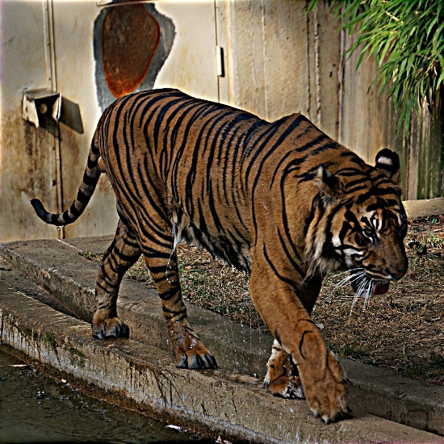
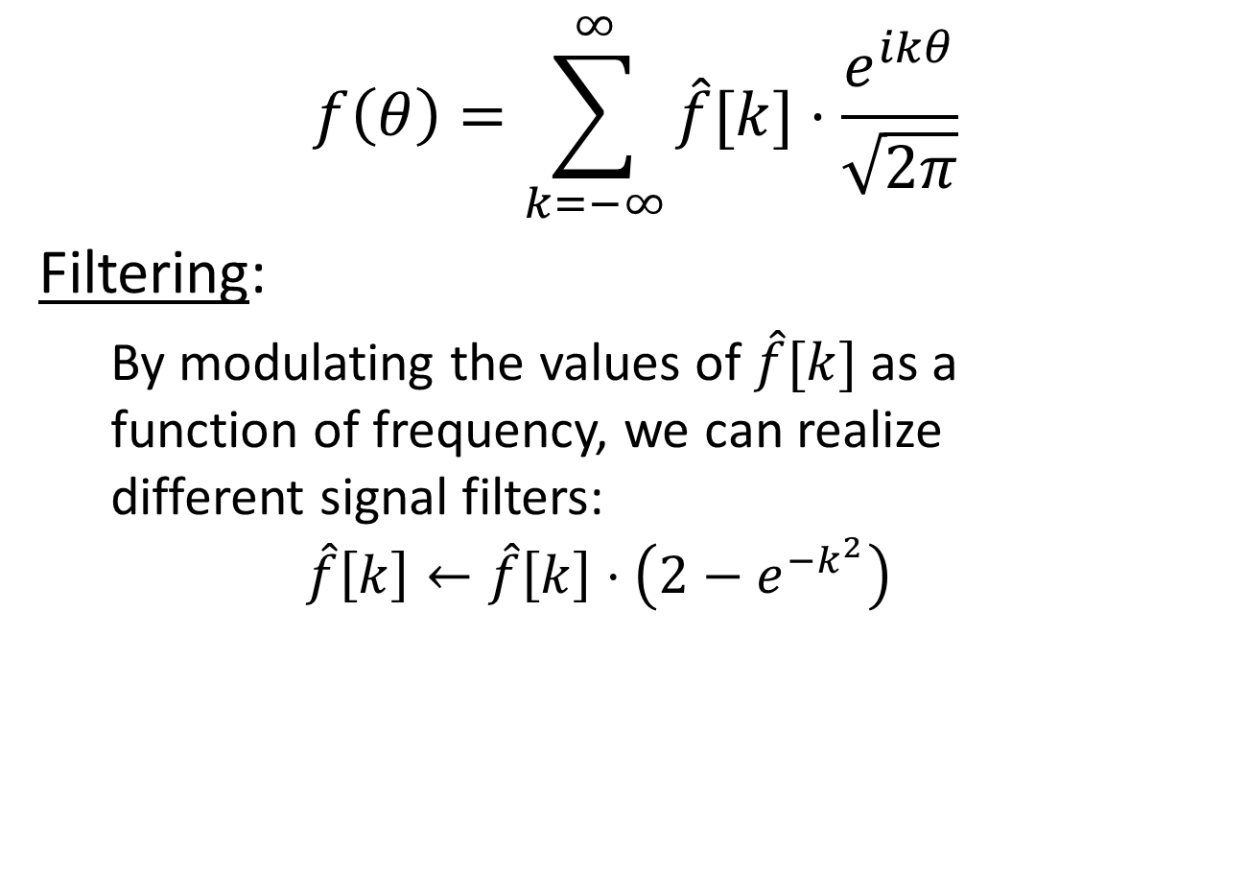
Motivation
$$f\left(θ\right)=\sum_{k=−∞}^{∞}{\hat{f}[k]⋅\frac{e^{ikθ}}{\sqrt{2π}}}$$
Filtering:
  By modulating the values of $\hat{f}[k]$ as a
  function of frequency, we can realize
  different signal filters:
  $$\hat{f}\left[k\right]←\hat{f}\left[k\right]⋅\left(2−e^{−k^{2}}\right)$$

Slide 8
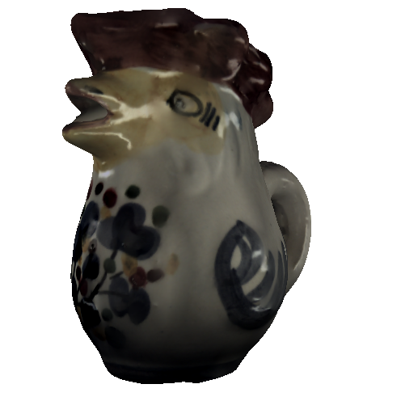
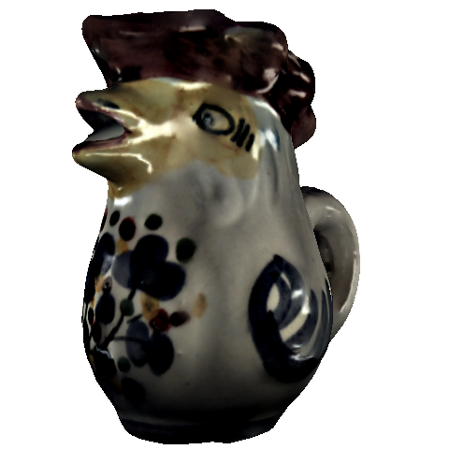

Motivation
Goal:
  We would like to extend this type of processing to the context of signals defined on surfaces*:
$$\hat{f}\left[k\right]←\hat{f}\left[k\right]⋅\left(2−e^{−k^{2}}\right)$$
*For simplicity, we will assume all surfaces are w/o boundary.

Slide 9
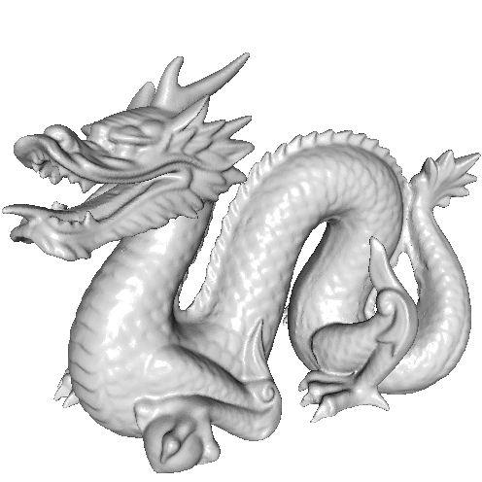
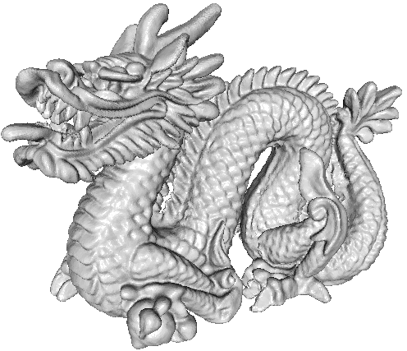
Motivation
Goal:
  We would like to extend this type of processing to the context of signals defined on surfaces* and even to the geometry of the surface itself:
$$\hat{f}\left[k\right]←\hat{f}\left[k\right]⋅\left(2−e^{−k^{2}}\right)$$
*For simplicity, we will assume all surfaces are w/o boundary.

Slide 10
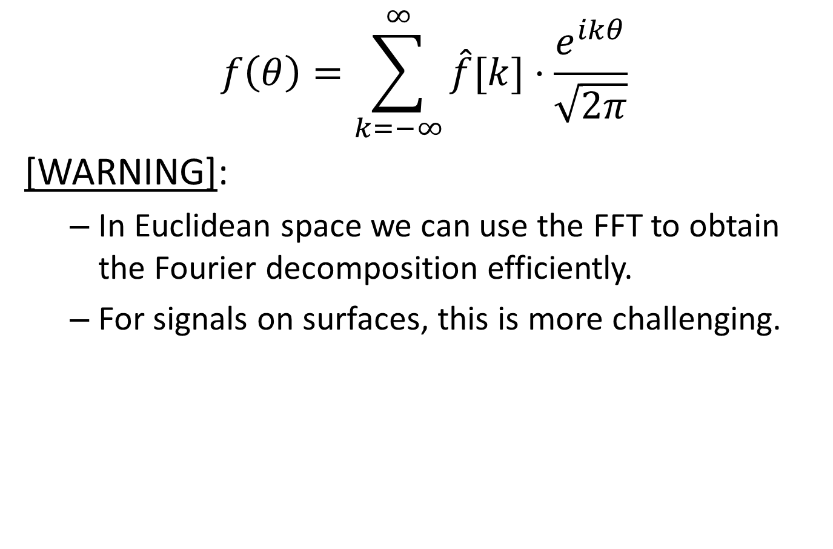
Motivation
$$f\left(θ\right)=\sum_{k=−∞}^{∞}{\hat{f}[k]⋅\frac{e^{ikθ}}{\sqrt{2π}}}$$
[WARNING]:
  In Euclidean space we can use the FFT to obtain the Fourier decomposition efficiently.
  For signals on surfaces, this is more challenging.

Slide 11

Outline
Motivation
Laplacian Spectrum
  Fourier $↔$ Laplacian
  FEM discretization
Applications
Conclusion

Slide 12
How do we obtain the
Fourier decomposition?

Slide 13

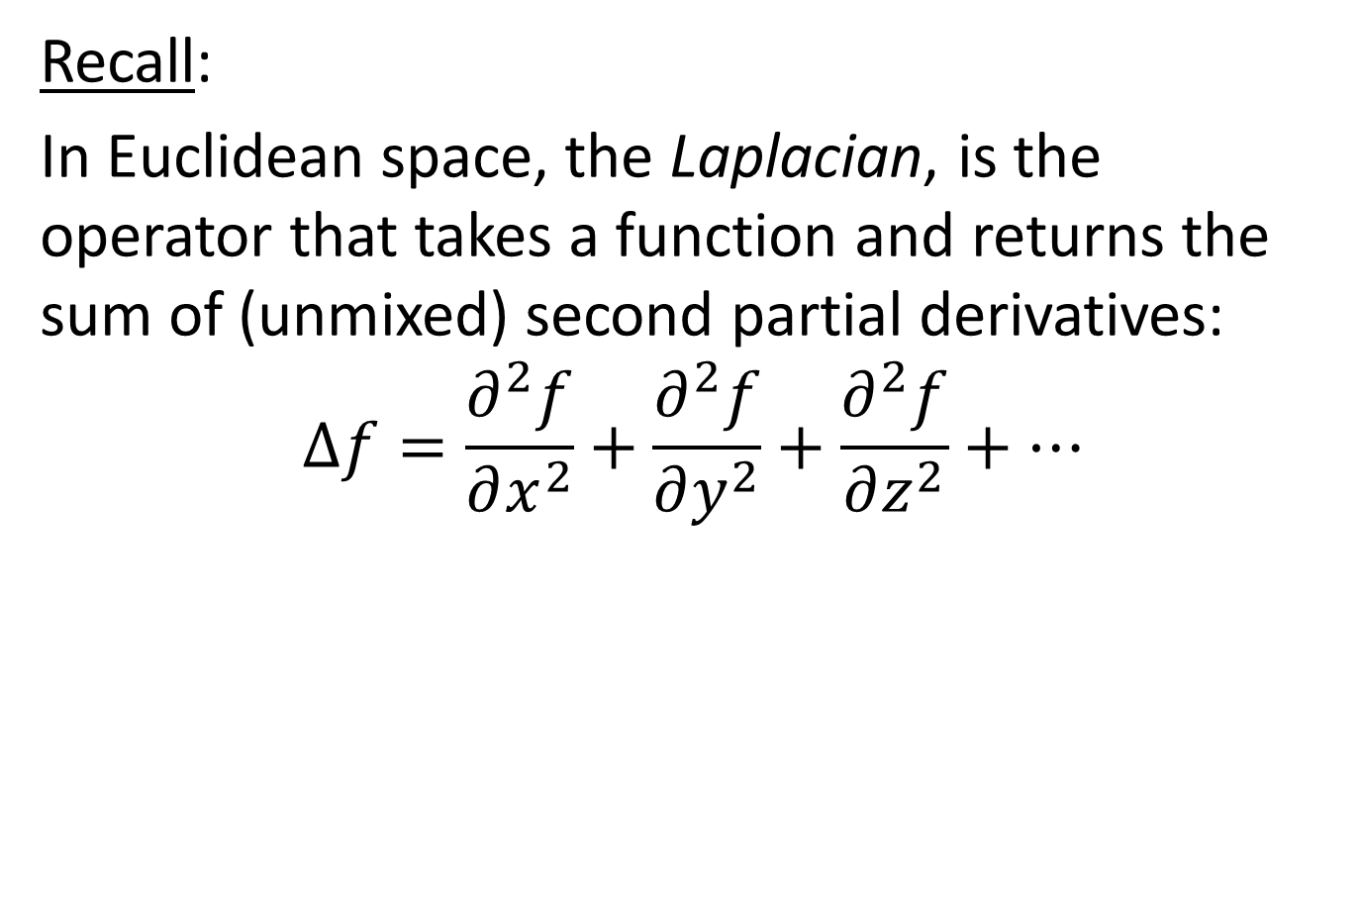
Fourier $↔$ Laplacian
Recall:
In Euclidean space, the Laplacian, is the operator that takes a function and returns the sum of (unmixed) second partial derivatives:
$$Δf=\frac{∂^{2}f}{∂x^{2}}+\frac{∂^{2}f}{∂y^{2}}+\frac{∂^{2}f}{∂z^{2}}+…$$

Slide 14
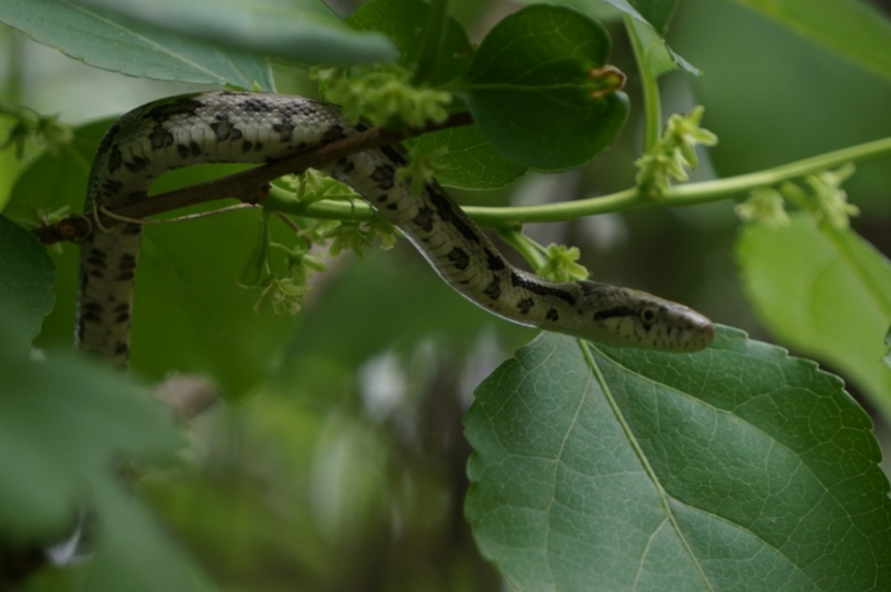
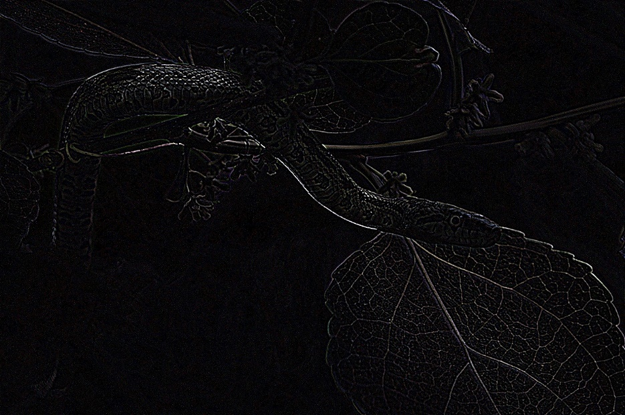





Fourier $↔$ Laplacian
Informally:
The Laplacian gives the difference between the value at a point and the average in the vicinity:
$$Δf\left(p\right)∼\lim_{ε→0}{\frac{1}{ε^{2}}\left(Avg_{B_{ε}\left(p\right)}\left(f\right)−f\left(p\right)\right)}$$
$$B_{ε}(p)$$
$$p$$
$$f$$
$$Δf$$

Slide 15
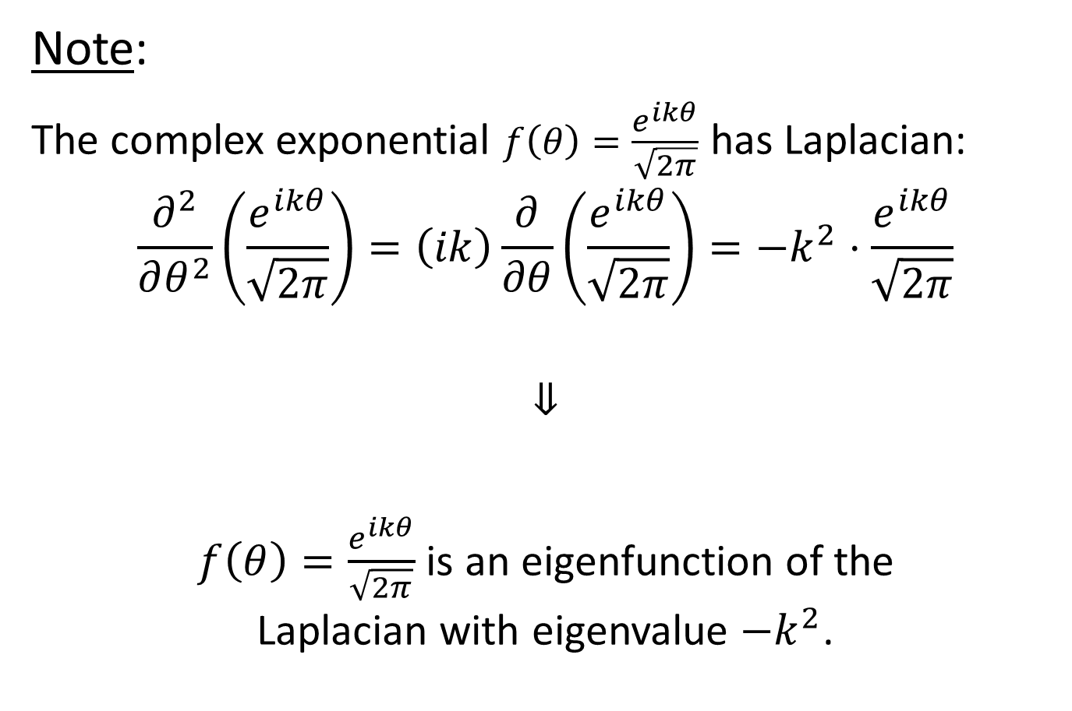
Fourier $↔$ Laplacian
Note:
The complex exponential $f\left(θ\right)=\frac{e^{ikθ}}{\sqrt{2π}}$ has Laplacian:
$$\frac{∂^{2}}{∂θ^{2}}\left(\frac{e^{ikθ}}{\sqrt{2π}}\right)=\left(ik\right)\frac{∂}{∂θ}\left(\frac{e^{ikθ}}{\sqrt{2π}}\right)=−k^{2}⋅\frac{e^{ikθ}}{\sqrt{2π}}$$
$$⇓$$
$f\left(θ\right)=\frac{e^{ikθ}}{\sqrt{2π}}$ is an eigenfunction of the
Laplacian with eigenvalue $−k^{2}$.

Slide 16
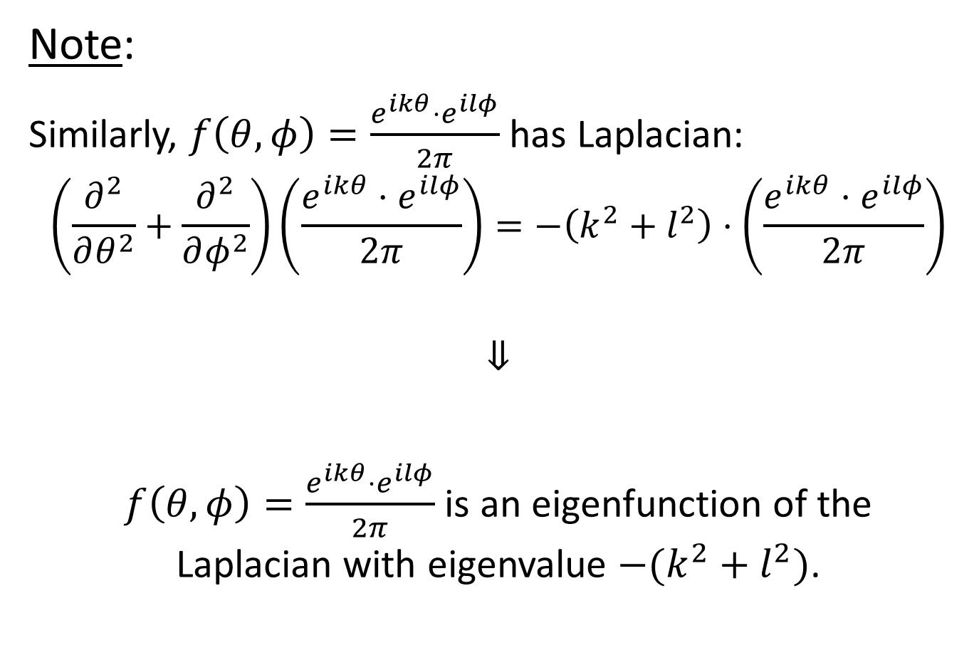
Fourier $↔$ Laplacian
Note:
Similarly, $f\left(θ,φ\right)=\frac{e^{ikθ}⋅e^{ilφ}}{2π}$ has Laplacian:
$$\left(\frac{∂^{2}}{∂θ^{2}}+\frac{∂^{2}}{∂φ^{2}}\right)\left(\frac{e^{ikθ}⋅e^{ilφ}}{2π}\right)=−\left(k^{2}+l^{2}\right)⋅\left(\frac{e^{ikθ}⋅e^{ilφ}}{2π}\right)$$
$$⇓$$
$f\left(θ,φ\right)=\frac{e^{ikθ}⋅e^{ilφ}}{2π}$ is an eigenfunction of the
Laplacian with eigenvalue $−(k^{2}+l^{2})$.

Slide 17
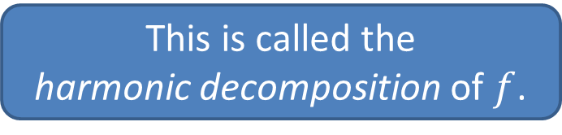
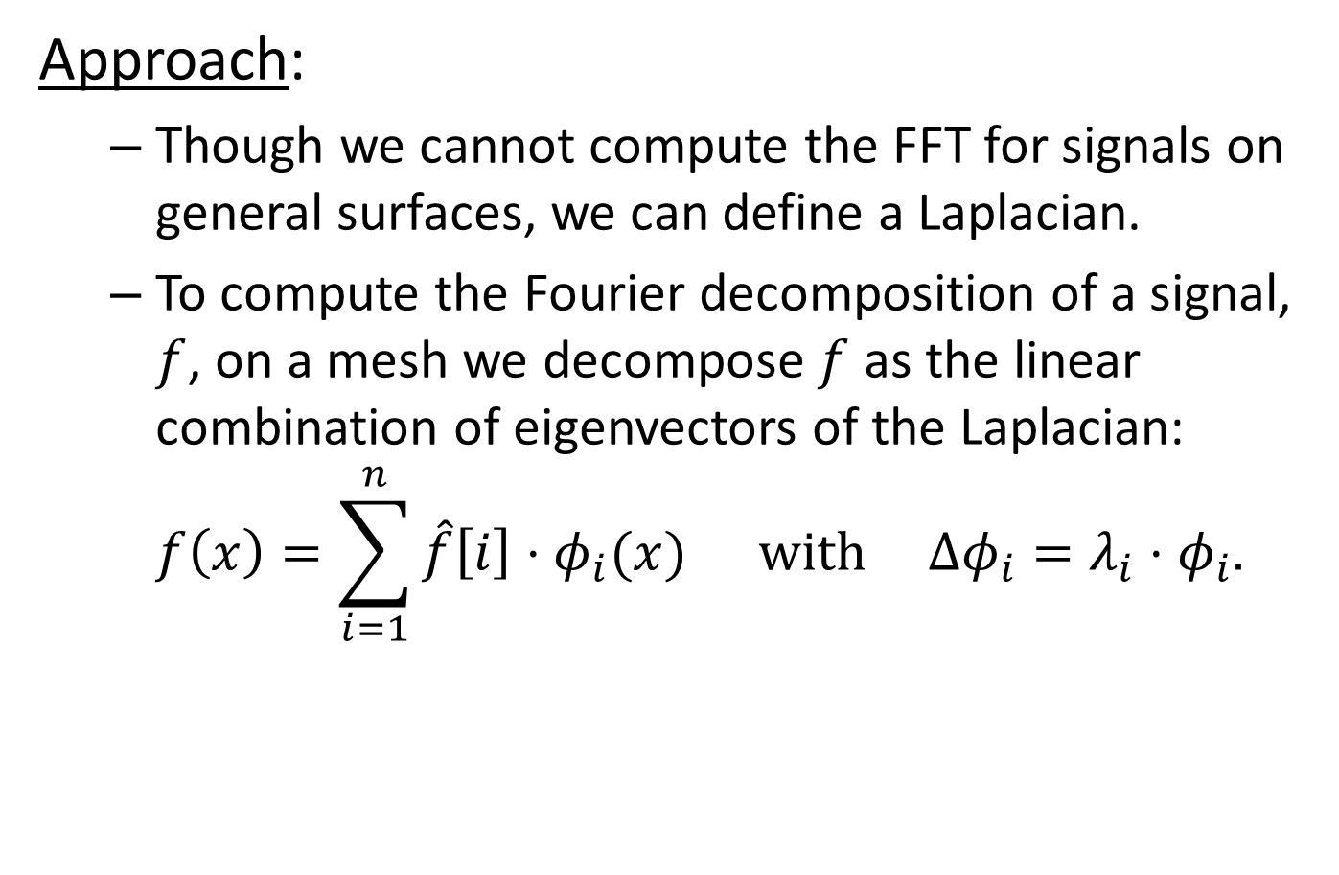
Fourier $↔$ Laplacian
Approach:
  Though we cannot compute the FFT for signals on general surfaces, we can define a Laplacian.
  To compute the Fourier decomposition of a signal, $f$, on a mesh we decompose $f$ as the linear combination of eigenvectors of the Laplacian:
  $f\left(x\right)=\sum_{i=1}^{n}{\hat{f}\left[i\right]⋅φ_{i}(x)} with Δφ_{i}=λ_{i}⋅φ_{i}.$
This is called the
harmonic decomposition of $f$.

Slide 18
Fourier $↔$ Laplacian
How do we know the eigenvectors of the Laplacian form a basis?
Claims:
  The Laplacian is a symmetric operator.
  The eigenvectors of a symmetric operator form an orthogonal basis (and have real eigenvalues).

Slide 19
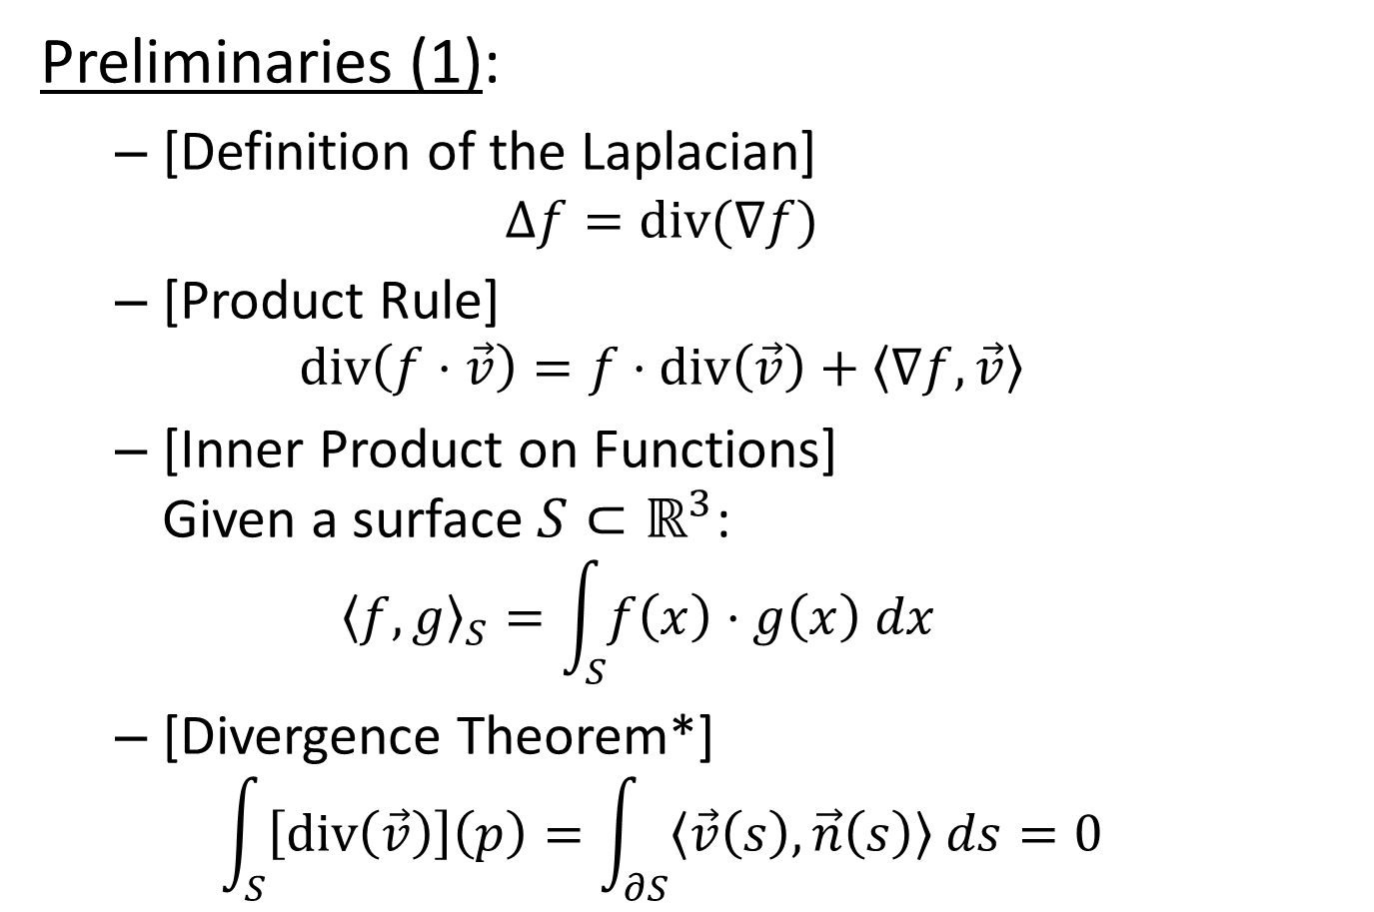
Fourier $↔$ Laplacian
Preliminaries (1):
  [Definition of the Laplacian]
  $Δf=div(\text{∇}f)$
  [Product Rule]
  $div\left(f⋅\vec{v}\right)=f⋅div\left(\vec{v}\right)+〈\text{∇}f,\vec{v}〉$
  [Inner Product on Functions]
  Given a surface $S⊂ℝ^{3}$:
  ${〈f,g〉}_{S}=\int_{S}{f\left(x\right)⋅g\left(x\right) dx}$
  [Divergence Theorem*]
  $\int_{S}{\left[div\left(\vec{v}\right)\right]\left(p\right)=\int_{∂S}{〈\vec{v}\left(s\right),\vec{n}\left(s\right)〉 ds}}=0$

Slide 20
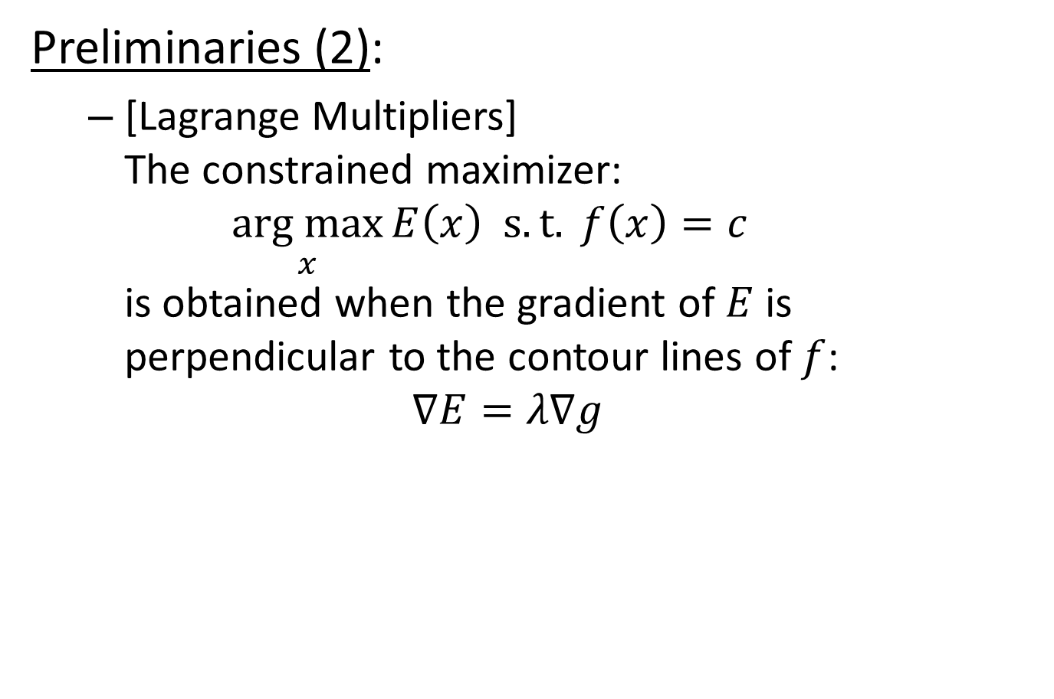
Fourier $↔$ Laplacian
Preliminaries (2):
  [Lagrange Multipliers]
  The constrained maximizer:
  $\underset{x}{arg max}{E\left(x\right) s.t. f\left(x\right)=c}$
  is obtained when the gradient of $E$ is perpendicular to the contour lines of $f$:
  $$\text{∇}E=λ\text{∇}g$$

Slide 21
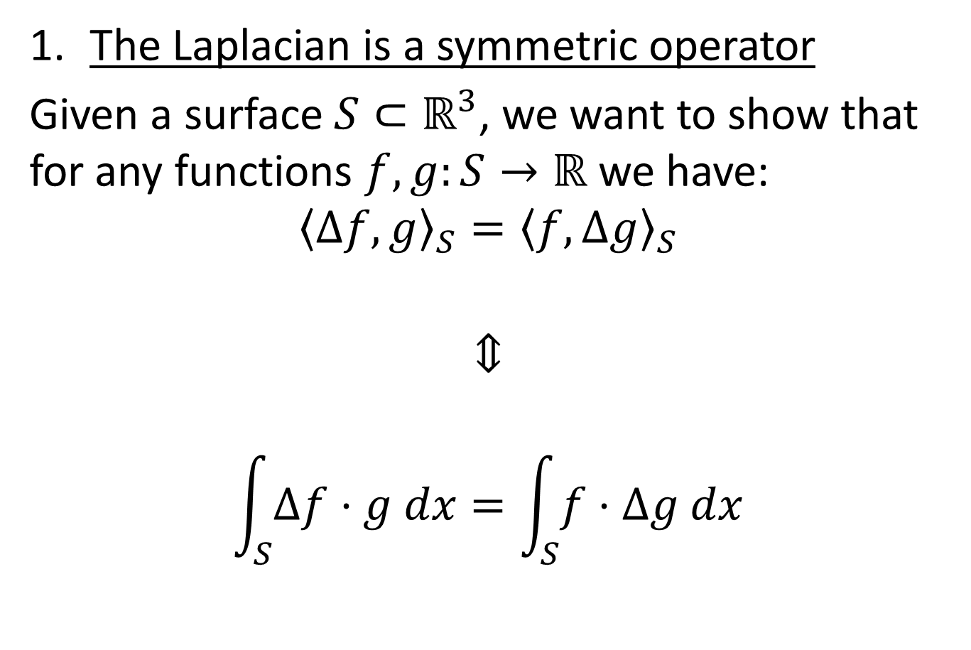
Symmetry of The Laplacian
The Laplacian is a symmetric operator
Given a surface $S⊂ℝ^{3}$, we want to show that for any functions $f,g:S→ℝ$ we have:
$${〈Δf,g〉}_{S}={〈f,Δg〉}_{S}$$
$$⇕$$
$$\int_{S}{Δf⋅g dx}=\int_{S}{f⋅Δg dx}$$

Slide 22


Symmetry of The Laplacian
Proof:
By the definition of the Laplacian:
$$Δf=div\left(\text{∇}f\right)$$
$${〈Δf,g〉}_{S}=\int_{S}{Δf⋅g dx}$$
$$=\int_{S}{div\left(\text{∇}f\right)⋅g dx}$$
$$=\int_{S}{\left(div\left(g⋅\text{∇}f\right)−〈\text{∇}f,\text{∇}g〉\right) dx}$$
$$=−\int_{S}{〈\text{∇}f,\text{∇}g〉 dx}$$

Slide 23
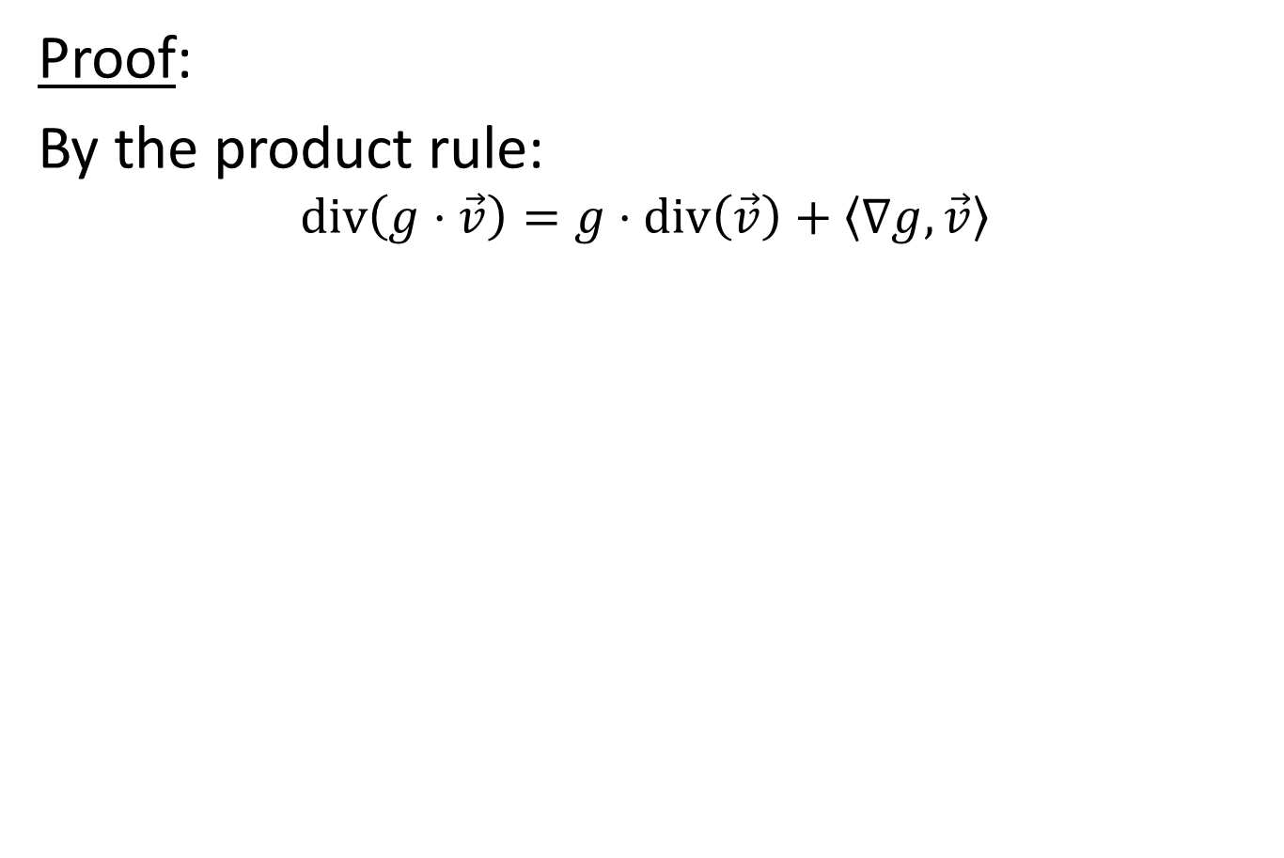
Symmetry of The Laplacian
Proof:
By the product rule:
$${〈Δf,g〉}_{S}=\int_{S}{Δf⋅g dx}$$
$$=\int_{S}{div\left(\text{∇}f\right)⋅g dx}$$
$$=\int_{S}{\left(div\left(g⋅\text{∇}f\right)−〈\text{∇}f,\text{∇}g〉\right) dx}$$
$$=−\int_{S}{〈\text{∇}f,\text{∇}g〉 dx}$$

Slide 24

Symmetry of The Laplacian
Proof:
By the Divergence Theorem*:
$$\int_{S}{\left[div\left(\vec{v}\right)\right]\left(p\right)=\int_{∂S}{〈\vec{v}\left(s\right),\vec{n}\left(s\right)〉 ds}}=0$$
$${〈Δf,g〉}_{S}=\int_{S}{Δf⋅g dx}$$
$$=\int_{S}{div\left(\text{∇}f\right)⋅g dx}$$
$$=\int_{S}{\left(div\left(g⋅\text{∇}f\right)−〈\text{∇}f,\text{∇}g〉\right) dx}$$
$$=−\int_{S}{〈\text{∇}f,\text{∇}g〉 dx}$$

Slide 25
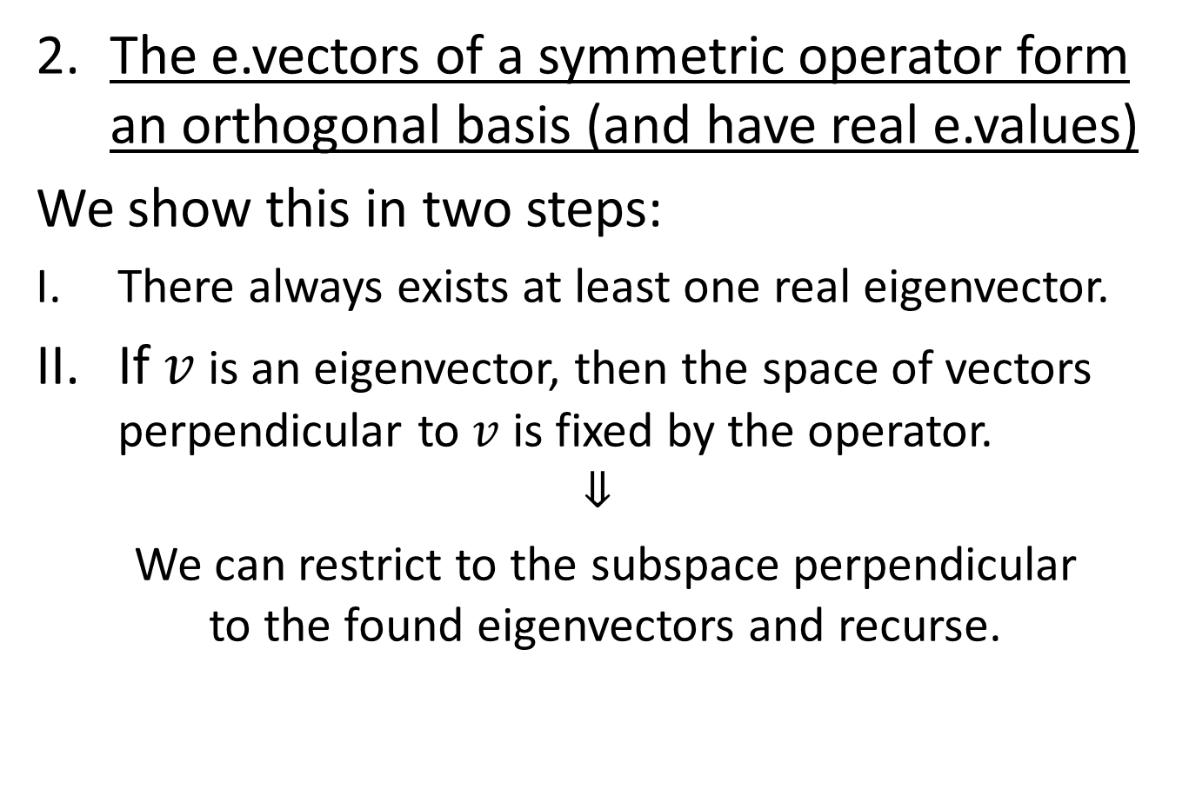
Spectra of Symmetric Operators
  The e.vectors of a symmetric operator form an orthogonal basis (and have real e.values)
  We show this in two steps:
  There always exists at least one real eigenvector.
  If $v$ is an eigenvector, then the space of vectors perpendicular to $v$ is fixed by the operator.
  $$⇓$$
  We can restrict to the subspace perpendicular
  to the found eigenvectors and recurse.

Slide 26
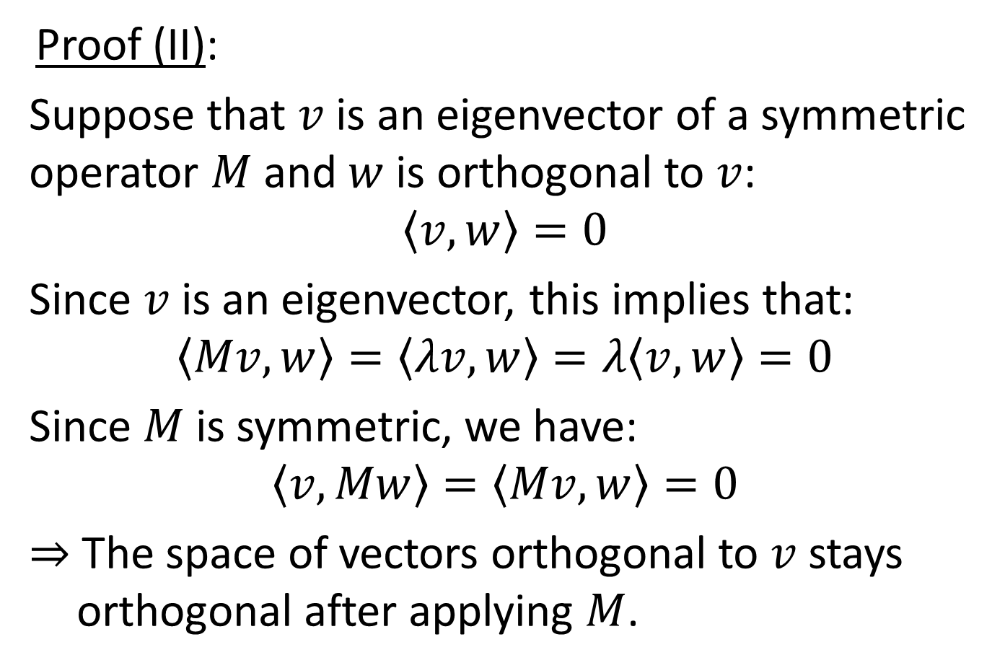
Spectra of Symmetric Operators
  Proof (II):
Suppose that $v$ is an eigenvector of a symmetric operator $M$ and $w$ is orthogonal to $v$:
$$〈v,w〉=0$$
Since $v$ is an eigenvector, this implies that:
$$〈Mv,w〉=〈λv,w〉=λ〈v,w〉=0$$
Since $M$ is symmetric, we have:
$$〈v,Mw〉=〈Mv,w〉=0$$
$⇒$ The space of vectors orthogonal to $v$ stays orthogonal after applying $M$.

Slide 27
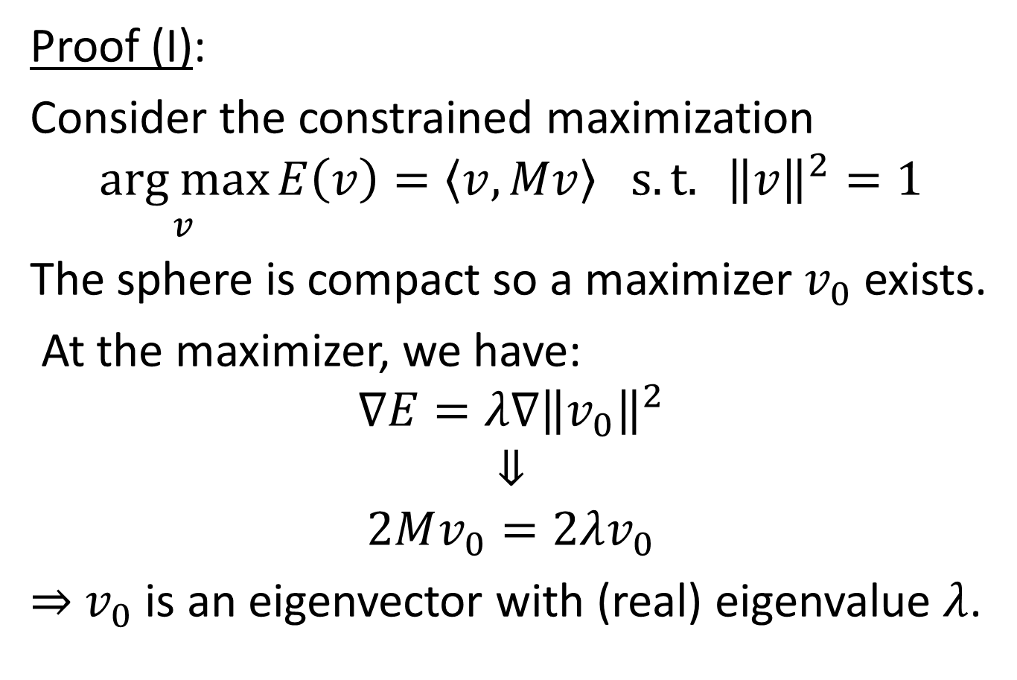
Spectra of Symmetric Operators
  Proof (I):
  Consider the constrained maximization
$$\underset{v}{arg max}{E\left(v\right)=〈v,Mv〉 s.t. {\left\|v\right\|}^{2}=1}$$
  The sphere is compact so a maximizer $v_{0}$ exists.
  At the maximizer, we have:
  $$\text{∇}E=λ\text{∇}{\left\|v_{0}\right\|}^{2}$$
  $$⇓$$
  $$2Mv_{0}=2λv_{0}$$
  $⇒$ $v_{0}$ is an eigenvector with (real) eigenvalue $λ$.

Slide 28
What happens in the
discrete setting?

Slide 29
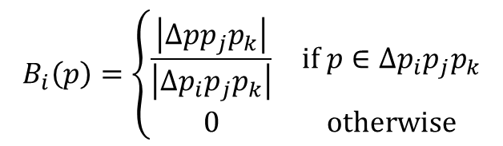





FEM Discretization
To enable computation, we restrict ourselves to a finite-dimensional space of functions, spanned by basis functions ${\left\{B_{i}:S→ℝ\right\}}_{i=1}^{n}$.
Often these are defined
to be the hat functions
centered at vertices.
  Piecewise linear
    $⇒$ Gradients are constant
    within each triangle
  Interpolatory
    $⇒$ $B_{i}\left(p_{j}\right)=δ_{ij}$
$$pi$$
$$pk$$
$$Bi(p)$$
$$pj$$
$$B_{i}\left(p\right)=\left\{\begin{matrix}\frac{\left|Δpp_{j}p_{k}\right|}{\left|Δp_{i}p_{j}p_{k}\right|} & if p∈Δp_{i}p_{j}p_{k} \\ 0 & otherwise\end{matrix}\right.$$

Slide 30
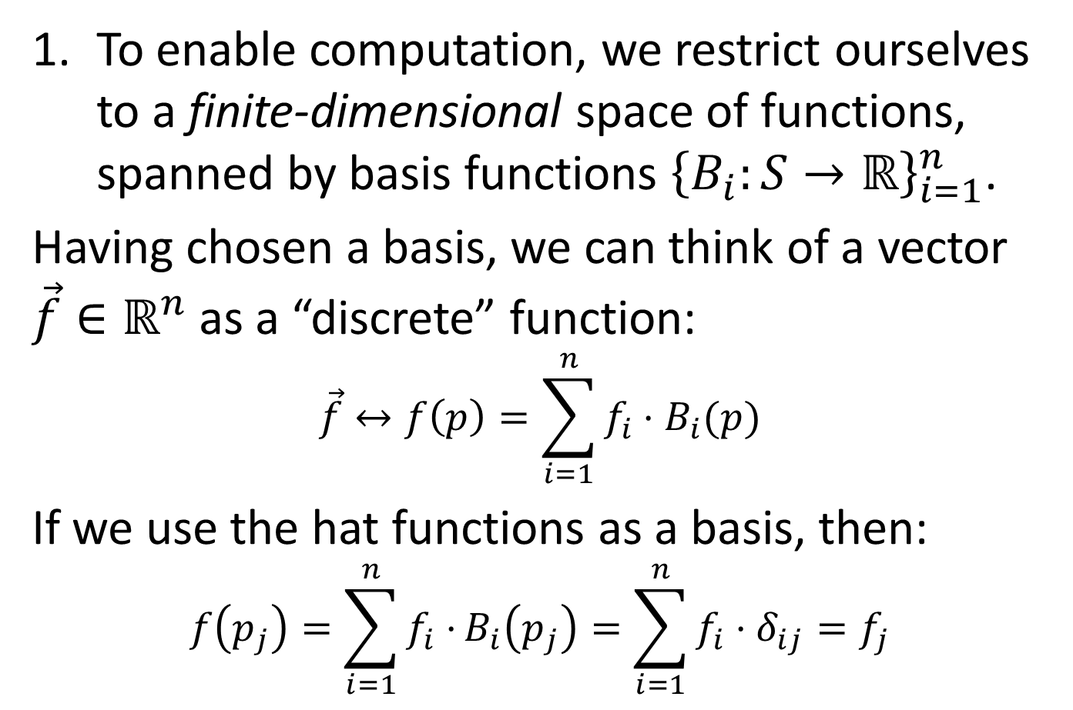
FEM Discretization
To enable computation, we restrict ourselves to a finite-dimensional space of functions, spanned by basis functions ${\left\{B_{i}:S→ℝ\right\}}_{i=1}^{n}$.
Having chosen a basis, we can think of a vector $\vec{f}∈ℝ^{n}$ as a “discrete” function:
$$\vec{f}↔f\left(p\right)=\sum_{i=1}^{n}{f_{i}⋅B_{i}(p)}$$
If we use the hat functions as a basis, then:
$$f\left(p_{j}\right)=\sum_{i=1}^{n}{f_{i}⋅}B_{i}\left(p_{j}\right)=\sum_{i=1}^{n}{f_{i}⋅δ_{ij}}=f_{j}$$

Slide 31
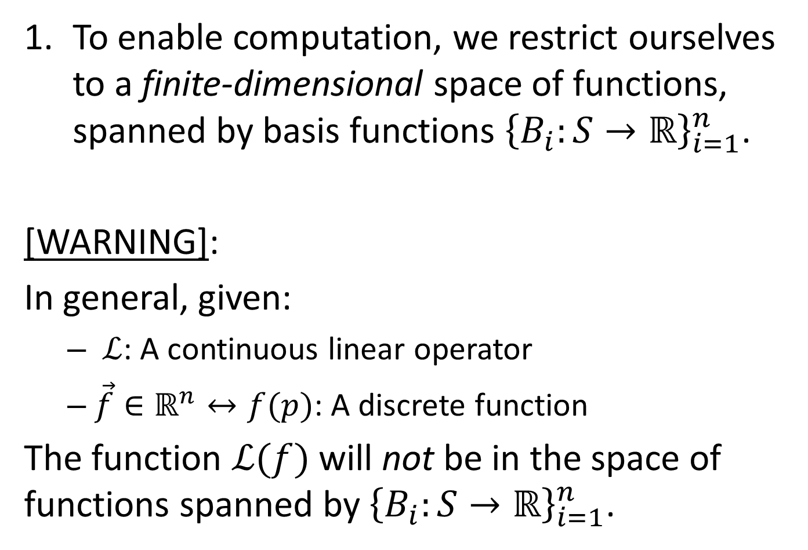
FEM Discretization
To enable computation, we restrict ourselves to a finite-dimensional space of functions, spanned by basis functions ${\left\{B_{i}:S→ℝ\right\}}_{i=1}^{n}$.
[WARNING]:
In general, given:
  $ℒ$: A continuous linear operator
  $\vec{f}∈ℝ^{n}↔f(p)$: A discrete function
The function $ℒ(f)$ will not be in the space of functions spanned by ${\left\{B_{i}:S→ℝ\right\}}_{i=1}^{n}$.

Slide 32
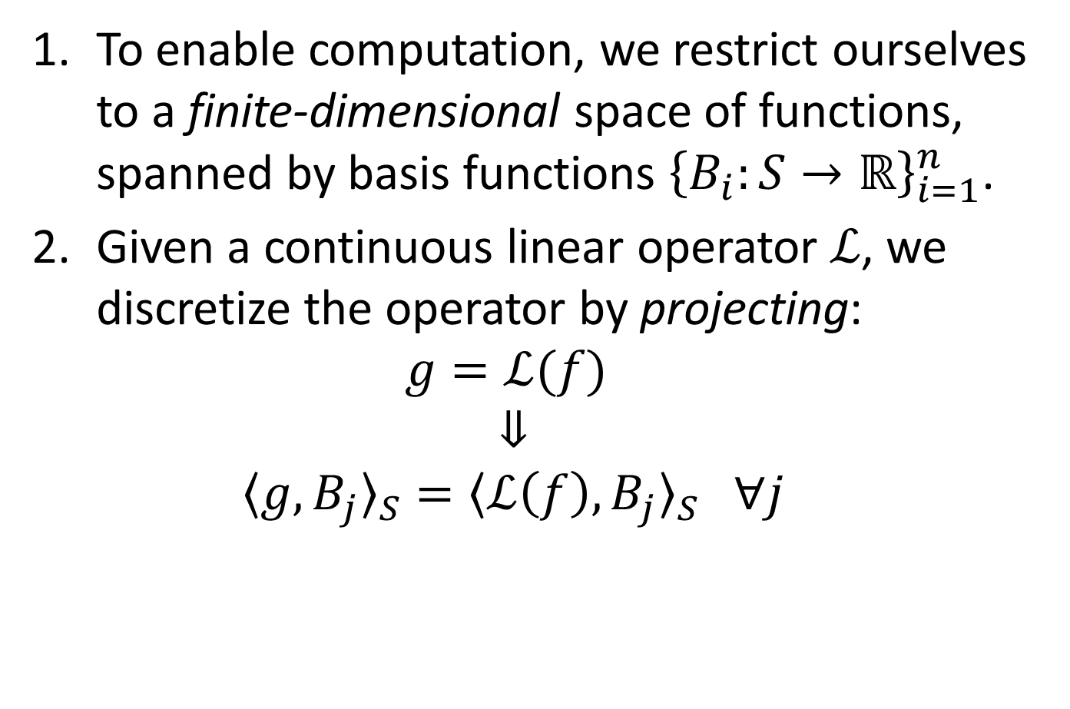
FEM Discretization
To enable computation, we restrict ourselves to a finite-dimensional space of functions, spanned by basis functions ${\left\{B_{i}:S→ℝ\right\}}_{i=1}^{n}$.
Given a continuous linear operator $ℒ$, we discretize the operator by projecting:
$g=ℒ(f)$
  $$⇓$$
  $${〈g,B_{j}〉}_{S}={〈ℒ\left(f\right),B_{j}〉}_{S} ∀j$$

Slide 33
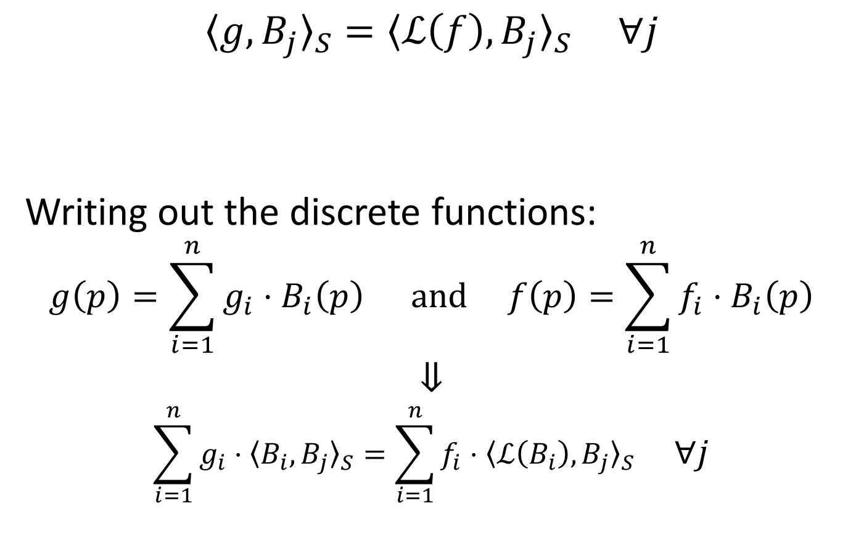
FEM Discretization
$${〈g,B_{j}〉}_{S}={〈ℒ\left(f\right),B_{j}〉}_{S} ∀j$$
Writing out the discrete functions:
$$g\left(p\right)=\sum_{i=1}^{n}{g_{i}⋅B_{i}\left(p\right)} and f\left(p\right)=\sum_{i=1}^{n}{f_{i}⋅B_{i}\left(p\right)}$$
$$⇓$$
$$\sum_{i=1}^{n}{g_{i}⋅{〈B_{i},B_{j}〉}_{S}}=\sum_{i=1}^{n}{f_{i}⋅{〈ℒ\left(B_{i}\right),B_{j}〉}_{S}} ∀j$$

Slide 34
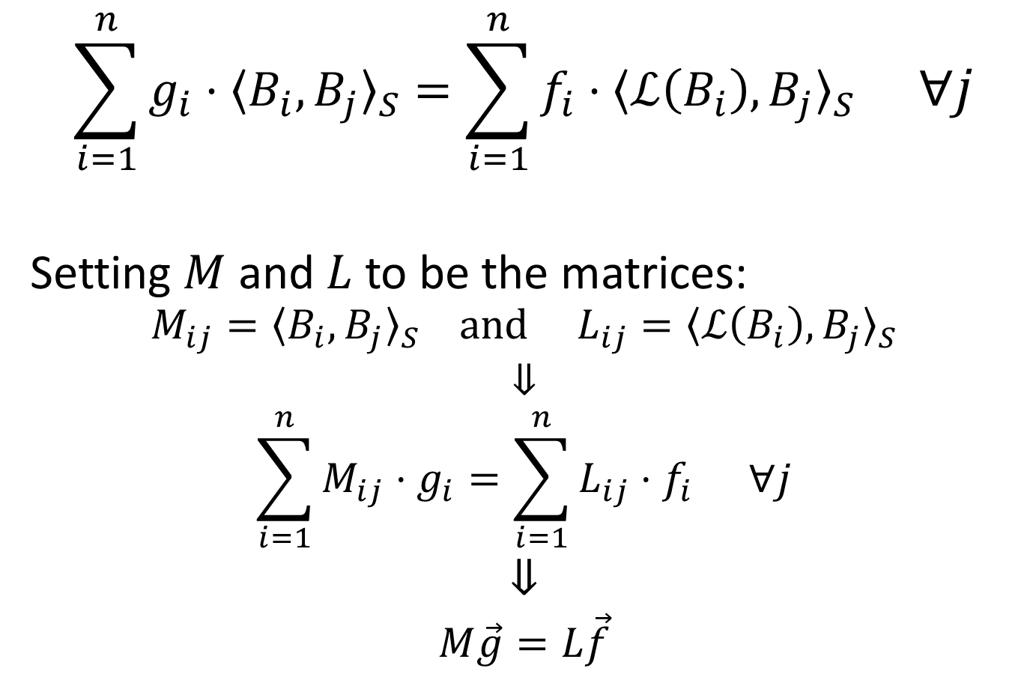
FEM Discretization
$$\sum_{i=1}^{n}{g_{i}⋅{〈B_{i},B_{j}〉}_{S}}=\sum_{i=1}^{n}{f_{i}⋅{〈ℒ\left(B_{i}\right),B_{j}〉}_{S}} ∀j$$
Setting $M$ and $L$ to be the matrices:
$$M_{ij}={〈B_{i}, B_{j}〉}_{S} and L_{ij}={〈ℒ\left(B_{i}\right),B_{j}〉}_{S}$$
$$⇓$$
$$\sum_{i=1}^{n}{M_{ij}⋅g_{i}}=\sum_{i=1}^{n}{L_{ij}⋅f_{i}} ∀j$$
$$⇓$$
$$M\vec{g}=L\vec{f}$$

Slide 35
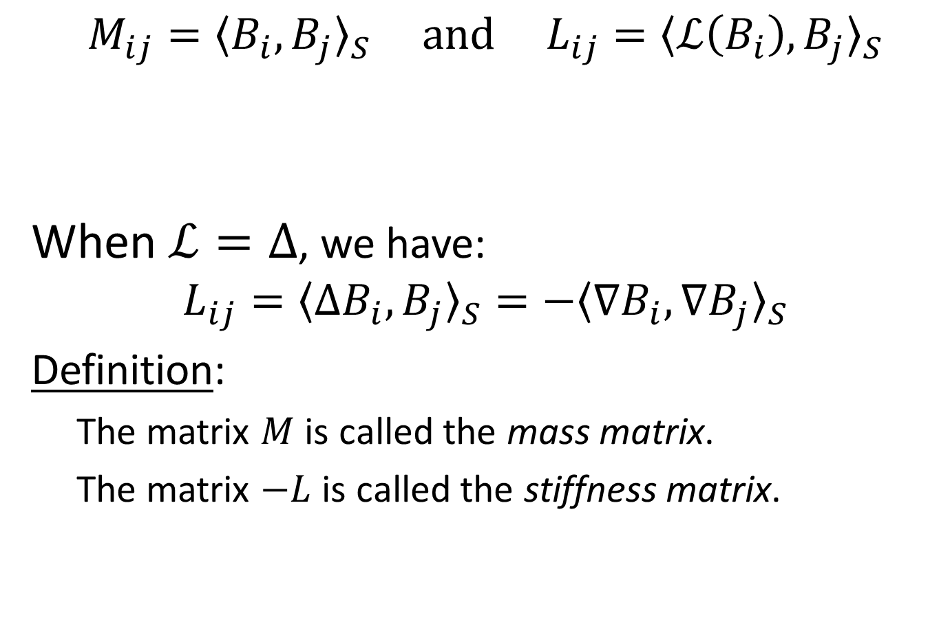
FEM Discretization
$$M_{ij}={〈B_{i}, B_{j}〉}_{S} and L_{ij}={〈ℒ\left(B_{i}\right),B_{j}〉}_{S}$$
When $ℒ=Δ$, we have:
$$L_{ij}={〈ΔB_{i},B_{j}〉}_{S}=−{〈\text{∇}B_{i},\text{∇}B_{j}〉}_{S}$$
Definition:
  The matrix $M$ is called the mass matrix.
  The matrix $−L$ is called the stiffness matrix.
Both the mass and stiffness matrices are symmetric and positive (semi)-definite.

Slide 36








FEM Discretization
$$M_{ij}={〈B_{i}, B_{j}〉}_{S} and L_{ij}=−{〈\text{∇}B_{i},\text{∇}B_{j}〉}_{S}$$
Setting ${\{B}_{i}:→ℝ\}$ to the hat
functions, the matrix $M$ is:
$$pi$$
$$T_{ij}^{1}$$
$$T_{ij}^{2}$$
$$M_{ij}=\left\{\begin{matrix}\frac{\left|T_{ij}^{1}\right|+\left|T_{ij}^{2}\right|}{12} & if j∈N\left(i\right) \\ \sum_{k∈N\left(i\right)}{M_{ik}} & if i=j \end{matrix}\right.$$
$$pk$$
$$Bi(p)$$
$$pj$$

Slide 37




FEM Discretization
$$M_{ij}={〈B_{i}, B_{j}〉}_{S} and L_{ij}=−{〈\text{∇}B_{i},\text{∇}B_{j}〉}_{S}$$
Setting ${\{B}_{i}:→ℝ\}$ to the hat
functions, the matrix $L$ is
the cotangent-Laplacian:
$$α$$
$$pi$$
$$β$$
$$pk$$
$$L_{ij}=\left\{\begin{matrix}\cot{α}+\cot{β} & if j∈N\left(i\right) \\ −\sum_{k∈N\left(i\right)}{L_{ik}} & if i=j \end{matrix}\right.$$
$$Bi(p)$$
$$pj$$

Slide 38

FEM Discretization
$$M_{ij}=\left\{\begin{matrix}\frac{\left|T_{ij}^{1}\right|+\left|T_{ij}^{2}\right|}{12} & if j∈N\left(i\right) \\ \sum_{k∈N\left(i\right)}{M_{ik}} & if i=j \end{matrix}\right. and L_{ij}=\left\{\begin{matrix}\cot{α}+\cot{β} & if j∈N\left(i\right) \\ −\sum_{k∈N\left(i\right)}{L_{ik}} & if i=j \end{matrix}\right.$$
Observations:
  [Sparsity]
  Entry $(i,j)$ can only be non-zero
  if vertex $i$ and vertex $j$ are
  neighbors in the mesh.
$$pi$$
$$pk$$
$$Bi(p)$$
$$pj$$

Slide 39

FEM Discretization
$$M_{ij}=\left\{\begin{matrix}\frac{\left|T_{ij}^{1}\right|+\left|T_{ij}^{2}\right|}{12} & if j∈N\left(i\right) \\ \sum_{k∈N\left(i\right)}{M_{ik}} & if i=j \end{matrix}\right. and L_{ij}=\left\{\begin{matrix}\cot{α}+\cot{β} & if j∈N\left(i\right) \\ −\sum_{k∈N\left(i\right)}{L_{ik}} & if i=j \end{matrix}\right.$$
Observations:
  [Authalicity]
  The mass matrix is invariant to
  area-preserving deformations.
  [Conformality]
  The stiffness matrix is invariant to
  angle-preserving deformations.
$$α$$
$$pi$$
$$T_{ij}^{1}$$
$$T_{ij}^{2}$$
$$β$$
$$pk$$
$$Bi(p)$$
$$pj$$

Slide 40
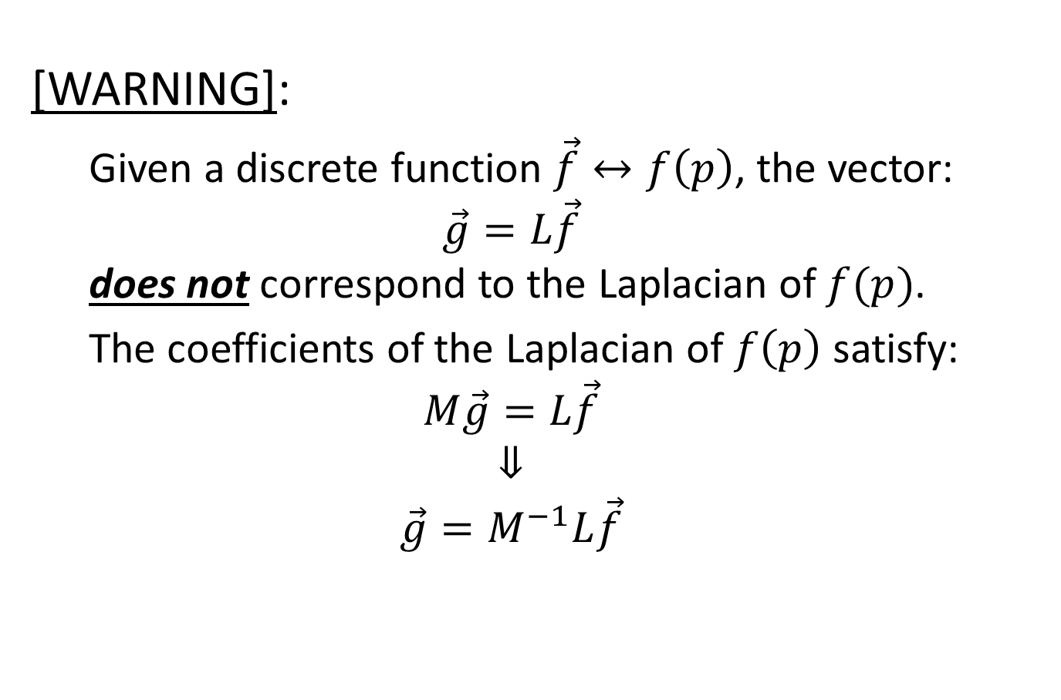
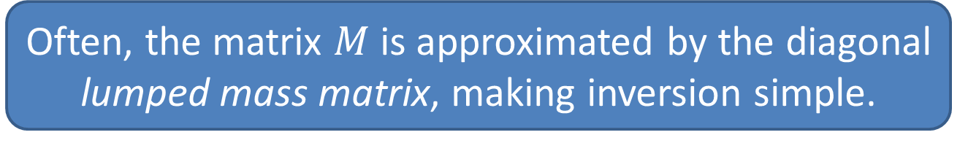
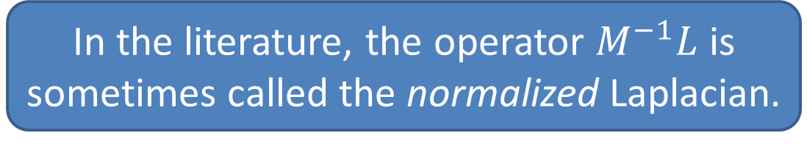
FEM Discretization
[WARNING]:
  Given a discrete function $\vec{f}↔f\left(p\right)$, the vector:
  $$\vec{g}=L\vec{f}$$
  does not correspond to the Laplacian of $f(p)$.
  The coefficients of the Laplacian of $f\left(p\right)$ satisfy:
  $$M\vec{g}=L\vec{f}$$
  $$⇓$$
  $$\vec{g}=M^{−1}L\vec{f}$$
Often, the matrix $M$ is approximated by the diagonal lumped mass matrix, making inversion simple.
In the literature, the operator $M^{−1}L$ is sometimes called the normalized Laplacian.

Slide 41

FEM Discretization
Laplacian Spectrum:
In the continuous setting, the spectrum of the Laplacian, $\left\{\left(φ_{i}:S→ℝ,−λ_{i}∈ℝ^{≥0}\right)\right\}$, satisfies:
$$Δφ_{i}=−λ_{i}⋅φ_{i}$$
And the $\left\{φ_{i}\right\}$ form an orthonormal basis:
$${〈φ_{i},φ_{j}〉}_{s}=\int_{S}{φ_{i}\left(p\right)⋅φ_{j}\left(p\right) dp}=δ_{ij}$$

Slide 42


FEM Discretization
Laplacian Spectrum:
In the discrete setting, the spectrum of the Laplacian, $\left\{\left({\vec{φ}}_{i}∈ℝ^{n},−λ_{i}∈ℝ^{≥0}\right)\right\}$, satisfies:
$$L{\vec{φ}}_{i}=−λ_{i}⋅M{\vec{φ}}_{i}$$
And the $\left\{{\vec{φ}}_{i}\right\}$ form an orthonormal basis:
$${〈{\vec{φ}}_{i},{\vec{φ}}_{j}〉}_{s}={\vec{φ}}_{i}^{T}⋅M⋅{\vec{φ}}_{j}=δ_{ij}$$
Finding the $\left\{\left({\vec{φ}}_{i},λ_{i}\right)\right\}$ is called the
generalized eigenvalue problem.

Slide 43

The Spectrum of the Laplacian
Interpreting the Eigenvalues:
If $φ$ is a (unit-norm) eigenfunction of the Laplacian, with eigenvalue $λ$:
$$Δφ=λ⋅φ$$
$$⇓$$
$${〈Δφ,φ〉}_{S}=λ⋅{〈φ,φ〉}_{S}$$
$$⇓$$
$$−{〈\text{∇}φ,\text{∇}φ〉}_{S}=λ$$
$⇒$ The eigenvalue $λ$ is a measure of how much $φ$ changes, i.e. the frequency of $φ$.

Slide 44
How do we compute the
spectral decomposition?

Slide 45

Getting the Dominant Eigenvector
Assume that a matrix $A$ is diagonalizable, with (unit-norm) spectrum $\left\{\left({\vec{φ}}_{i},λ_{i}\right)\right\}$.
Given $\vec{v}$, we have the harmonic decomposition:
$$\vec{v}=\sum_{i=1}^{n}{\hat{v}[i]⋅{\vec{φ}}_{i}}$$
$$⇒ A\vec{v}=\sum_{i=1}^{n}{\hat{v}[i]⋅λ_{i}⋅{\vec{φ}}_{i}}$$
$$⇒ A^{k}\vec{v}=\sum_{i=1}^{n}{\hat{v}[i]⋅λ_{i}^{k}⋅{\vec{φ}}_{i}}$$

Slide 46

Getting the Dominant Eigenvector
$$A^{k}\vec{v}=\sum_{i=1}^{n}{\hat{v}[i]⋅λ_{i}^{k}⋅{\vec{φ}}_{i}}$$
Without loss of too much generality, assume $λ_{n}$ is the largest eigenvalue, $\left|{λ_{i}}/{λ_{n}}\right|<1$ for $i≠n$.
$$A^{k}\vec{v}=λ_{n}^{k}⋅\sum_{i=1}^{n}{\hat{v}[i]⋅{\left(\frac{λ_{i}}{λ_{n}}\right)}^{k}⋅{\vec{φ}}_{i}}$$
Then ${\left({λ_{i}}/{λ_{n}}\right)}^{k}→0$ as $k→∞$, for $i≠n$.
$$⇒ \frac{A^{k}\vec{v}}{\left|A^{k}\vec{v}\right|}→{\vec{φ}}_{n} as k→∞$$

Slide 47

Getting the Dominant Eigenvector
  ArnoldiDominant($A∈ℝ^{n}×ℝ^{n}$ )
    $\vec{v}←$ RandomVector( )
    while( … )
    $\vec{v}←A\vec{v}$
    $\vec{v}←\vec{v}/\left|\vec{v}\right|$
    $λ←〈A\vec{v},\vec{v}〉$
    return ( $\vec{v}$ , $λ$ )

Slide 48


Getting the Sub-Dominant Eigenvector
If the matrix $A$ is symmetric, the eigenvectors will be orthogonal:
  ArnoldiSubDominant($A∈ℝ^{n}×ℝ^{n}$ )
    $({\vec{v}}_{0},λ_{0})←$ ArnoldiDominant( $A$ )
    ${\vec{v}}_{1}←$ RandomVector( )
    while( … )
    ${\vec{v}}_{1}←A{\vec{v}}_{1}$
    ${\vec{v}}_{1}←{\vec{v}}_{1}−〈{\vec{v}}_{1},{\vec{v}}_{0}〉⋅{\vec{v}}_{0}$
    ${\vec{v}}_{1}←{\vec{v}}_{1}/\left|{\vec{v}}_{1}\right|$
    $λ_{1}←〈A{\vec{v}}_{1},{\vec{v}}_{1}〉$
    return ( ${\vec{v}}_{1}$ , $λ_{1}$ )
A similar approach can be applied to:
Solving the generalized eigenvalue problem
Finding the eigenvectors with smallest eigenvalues
Finding the eigenvectors with eigenvalues closest to $λ$

Slide 49
Outline
Motivation
Laplacian Spectrum
Applications
  Signal/Geometry Filtering
  Partial Differential Equations
  Complexity and Approximation
Conclusion

Slide 50


Signal/Geometry Filtering
  HarmonicDecomposition( $S⊂ℝ^{3}$ , $\vec{f}∈ℝ^{n}$ )
    $(M,L)←$ MassAndStiffness ( $S$ )
    ${\left\{\left({\vec{φ}}_{i},−λ_{i}\right)\right\}}_{i=1}^{n}←$ GeneralizedEigen( $M$ , $L$ )
    For each $i∈[1,n]$:
    $\hat{f}[i]←{〈\vec{f},{\vec{φ}}_{i}〉}_{S}$
  Process( $F:ℝ→ℝ$ )
    $\vec{g}←0$
    For each $i∈[1,n]$:
    $\hat{g}[i]←\hat{f}[i]⋅F\left(λ_{i}\right)$
    $\vec{g}←\vec{g}+\hat{g}[i]⋅{\vec{φ}}_{i}$
    return $\vec{g}$
$${\vec{f}}^{T}⋅M⋅{\vec{φ}}_{i}$$

Slide 51






Signal Filtering
Given a color at each vertex, we can modulate the frequency coefficients of each channel to smooth/sharpen the colors.
$$F\left(λ\right)=e^{−λ}$$
$$Input$$
$$F\left(λ\right)=\left(2−e^{−λ}\right)$$

Slide 52






Geometry Filtering
Using the position of the vertices as the signal, we can modulate the frequency coefficients of each coordinate to smooth/sharpen the shape.
$$F\left(λ\right)=e^{−λ}$$
$$Input$$
$$F\left(λ\right)=\left(2−e^{−λ}\right)$$

Slide 53

Partial Differential Equations
Recall:
The Laplacian of a function at a point $p∈S$ is the difference between the value at $p$ and the average value of its neighbors.

Slide 54

Heat Diffusion
Newton’s Law of Cooling:
The rate of heat loss of a body is proportional to the difference in temperatures between the body and its surroundings.
Translating this into the PDE, if $H\left(p,t\right)$ is the heat at position $p∈S$ at time $t$, then:
$$\frac{∂H}{∂t}=η⋅ΔH$$

Slide 55

Heat Diffusion
Newton’s Law of Cooling:
The rate of heat loss of a body is proportional to the difference in temperatures between the body and its surroundings.
Goal:
Given an initial heat distribution $h:S→ℝ$, find the solution to the PDE:
$$\frac{∂H}{∂t}=η⋅ΔH$$
such that:
$$H\left(p,0\right)=h(p)$$

Slide 56


Heat Diffusion
$$\frac{∂H}{∂t}=η⋅ΔH$$
Note:
Let ${\left\{\left(φ_{i},−λ_{i}\right)\right\}}_{i=1}^{n}$ be the Laplacian spectrum.
$⇒$ The functions:
$$H_{i}\left(p,t\right)=e^{−η⋅λ_{i}⋅t}⋅φ_{i}\left(p\right)$$
are solutions to the PDE.
$⇒$ Any linear sum of the $H_{i}(p,t)$ is a solution.

Slide 57

Heat Diffusion
$$\frac{∂H}{∂t}=η⋅ΔH$$
Compute the harmonic decomposition of $h$:
$$h\left(p\right)=\sum_{i=1}^{n}{\hat{h}\left[i\right]⋅φ_{i}(p)}$$
Then consider the function:
$$H\left(p,t\right)=\sum_{i=0}^{n}{\hat{h}\left[i\right]⋅}H_{i}\left(p,t\right)=\sum_{i=0}^{n}{\hat{h}\left[i\right]⋅}e^{−η⋅λ_{i}⋅t}⋅φ_{i}\left(p\right)$$
  It is a solution to the heat equation.
  It satisfies $H\left(p,0\right)=h\left(p\right).$

Slide 58


Heat Diffusion (Colors)
  HarmonicDecomposition( $S⊂ℝ^{3}$ , $h:S→ℝ$ )
    …
  Process( $t∈[0,∞)$ )
    $\vec{g}←0$
    For each $i∈[1,n]$:
    $\hat{g}\left[i\right]←\hat{h}\left[i\right]⋅e^{−η⋅λ_{i}⋅t}$
    $\vec{g}←\vec{g}+\hat{g}[i]⋅{\vec{φ}}_{i}$
    return $\vec{g}$

Slide 59

Heat Diffusion (Geometry)
  HarmonicDecomposition( $S⊂ℝ^{3}$ , $h:S→ℝ$ )
    …
  Process( $t∈[0,∞)$ )
    $\vec{g}←0$
    For each $i∈[1,n]$:
    $\hat{g}\left[i\right]←\hat{h}\left[i\right]⋅e^{−η⋅λ_{i}⋅t}$
    $\vec{g}←\vec{g}+\hat{g}[i]⋅{\vec{φ}}_{i}$
    return $\vec{g}$

Slide 60


Heat Diffusion (Geometry)
[WARNING]:
  As the geometry diffuses, the areas and angles of the triangles change.
  $⇒$ The mass and stiffness matrices change.
  $⇒$ The harmonic decomposition changes.
  If we take this into account, we get a non-linear PDE called mean curvature flow.
  Mean curvature flow can create singularities.

Slide 61

Wave Equation
The acceleration of a wave’s height is proportional to the difference in height of the surrounding.
Translating this into the PDE, if $H\left(p,t\right)$ is the height at position $p∈S$ at time $t$, then:
$$\frac{∂^{2}H}{∂t^{2}}=η⋅ΔH$$

Slide 62

Wave Equation
The acceleration of a wave’s height is proportional to the difference in height of the surrounding.
Goal:
Given an initial height distribution $h:S→ℝ$, find the solution to the PDE:
$$\frac{∂^{2}H}{∂t^{2}}=η⋅ΔH$$
such that:
$$H\left(p,0\right)=h\left(p\right) and \frac{∂H}{∂t}\left(p,0\right)=0$$

Slide 63


Wave Equation
$$\frac{∂^{2}H}{∂t^{2}}=η⋅ΔH$$
Note:
If ${\left\{\left(φ_{i},−λ_{i}\right)\right\}}_{i=1}^{n}$ are the eigenfunctions/values of the Laplacian, then:
$$H_{i}^{c}\left(p,t\right)=\cos\left(\sqrt{{η⋅λ}_{i}}⋅t\right)⋅φ_{i}\left(p\right)$$
$$H_{i}^{s}\left(p,t\right)=\sin\left(\sqrt{{η⋅λ}_{i}}⋅t\right)⋅φ_{i}\left(p\right)$$
are solutions to the PDE.
$⇒$ Any linear sum of the $H_{i}^{c}(p,t)$ and $H_{i}^{s}(p,t)$ is a solution to the PDE.

Slide 64

Wave Equation
$$\frac{∂^{2}H}{∂t^{2}}=η⋅ΔH$$
Compute the harmonic decomposition of $h$:
$$h\left(p\right)=\sum_{i=1}^{n}{\hat{h}\left[i\right]⋅φ_{i}(p)}$$
Then consider the function:
$$H\left(p,t\right)=\sum_{i=0}^{n}{\hat{h}\left[i\right]⋅}H_{i}^{c}\left(p,t\right)=\sum_{i=0}^{n}{\hat{h}\left[i\right]⋅}\cos\left(\sqrt{{η⋅λ}_{i}}⋅t\right)⋅φ_{i}\left(p\right)$$
  It is a solution to the wave equation.
  It satisfies $H\left(p,0\right)=h\left(p\right).$
  It satisfies $\frac{∂H}{∂t}\left(p,0\right)=0$.

Slide 65


Wave Equation
  HarmonicDecomposition( $S⊂ℝ^{3}$ , $h:S→ℝ$ )
    …
  Process( $t∈[0,∞)$ )
    $\vec{g}←0$
    For each $i∈[1,n]$:
    $\hat{g}\left[i\right]←\hat{h}\left[i\right]⋅\cos\left(\sqrt{{η⋅λ}_{i}}⋅t\right)$
    $\vec{g}←\vec{g}+\hat{g}[i]⋅{\vec{φ}}_{i}$
    return $\vec{g}$

Slide 66
How practical is it to use the spectral decomposition?

Slide 67

Complexity
Challenge:
  If we have a mesh with $n$ vertices we get $n$ generalized eigenvectors.
  $O(n^{2})$ storage / $O(>n^{2})$ computation.
Approximate:
  Sometimes a low-frequency solution will do.
  $O(k⋅n)$ storage
  Sometimes a numerically inaccurate solution will do.
  $O(n)$ storage / $O(?)$ computation

Slide 68

Approximate Spectral Processing
Preliminaries:
  Let $M$ be the mass matrix, $−L$ the stiffness matrix, and $\left\{\left({\vec{φ}}_{i},−λ_{i}\right)\right\}$ the spectrum, we have:
  $$M{\vec{φ}}_{i}=M{\vec{φ}}_{i} −Lφ_{i}=λ_{i}⋅Mφ_{i}$$
  Taking $α$ times the 1st equation plus $β$ times the 2nd:
  $$\left(α⋅M−β⋅L\right){\vec{φ}}_{i}=\left(α+β⋅λ_{i}\right)⋅M{\vec{φ}}_{i}$$
  Multiplying by ${\left(α⋅M−β⋅L\right)}^{−1}$:
  $${\vec{φ}}_{i}=\left(α+β⋅λ_{i}\right)⋅\left({\left(α⋅M−β⋅L\right)}^{−1}∘M\right){\vec{φ}}_{i}$$
  $$\frac{1}{\left(α+β⋅λ_{i}\right)}⋅{\vec{φ}}_{i}=\left({\left(α⋅M−β⋅L\right)}^{−1}∘M\right){\vec{φ}}_{i}$$

Slide 69

Approximate Spectral Processing
Preliminaries:
  $$\left(γ+δ⋅λ_{i}\right)⋅M{\vec{φ}}_{i}=\left(γ⋅M−δ⋅L\right){\vec{φ}}_{i}$$
  $$\frac{1}{\left(α+β⋅λ_{i}\right)}⋅{\vec{φ}}_{i}=\left({\left(α⋅M−β⋅L\right)}^{−1}∘M\right){\vec{φ}}_{i}$$
Combining these, we get:
  $$\left({\left(α⋅M−β⋅L\right)}^{−1}∘(γ⋅M−δ⋅L)\right){\vec{φ}}_{i}=$$
  $$=\left(γ+δ⋅λ_{i}\right)⋅\left({\left(α⋅M−β⋅L\right)}^{−1}∘M\right){\vec{φ}}_{i}$$
  $$=\frac{γ+δ⋅λ_{i}}{α+β⋅λ_{i}}⋅{\vec{φ}}_{i}$$

Slide 70

Approximate Spectral Processing
Example (Signal Smoothing):
  The goal is to obtain a smoothed signal:
  $$\hat{f}\left[i\right]←\hat{f}\left[i\right]⋅F\left(λ_{i}\right)$$
  We can relax the condition that $F\left(λ\right)=e^{−λ}$ and use a different filter $F:ℝ→ℝ$.
  The new filter should:
  preserve the low frequencies
  decay at higher frequencies

Slide 71



Approximate Spectral Processing
$$\left({\left(α⋅M−β⋅L\right)}^{−1}∘(γ⋅M−δ⋅L)\right){\vec{φ}}_{i}=\left(\frac{γ+δ⋅λ_{i}}{α+β⋅λ_{i}}\right)⋅{\vec{φ}}_{i}$$
Example (Signal Smoothing):
  Consider the solution to the linear system:
  $$\vec{g}=\left({\left(M−β⋅L\right)}^{−1}∘M\right)\vec{f}$$
  Taking the spectral decomposition of $\vec{f}$:
  $$\vec{g}=\sum{\hat{f}\left[i\right]⋅\left({\left(M−β⋅L\right)}^{−1}∘M\right){\vec{φ}}_{i}}$$
  $$=\sum{\hat{f}\left[i\right]⋅\frac{1}{1+β⋅λ_{i}}⋅{\vec{φ}}_{i}}$$
Solving this linear system is equivalent to filtering with:
$$F\left(λ\right)=\frac{1}{1+β⋅λ}$$
with $β$ the rate of decay of higher frequencies.

Slide 72

Approximate Spectral Processing
$$\left({\left(α⋅M−β⋅L\right)}^{−1}∘(γ⋅M−δ⋅L)\right){\vec{φ}}_{i}=\left(\frac{γ+δ⋅λ_{i}}{α+β⋅λ_{i}}\right)⋅{\vec{φ}}_{i}$$
Example (Signal Sharpening):
  Consider the solution to the linear system:
  $$\vec{g}=\left({\left(M−β⋅L\right)}^{−1}∘(M−β⋅σ⋅L)\right)\vec{f}$$
  Taking the spectral decomposition of $\vec{f}$:
  $$\vec{g}=\sum{\hat{f}\left[i\right]⋅\frac{1+σ⋅β⋅λ_{i}}{1+β⋅λ_{i}}⋅{\vec{φ}}_{i}}$$

Slide 73

Approximate Spectral Processing
$$\left({\left(α⋅M−β⋅L\right)}^{−1}∘(γ⋅M−δ⋅L)\right){\vec{φ}}_{i}=\left(\frac{γ+δ⋅λ_{i}}{α+β⋅λ_{i}}\right)⋅{\vec{φ}}_{i}$$
Example (Signal Sharpening):
  Consider the solution to the linear system:
  $$\vec{g}=\left({\left(M−β⋅L\right)}^{−1}∘(M−β⋅σ⋅L)\right)\vec{f}$$
  $$⇒ F\left(λ\right)=\frac{1+σ⋅β⋅λ}{1+β⋅λ}$$
  This filter satisfies:
  $\lim_{λ→0}{F\left(λ\right)}=1$: Low-frequencies preserved
  $\lim_{λ→∞}{F\left(λ\right)=σ}$: High frequencies scaled by $σ$.
Signal smoothing is a special instance, with $σ=0$.

Slide 74

Approximate Spectral Processing
  Process( $S⊂ℝ^{3}$ , $\vec{f}∈ℝ^{n}$ , $σ∈ℝ$ , $β∈ℝ$ )
    $(M,L)←$ MassAndStiffness ( $S$ )
    $\vec{g}←\left(M−β⋅σ⋅L\right)\vec{f}$
    $A←\left(M−β⋅L\right)$
    return Solve( $A$ , $\vec{g}$ )
By approximating, we replace the computational complexity of storing/computing the spectral decomposition with the complexity of solving a sparse linear system.

Slide 75



Heat Diffusion (Revisited)
$$\frac{∂H}{∂t}=ΔH s.t. H\left(p,0\right)=h(p)$$
Discretization (Temporal):
Letting $H_{t}:S→ℝ$ be the solution at time $t$, we can (temporally) discretize the PDE in two ways:
Explicit
$$\frac{H_{t+δ}−H_{t}}{δ}≈ΔH_{t}$$
$$⇓$$
$$H_{t+δ}=H_{t}+δ⋅ΔH_{t}$$
Implicit
$$\frac{H_{t+δ}−H_{t}}{δ}≈ΔH_{t+δ}$$
$$⇓$$
$$\left(1−δ⋅Δ\right)H_{t+δ}=H_{t}$$

Slide 76






Heat Diffusion (Revisited)
Explicit
$$H_{t+δ}=H_{t}+δ⋅ΔH_{t}$$
Implicit
$$\left(1−δ⋅Δ\right)H_{t+δ}=H_{t}$$
Discretization (Spatial):
Projecting onto the discrete function basis gives:
$$⇓$$
$$M{\vec{H}}_{t+δ}=M{\vec{H}}_{t}+δ⋅L{\vec{H}}_{t}$$
$$⇓$$
$$\left(M−δ⋅L\right){\vec{H}}_{t+δ}=M{\vec{H}}_{t}$$
$$⇓$$
$${\vec{H}}_{t+δ}=\left(M^{−1}∘\left(M+δ⋅L\right)\right){\vec{H}}_{t}$$
$$⇓$$
$${\vec{H}}_{t+δ}=\left({\left(M−δ⋅L\right)}^{−1}∘M\right){\vec{H}}_{t}$$

Slide 77






Heat Diffusion (Revisited)
Explicit
$${\vec{H}}_{t+δ}=\left(M^{−1}∘\left(M+δ⋅L\right)\right){\vec{H}}_{t}$$
Implicit
$${\vec{H}}_{t+δ}=\left({\left(M−δ⋅L\right)}^{−1}∘M\right){\vec{H}}_{t}$$
Discretization:
Both methods give an inaccurate answer when a large time-step, $δ$, is used.
But…
$$⇓$$
$${\hat{H}}_{t+δ}\left[i\right]=\left(1−δ⋅λ_{i}\right)⋅{\hat{H}}_{t}\left[i\right]$$
$$⇓$$
$${\hat{H}}_{t+δ}\left[i\right]=\frac{1}{1+δ⋅λ_{i}}⋅{\hat{H}}_{t}\left[i\right]$$
  $$\vec{g}=\left({\left(α⋅M−β⋅L\right)}^{−1}∘(γ⋅M−δ⋅L)\right)\vec{f}$$
  $$⇒ F\left(λ\right)=\frac{γ+δ⋅λ_{i}}{α+β⋅λ_{i}}$$

Slide 78




Heat Diffusion (Revisited)
Explicit
$${\vec{H}}_{t+δ}=\left(M^{−1}∘\left(M+δ⋅L\right)\right){\vec{H}}_{t}$$
Implicit
$${\vec{H}}_{t+δ}=\left({\left(M−δ⋅L\right)}^{−1}∘M\right){\vec{H}}_{t}$$
Discretization:
Both filters preserve low frequencies:
But at high frequencies (and large time-steps):
Though neither approximation gives an accurate answer at large times-steps, implicit integration is guaranteed to be (unconditionally) stable.
$$⇓$$
$${\hat{H}}_{t+δ}\left[i\right]=\left(1−δ⋅λ_{i}\right)⋅{\hat{H}}_{t}\left[i\right]$$
$$⇓$$
$${\hat{H}}_{t+δ}\left[i\right]=\frac{1}{1+δ⋅λ_{i}}⋅{\hat{H}}_{t}\left[i\right]$$
A similar approach can be used to approximate the solution to the wave equation without a harmonic decomposition.
$$\lim_{λ→0}\left(\frac{1}{1+δ⋅λ_{i}}\right)=1$$
$$\lim_{λ→0}\left(1−δ⋅λ_{i}\right)=1$$
$$\lim_{λ→0}\left(\frac{1}{1+δ⋅λ_{i}}\right)=0$$
$$\lim_{λ→∞}\left(1−δ⋅λ_{i}\right)=−∞$$

Slide 79
Outline
Motivation
Laplacian Spectrum
Applications
Conclusion

Slide 80
Conclusion
Though there is no Fourier Transform for general surfaces, we can use the spectrum of the Laplacian to get a frequency decomposition.
This enables:
  Filtering of signals
  Solving PDEs
by modulating the frequency coefficients.

Slide 81
Conclusion
Though computing a full spectral decomposition is not space/time efficient, we can often:
  Use the lower frequencies.
  Design linear operators whose solution has the desired frequency modulation.
Using the theory of spectral decomposition:
  We can design stable simulations, without explicitly computing the decomposition.

Slide 82

Future
We have seen that the mass and stiffness matrices are invariant to (respectively) authalic and conformal deformations.
  $→$ Eigenvalues as isometry-invariant signatures
  [Reuter, 2006] Laplace-Beltrami Spectra as `Shape-DNA’…
  $→$ Isometric embedding for intrinsic symmetry detection
  [Ovsjanikov et al., 2008] Global Intrinsic Symmetries of Shapes
  $→$ Heat diffusion for computing isometry-invariant distances.
  [Sun et al., 2009] A Concise and Provably Informative Multi-Scale…
  $→$ Authalicity/Conformality constraints for correspondence
  [Rustamov et al., 2013] Map-Based Exploration of Intrinsic Shape…
  $→$ And much, much, much more…

Slide 83
Thank You!

